Slide 1


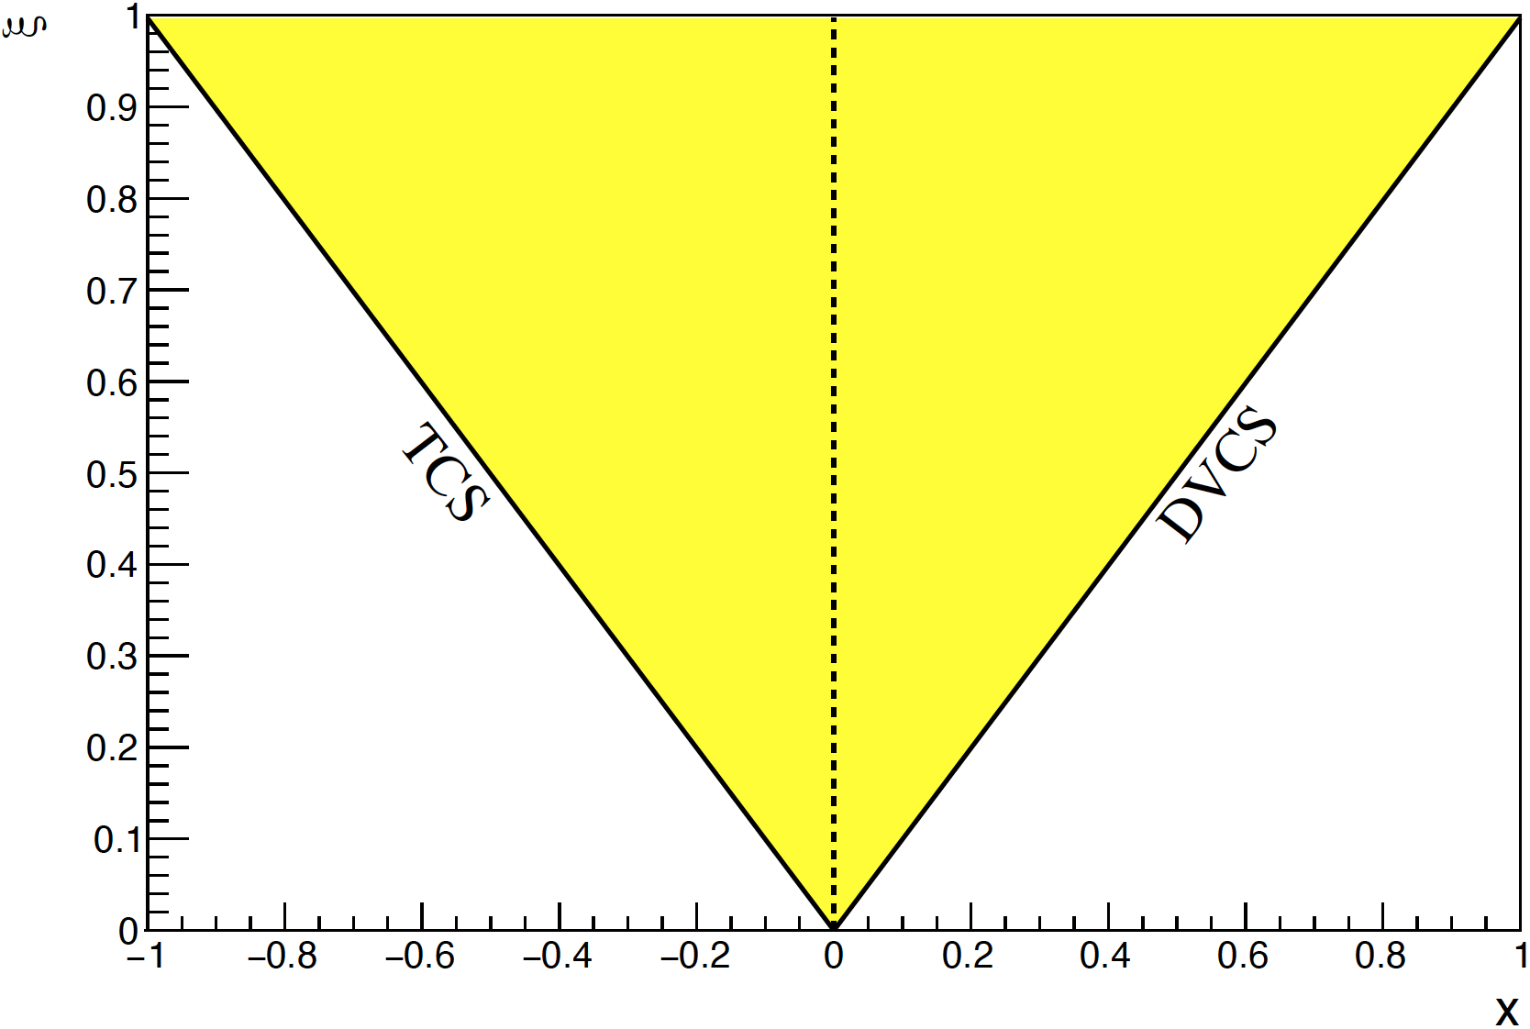
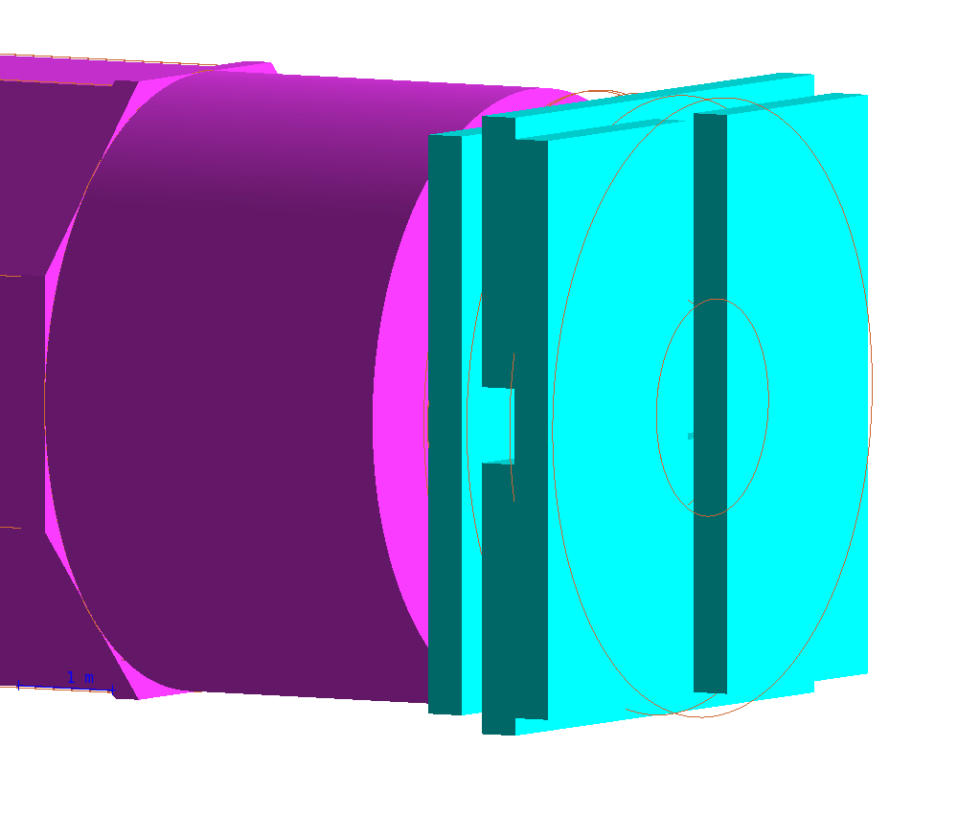
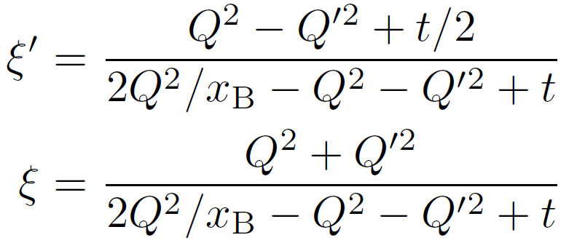
Double Deeply Virtual Compton Scattering with SoLID at JLab 12GeV
DDVCS
DDVCS explores wide off-axis kinematic region of GPDs, beyond DVCS and TCS. The exclusive reaction has small crosssection and thus needs high luminosity and large acceptance.
The SoLID apparatus completed with muon detectors at forward and large angles and barrel, enables DDVCS measurements with both polarized electron and positron beams at 11GeV.
Lumi = 1e37/cm²/s
polar angle 8-28-70 deg
full azimuthal
Iron plate for
forward angle muon detector
S. Zhao et al. EPJ A 57 (2021) 240
JLab LOI12-15-005 (M. Boer,A. Camsonne,K. Gnanvo, E. Voutier, Z.W. Zhao et al.)

Slide 2
DDVCS with 11GeV circular polarized beam and LH2 target
coverage
projection
50 days of electron BSA
plus 50 days of positron BCA
EPJA 57, 240 (2021)

