Slide 1
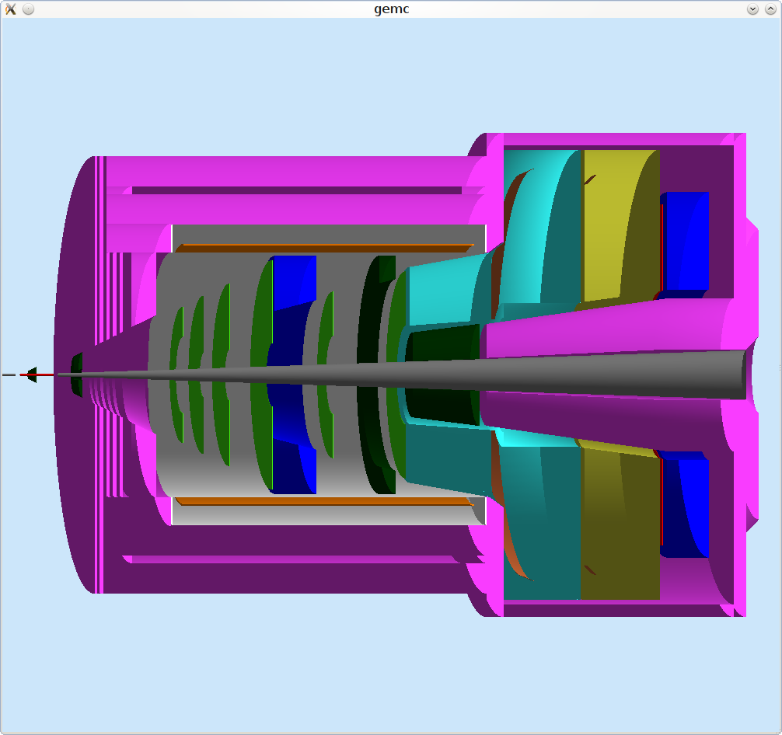
SoLID CLEO SIDIS
EM Calorimeter
(forward angle)
EM Calorimeter
(large angle)
GEM
MRPC
Target
Collimator
Collimator
Coil and Yoke
Light Gas
Cherenkov
Heavy Gas
Cherenkov

