Slide 1
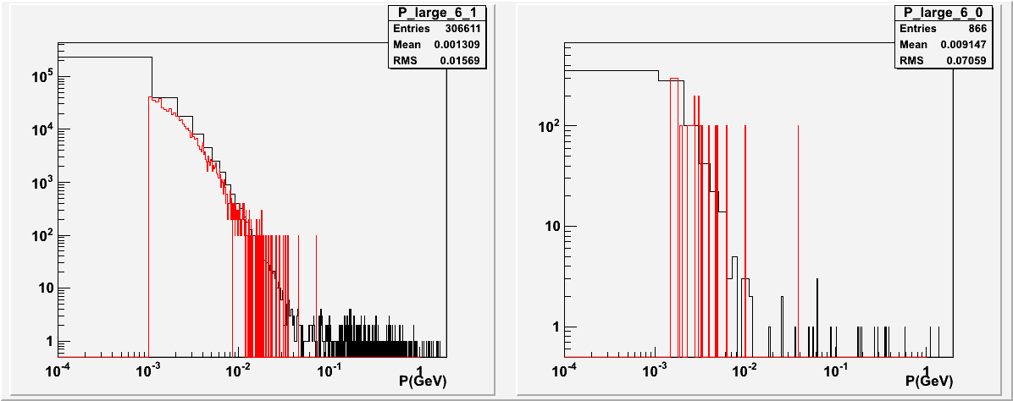
PVDIS EM Background (on EC, no baffle) red Geant3, black Geant4
Both
photon
electron
VS
Energy Flux VS R
photon
electron
For Energy Flux, Geant4 shows ~30% larger than Geant3
Momentum Distribution

Slide 2
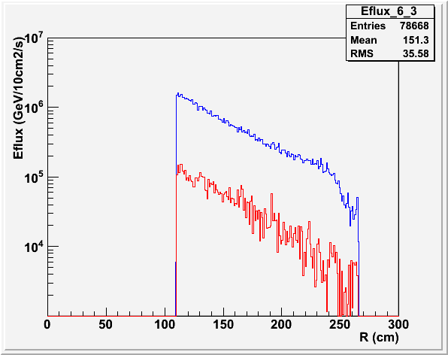
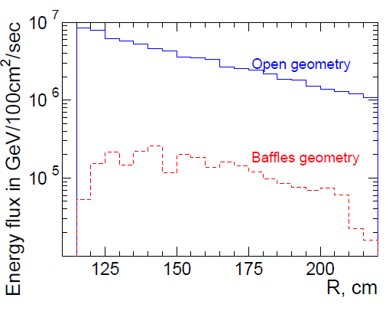
PVDIS EM Background (on EC) red with Baffle, black without Baffle
Baffle has factor 50 reduction for Geant3, but only factor 12 reduction for Gean4. Still looking into this.
Geant4
Geant3

Slide 3
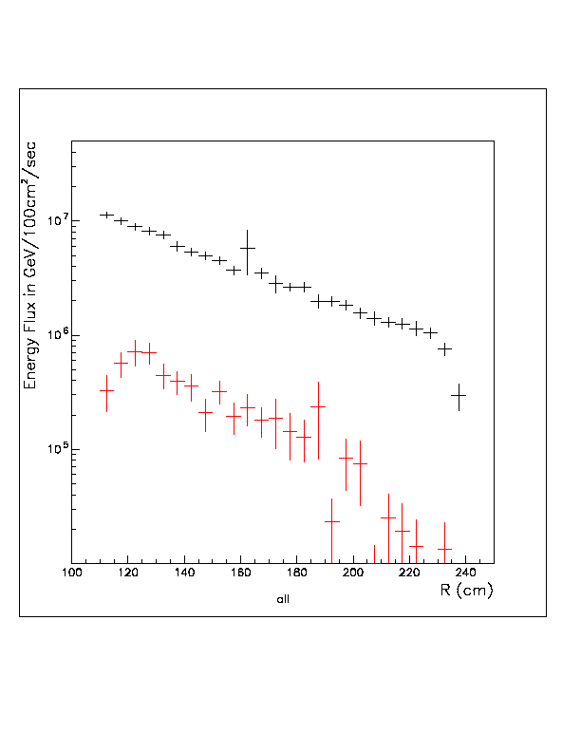
PVDIS EM Background (on EC) red with Baffle, black without Baffle
My Geant3 has also about factor 10 reduction. Still looking into this.
My Geant3
Geant3

