Slide 1
PVDIS trigger rate
Yuxiang Zhao

Slide 2
Singles rate update on EC
singles | Rate (MHz) Jin’s curve, wiser generator, extrapolation below 1 GeV | Rate (MHz) Rakitha’s curve, Hall D generator, cut off at 1 GeV
Electron | 0.282 | 0.241
Pim (Hall D) | 5.05 | 4.4
Pip (Hall D) | 1.0 | 0.43
Pi0(Hall D) | 0.031 | 0.015
Total | 6.36=(212 KHz/sector) | 5.09=(170 KHz/sector)
The real calculation will use Rakitha’s curve and Hall D generator
the other numbers are just for reference

Slide 3
Singles rate update using Hall D generator
Singles rate on lgc
Threshold: PMT=2, PE on each pmt=2
singles | Rate (MHz)
Electron | 0.4465
Pim (Hall D) | 0.823
Pip (Hall D) | 0.436
Pi0(Hall D) | 21.76
EM background only (beam on target with hadron process blocked) | 0.6 (18 out of 1066 windows can produce a lgc trigger)
Total | 24.1 MHZ (803KHz/sector)
Beam on target with all processes open: 42MHz
Different by 17.9 MHz
From difference of pi0 rate between G4 and Hall D generator

Slide 4
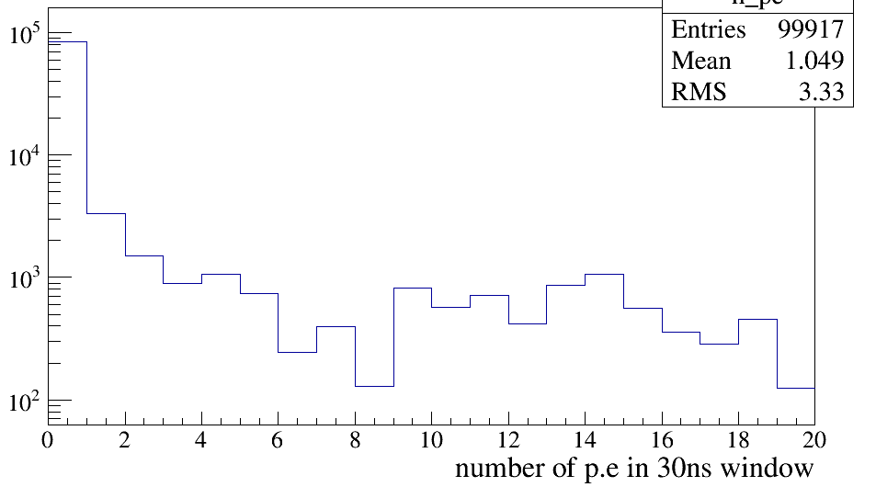
Number of p.e produced by EM on lgc within 30ns
On whole LGC, not per sector
EM is not an issue on lgc, only the pile up effects

Slide 5
Rate with EC&lgc both fired for singles event
Numbers with Rakitha’s curve and Hall D generator:
PID | Only EC fired | Rate with EC and lgc both fired for the same e or pion event | Efficiency of LGC
Electron | 0.24 MHz | 0.23 MHz | 95.7%
Pim | 4.43 MHz | 0.64 KHz | 0.01%
Pip | 0.43 MHz | 0 (limit: 0.04kHz) | 0.01%
Pi0 | 0.015 MHz | 8.5 KHz | 57%
Both EC and LGC have backgrounds taken into account

Slide 6
Coincidence Rate estimation ---Rakitha’s curve and Hall D generator
PID | Only EC fired | Rate with EC and lgc both fired for the same e or pion event | Efficiency of LGC
Electron | 0.24 MHz | 0.23 MHz | 95.7%
Pim | 4.43 MHz | 0.64 KHz | 0.01%
Pip | 0.43 MHz | 0 (limit: 0.04kHz) | 0.01%
Pi0 | 0.015 MHz | 8.5 KHz | 55%
electron with EC&LGC = 230 KHz = 7.7 KHz/sector
pion with EC&LGC = (0.64 + 0.04 + 8.5) KHz = 9 KHz = 0.3 KHz/sector
Random coincidence per sector = 170 KHz * 803 KHz * 30ns = 4.1 KHz/sector
Total: (7.7+0.3+4.1) KHz = 12.1 KHz/sector

Slide 7
Concern of particle correlations
High singles rate: pim on EC, pi0 on LGC
How large is the correlation between pim and pi0 ???
Hall D generator can have all possible pions in one event
Looking at EC&LGC coincidence will give us hints on the correlations between pions
0.3% of “all-pion” events will fire EC and LGC at the same time
Seems that correlation of pions on EC and LGC is small
Will do more study on it …

Slide 8
Summary of PVDIS trigger rate
Rakitha’s EC curve and Hall D generator
Total: (7.7+0.3+4.1) KHz = 12.1 KHz/sector

Slide 9
Backups

Slide 10
Singles rate update on EC
singles | Rate (MHz) Jin’s curve, wiser generator | Rate (MHz) Jin’s curve, Hall D generator, extrapolation below 1 GeV | Rate (MHz) Rakitha’s curve, Hall D generator, cut off at 1 GeV
Electron | 0.282 | 0.282 | 0.241
Pim (Hall D) | 5.05 | 3.1 | 4.4
Pip (Hall D) | 1.0 | 0.455 | 0.43
Pi0(Hall D) | 0.031 | 0.021 | 0.015
Total | 6.36=(212 KHz/sector) | 3.8 (=127kHz/sector) | 5.09=(170 KHz/sector)
The real calculation will use Rakitha’s curve and Hall D generator
the other numbers are just for reference

Slide 11
Rate with EC&lgc both fired for singles event
Numbers with Jin’s curve and Hall D generator:
PID | Only EC fired | Rate with EC and lgc both fired for the same e or pion event | Efficiency of LGC
Electron | 0.282 MHz | 0.27 MHz | 95.7%
Pim | 3.065 MHz | 3.8 KHz | 0.12%
Pip | 0.455 MHz | 0 (limit: 0.55kHz) | 0.12%
Pi0 | 0.021 MHz | 8 KHz | 38%
Numbers with Rakitha’s curve and Hall D generator:
Both EC and LGC have backgrounds taken into account
PID | Only EC fired | Rate with EC and lgc both fired for the same e or pion event | Efficiency of LGC
Electron | 0.24 MHz | 0.23 MHz | 95.7%
Pim | 4.43 MHz | 0.64 KHz | 0.01%
Pip | 0.43 MHz | 0 (limit: 0.04kHz) | 0.01%
Pi0 | 0.015 MHz | 8.5 KHz | 57%

Slide 12
Coincidence Rate estimation ---Jin’s EC curve and Hall D generator
PID | Only EC fired | Rate with EC and lgc both fired for the same e or pion event | Efficiency of LGC
Electron | 0.282 MHz | 0.27 MHz | 95.7%
Pim | 3.065 MHz | 3.8 KHz | 0.12%
Pip | 0.455 MHz | 0 (limit: 0.55kHz) | 0.12%
Pi0 | 0.021 MHz | 8 KHz | 38%
electron with EC&LGC = 270 KHz = 9 KHz/sector
pion with EC&LGC = (3.8 + 0.55 + 8) KHz = 12 KHz = 0.4 KHz/sector
Random coincidence per sector = 127 KHz * 803 KHz * 30ns = 3.1 KHz/sector
Total: (9+0.4+3.1) KHz = 12.5 KHz/sector

