Slide 1
SIDIS trigger rate
Yuxiang Zhao

Slide 2
single (gas(hallD),win up(wiser),win down(wiser))
Jin’s EC Wiser trigger
e_FA(kHz) | EC | EC+LGC | EC+LGC+SPD
Electron | 68 (57) | 63(56) | 58(52)+1+2
Pip | 694(643) | 4.2(3.3) | 3.8(3.1)+2.5/2+1.6/2
Pim | 537(492) | 4.0(3.2) | 3.6(3.0) +2.3/2+2.1/2
Pi0 | 1024(120) | 43(31) | 32(30) +1.1/2+5.8/2
P | 202(185) | 0(0) | 0(0) +0/2+0/2
all hadrons, no electron | 2692 | 62 | 47 +?+?
Total: |  |  | 105+4+7=116
hit matching
e_LA(kHz) | EC | EC+SPD
electron | 4.5(4.3) | 4.1(4)+3.6+2.6
Pip | 8.6(8.5) | 7.9(8.1)+8.4/2+5.6/2
Pim | 6.4(6.0) | 5.9(5.7) +6.1/2+3.7/2
Pi0 | 15.3(0.2) | 0.6(0.2) +0.4/2+0.3/2
P | 2.9(3.2) | 2.8(3.0) +7.6/2+4.8/2
all hadrons, no electron | 38 | 18 +?+?
Total: |  | 22 +14+10=46
h_FA(kHz) | EC | EC+SPD
electron | 140(94) | 100(87) +4+4
Pip | 5855(4898) | 5151(4447) +3405/2+4570/2
Pim | 4925(3787) | 3971(3435) +3300/2+4590/2
Pi0 | 4607(811) | 548(468) +33/2+171/2
P | 3510(3103) | 3164(2831) +2243/2+2563/2
all hadrons, no electron | 17392 | 12805 +?+?
Total: |  | 12913 +4500+6000=23413
Random coin (116 + 46 - 10.3 - 7.06 - 6.96)*23413*1e3*30e-9=97KHz

Slide 3
SIDIS
Direct estimation: using SIDIS generator, EC&GEM acceptance histogram and 8deg cut
with or without vertex angle>2.5deg
hit matching
Coin trigger rate (kHz) (EC distance cut for e_FA & h_FA) |  | e_FA | h_FA | e_LA | e_FA & h_FA | e_LA & h_FA | (e_FA & h_FA) + (e_LA & h_FA) | Direct estimation
e+pip | >= 0cm | 36(32) | 127(74) | 4.5(3.5) | 36(6.3) | 1.2(0.71) | 37.2(7.0) | (7.54)
 | >= 32.5cm | same | same | same | 9.1(6.3) | same | 10.3 (7.0) | (7.45)
e+pim | >= 0cm | 27(25) | 99(58) | 3.3(2.8) | 27(4.7) | 0.76(0.53) | 27.76(5.2) | (5.51)
 | >= 32.5cm | same | same | same | 6.3(4.7) | Same | 7.06 (5.2) | (5.44)
e+pi0 | >= 0cm | 27 | 42 | 2.6 | 27 | 0.05 | 27.05
 | >= 32.5cm | same | same | same | 0.6 | same | 0.65
e+p | >= 0cm | 22 | 94 | 2.5 | 22 | 0.76 | 22.76
 | >= 32.5cm | same | same | same | 6.2 | same | 6.96

Slide 4
SIDIS
Direct estimation: using SIDIS generator, EC&GEM acceptance histogram and 8deg cut
with or without vertex angle>2.5deg
hit matching
Coin trigger rate (kHz) (EC distance cut for e_FA & h_FA) |  | e_FA | h_FA | e_LA | e_FA & h_FA | e_LA & h_FA | (e_FA & h_FA) + (e_LA & h_FA) | Direct estimation
e+kp | >= 0cm | 10 | 19 | 1 | 10 | 0.06 | 10.06
 | >= 32.5cm | same | same | same | 0.6 | same | 0.66
e+km | >= 0cm | 1.3 | 6.8 | 0 | 1.3 | 0.002 | 1.302
 | >= 32.5cm | same | same | same | 0.11 | same | 0.112
e+k0 | >= 0cm | 5.4 | 23 | 0.5 | 5.4 | 0.12 | 5.52
 | >= 32.5cm | same | same | same | 1.6 | same | 1.72
all hadrons, no electron | >= 0cm | 47 | 18 | 12805 | 47 | 5.9 | 53
 | >= 32.5cm | same | same | same | 17 | same | 23

Slide 5
SIDIS trigger rate consideration
---based on what we have from the current simulation
  Definition of SIDIS trigger
    LA electron + FA hadron
    FA electron + FA hadron && (R>32.5cm)
      Within the R range, SIDIS trigger is basically inclusive electron rate (see the rate table)
      Within the R range, only take prescaled singles electron trigger
Random Coin 97kHz with electrons from “true” SIDIS events subtracted
Coin from “true” SIDIS: 10.3+7.06+0.65+6.96+0.66+0.11+1.72=27.5 kHz
The question is: how to understand the rates with all hadrons run?
My understanding: an estimation of rate for fully correlated hadrons in
Coincidence processes

Slide 6
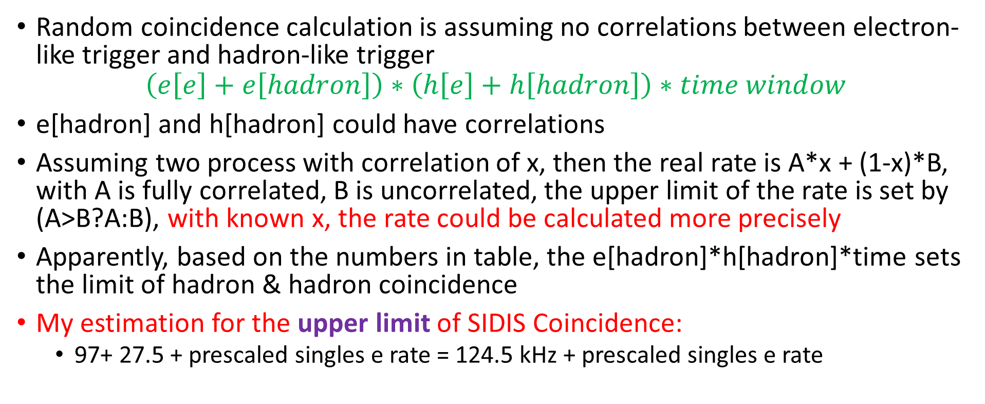
SIDIS trigger rate consideration
Random coincidence calculation is assuming no correlations between electron-like trigger and hadron-like trigger
$$\left(e\left[e\right]+e\left[hadron\right]\right)∗\left(h\left[e\right]+h\left[hadron\right]\right)∗time window$$
e[hadron] and h[hadron] could have correlations
Assuming two process with correlation of x, then the real rate is A*x + (1-x)*B, with A is fully correlated, B is uncorrelated, the upper limit of the rate is set by (A>B?A:B), with known x, the rate could be calculated more precisely
Apparently, based on the numbers in table, the e[hadron]*h[hadron]*time sets the limit of hadron & hadron coincidence
My estimation for the upper limit of SIDIS Coincidence:
  97+ 27.5 + prescaled singles e rate = 124.5 kHz + prescaled singles e rate
The prescaled singles electron rate should be constrained by the bandwidth of data taking
Need to optimize collimator design to reduce inclusive hadron rates from target window!!!

