Slide 1
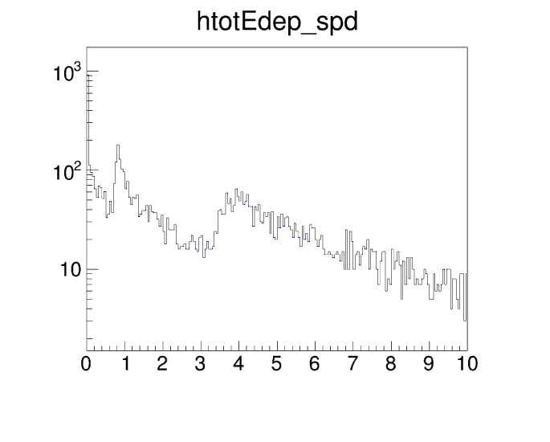
SPD cut and rate
Energy deposit from Pi- (0 to 11 GeV)
shooting into SoLID SIDIS He3 setup
MIP of FA at 1MeV
MIP at LA
MeV | MIP | low cut | Med cut | high cut
SPD_FA | 1 | 0.1 | 0.25 | 0.5
SPD_LA | 4 | 0.3 | 0.75 | 3.0
SIDIS_He3 | Max Occ(kHz/channel) low cut | Max Occ(kHz/channel) Med cut | Max Occ(kHz/channel) high cut | Average Occ(kHz/channel) low cut | Average Occ(kHz/channel) Med cut | Average Occ(kHz/channel) high cut
SPD_FA | 24.1e3 | 17.5e3 | 4.73e3 | 15.2e3 | 11.3e3 | 3.21e3
SPD_LA | 89.4e3 | 44.4e3 | 4.91e3 | 86.3e3 | 42.7e3 | 4.49e3
Note the SPD trigger cut 0.5MeV at FA and 1.5 at LA is studied differently.
JPsi_LH2 | Max Occ(kHz/channel) low cut | Max Occ(kHz/channel) Med cut | Max Occ(kHz/channel) high cut | Average Occ(kHz/channel) low cut | Average Occ(kHz/channel) Med cut | Average Occ(kHz/channel) high cut
SPD_FA | 24.1e3 | 17.5e3 | 13.0e3 | 15.2e3 | 11.3e3 | 8.63e3
SPD_LA | 89.4e3 | 44.4e3 | 10.12e3 | 86.3e3 | 42.7e3 | 9.19e3

