Slide 1
SoLID CLEO software
Zhiwen Zhao
2012/08

Slide 2
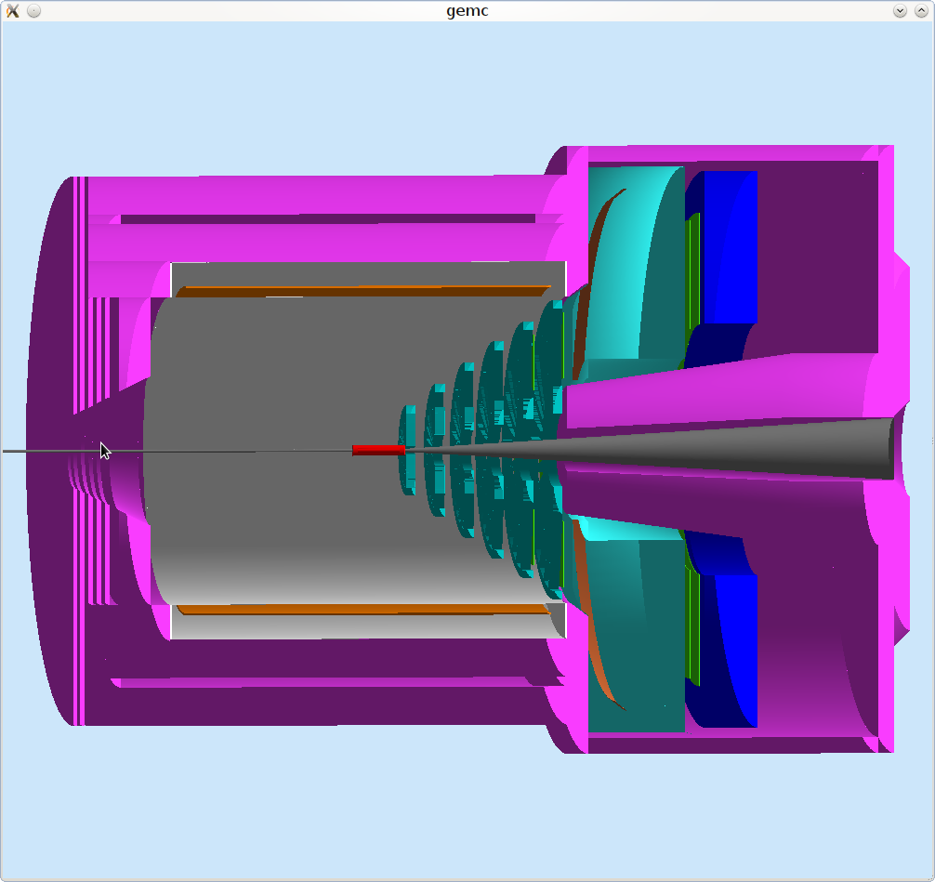

Slide 3
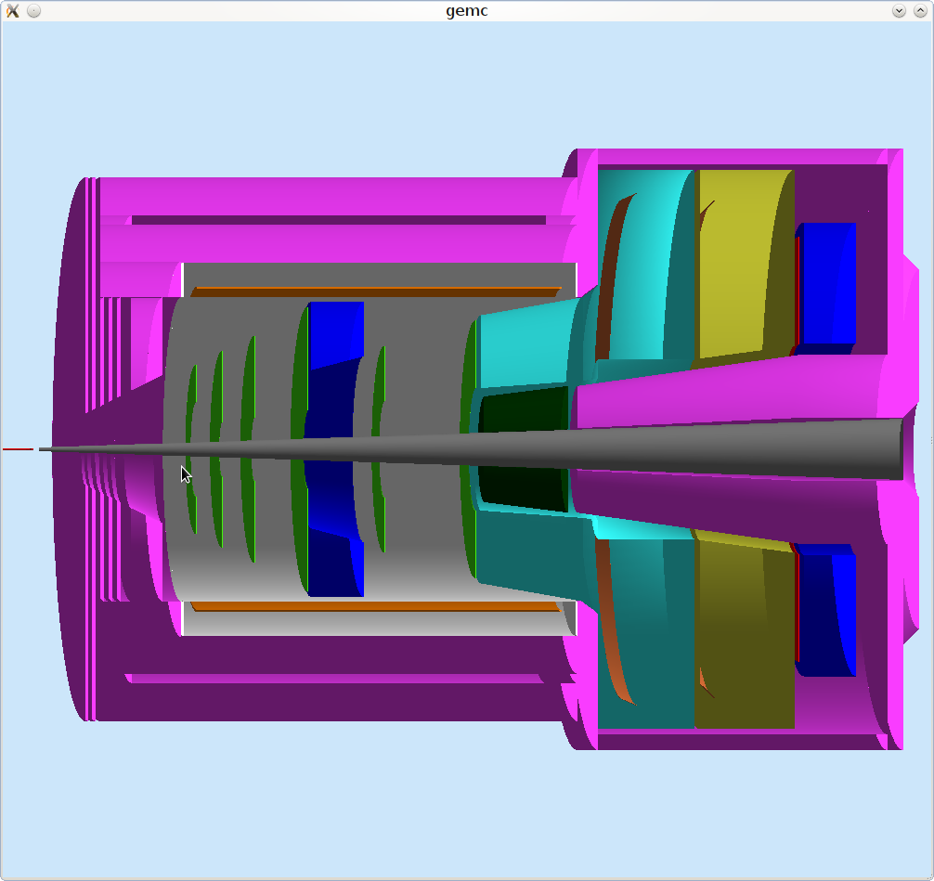

Slide 4
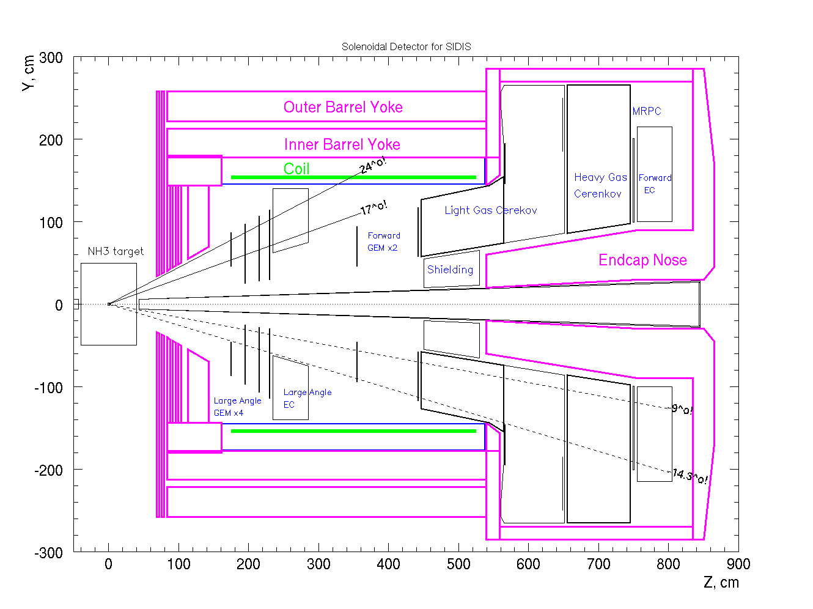

Slide 5
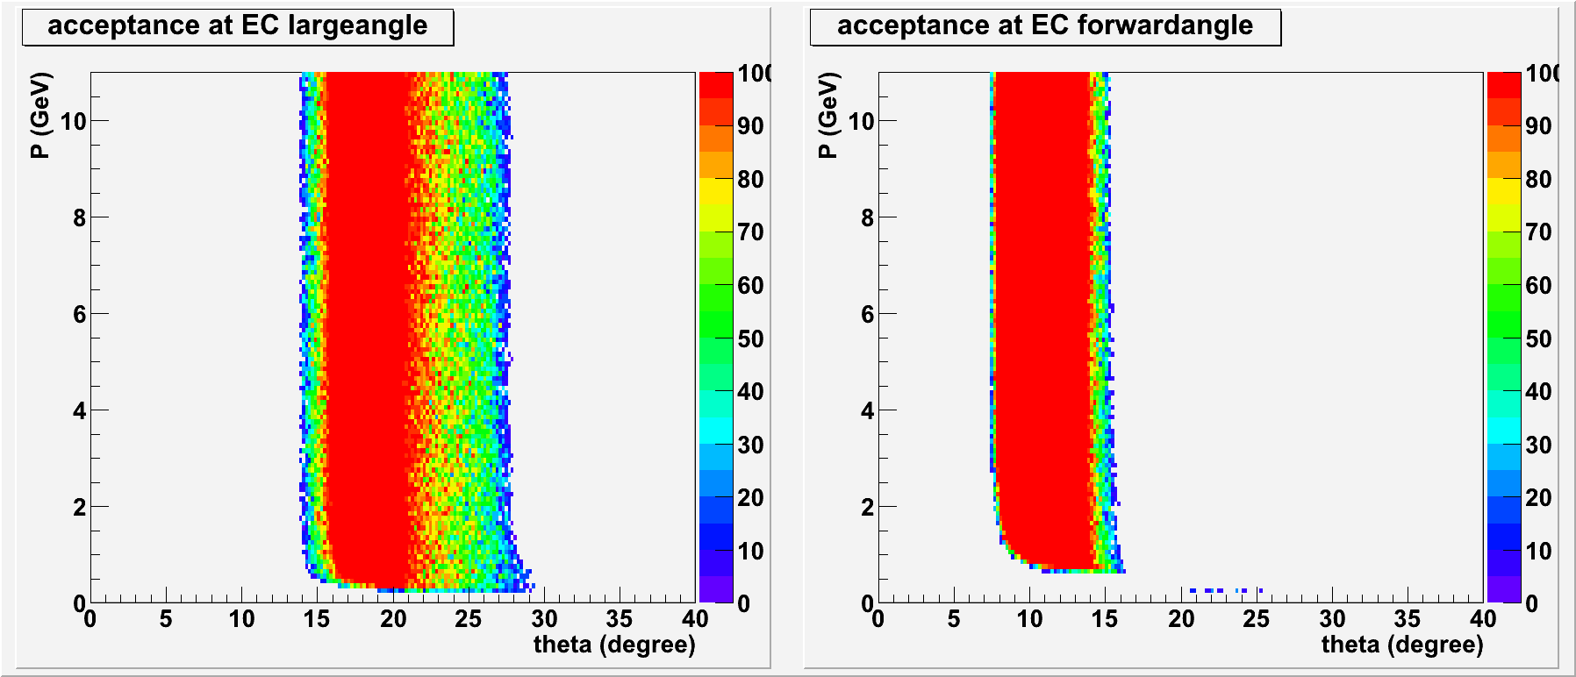
Acceptance (SIDIS 3He EC)

Slide 6
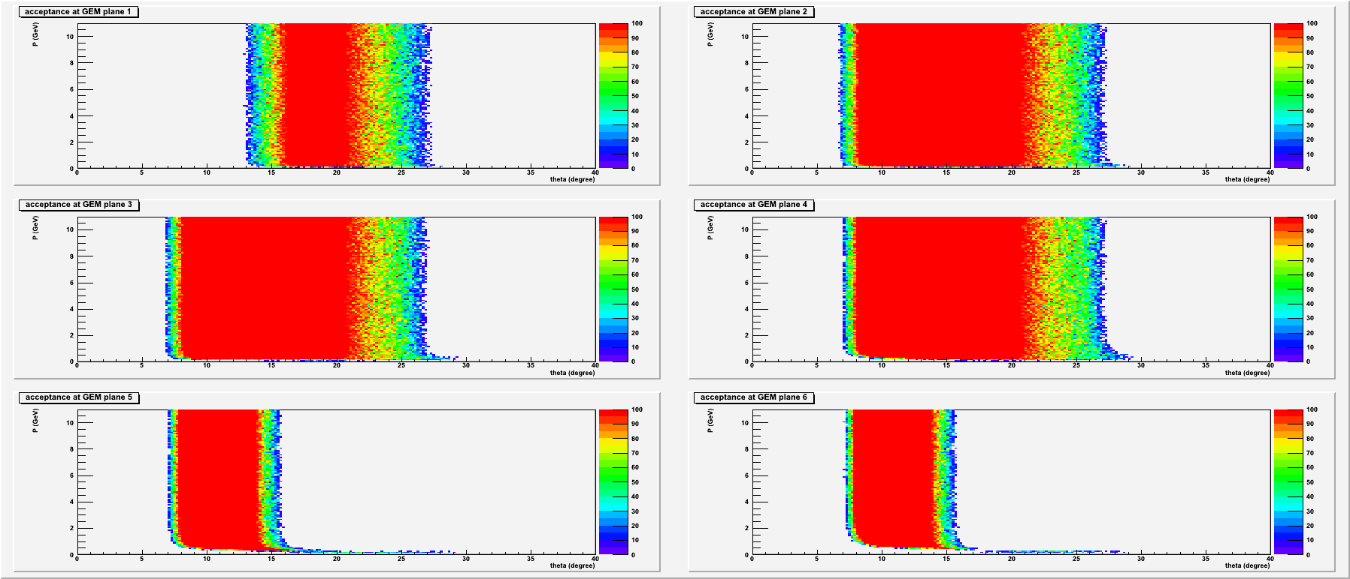
Acceptance (SIDIS 3He GEM)

Slide 7
SVN
https://jlabsvn.jlab.org/svnroot/solid/solid_gemc
database_io
script
analysistool
acceptance
…
The database solid_geometry updated
Soldi wiki updated

