Slide 1
Introduction
A simple study of MRPC rate using SoLID GEMC 2 (geant4.9.6.p02 based)
With all SoLID geometry and materials, shoot 11GeV electrons into He3 target and let geant4 use “QGSP_BERT_HP” physics list to generate secondary particles.
Results are normalized to 15uA beam which is Lumi ~7e36/cm2/s considering the target

Slide 2
MRPC geometry (10 layers of 90% Freon gas)
# MRPC structure
# Atucal: First Layer: 6mm Honeycomb + 0.8mm PCB (1)+(2)
# + Mylar 0.15mm + Electrode 0.4mm (3)+(4)
# + Glass 0.7mm + Gas 0.25mm (5)+(6)
# + Glass 0.7mm + Gas 0.25mm (7)+(8)
# + Glass 0.7mm + Gas 0.25mm (9)+(10)
# + Glass 0.7mm + Gas 0.25mm (11)+(12)
# + Glass 0.7mm + Gas 0.25mm + Glass 0.7mm (13)+(14)+(15)
# + Electrode 0.4mm + Mylar 0.15mm + 1.6mm PCB(16)+(17)+(18)
#
# Second Layer: Mylar 0.15mm + Electrode 0.4mm ()+()
# + Glass 0.7mm + Gas 0.25mm ()+()
# + Glass 0.7mm + Gas 0.25mm ()+()
# + Glass 0.7mm + Gas 0.25mm ()+()
# + Glass 0.7mm + Gas 0.25mm ()+()
# + Glass 0.7mm + Gas 0.25mm + 0.7mm Glass ()+()+()
# + 0.4mm Electrode + 0.15mm Mylar ()+()
# + 0.8mm PCB + 6mm Honey comb ()+()

Slide 3
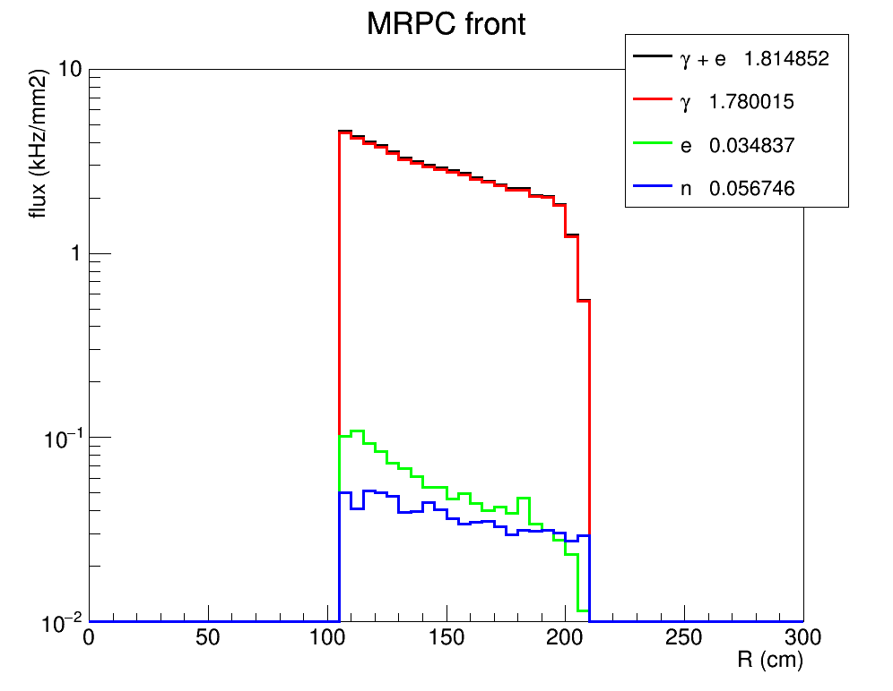
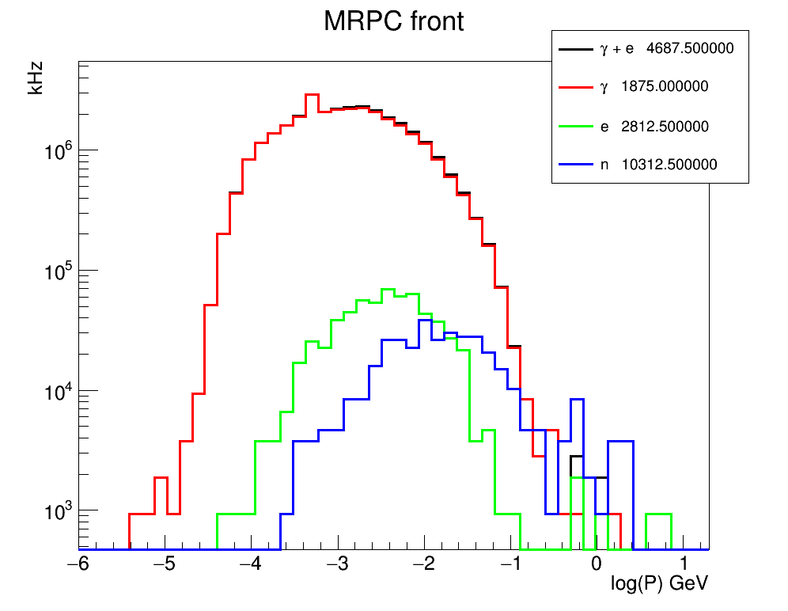
rate of particle entering MRPC
Dominant by photon in a few MeV

Slide 4
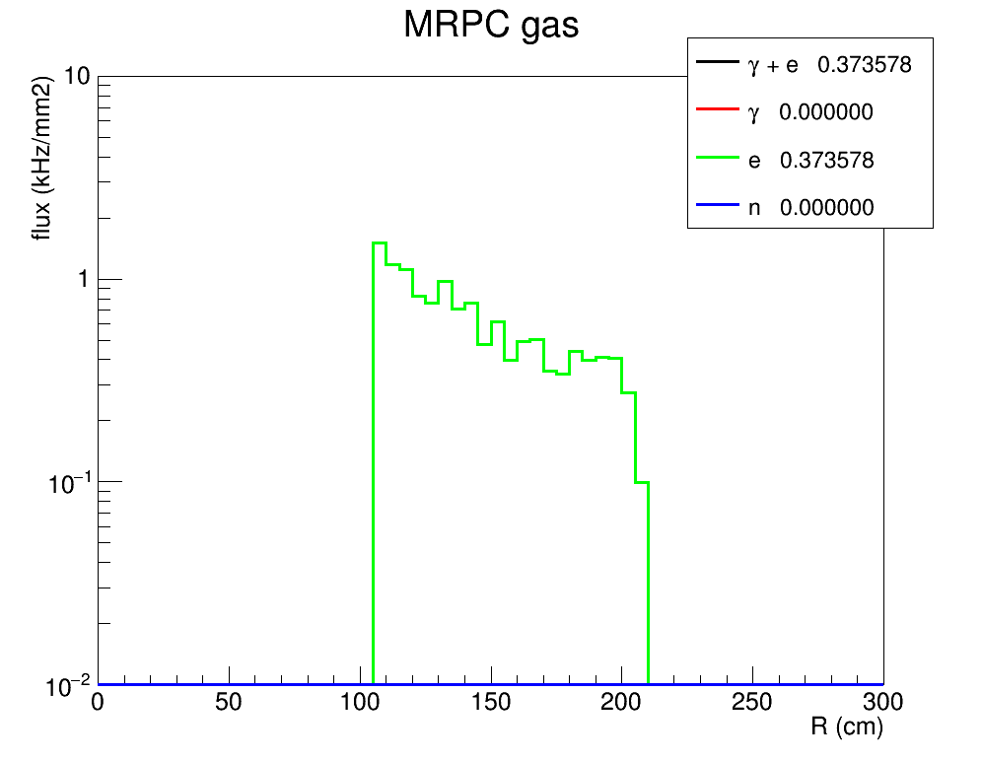
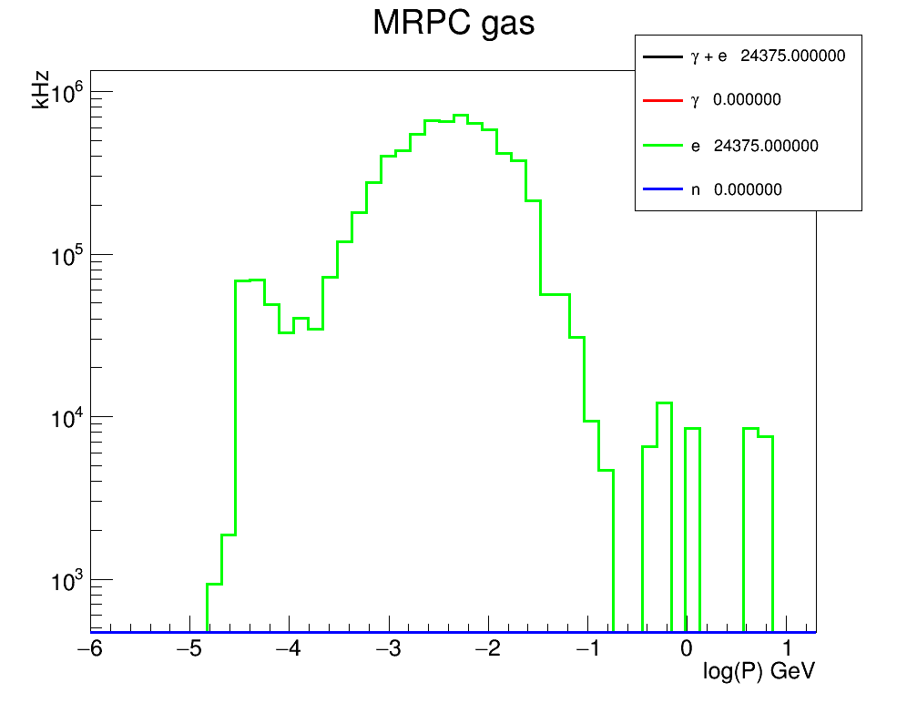
Rate of any hit with energy deposition > 16eV (Freon ionization) in any layer of MRPC gas

Slide 5
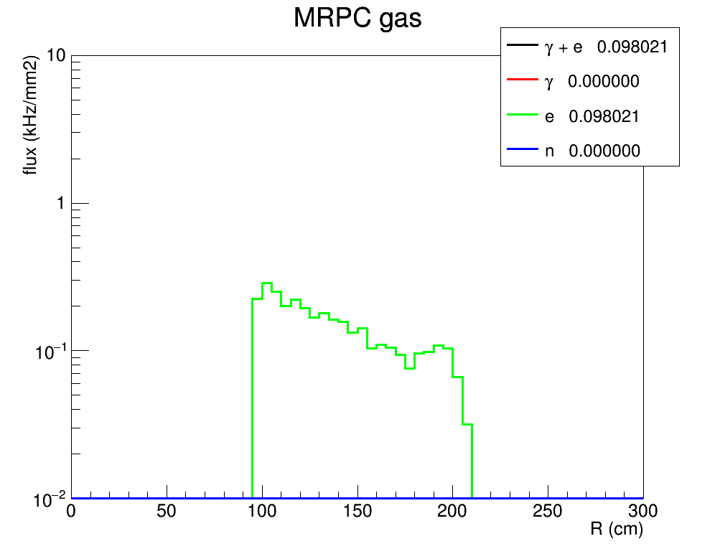
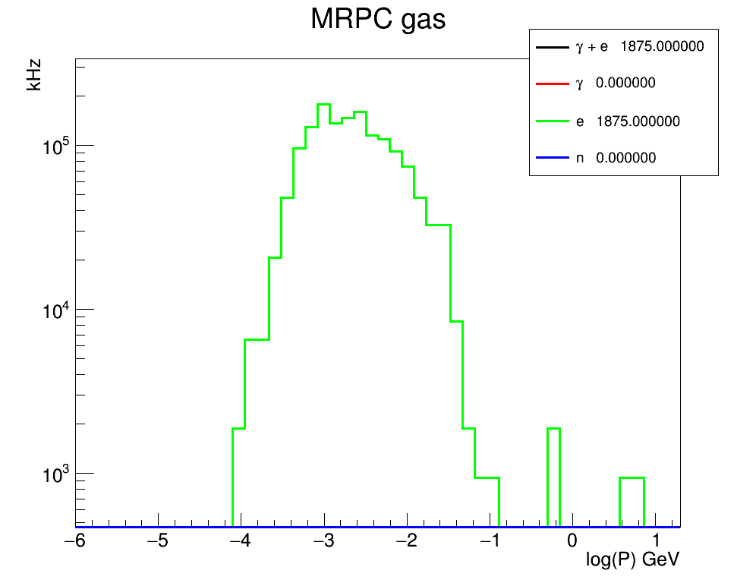
Rate of hit with energy deposition > 16eV (Freon ionization) in at least one layer of MRPC gas so this sum all hits produced by one electron on target and count as one entry for rate estimation

Slide 6
Summary
Background is dominated by a few MeV photons
Two ways to estimate MRPC background rate, maybe actual rate is in-between
30-150kHz/cm2 ???
Dedicated detector simulation and actual test data are needed to go further
Particles entering MRPC can be used as input for standalone MRPC simulation

