Slide 1
Event generator comparison
Zhiwen Zhao
2013/12/03 original
2014/02/12 update
2014/11/04 update

Slide 2
Intro
We are trying to compare particle rate between event generators and data
All code mentioned can be obtained from
https://hallaweb.jlab.org/wiki/index.php/Solid_eventgenerator

Slide 3
Wiser fit
Wiser fit is based on photon on proton target from SLAC data
It can output pip,pim,kp,km,p,anti-p result
no result on neutron
For electron on nuclei target, one can approximate electron with virtual photon flux
This way we can represent different targets solely in rad_len and the output is linearly proportional to rad_len
Here is one example of estimating rad_len
“RAD_LEN (%)is the radiation length of target, including internal (typically 5%)
= .5 *(target radiation length in %) +5.
= 100. IF BREMSTRULUNG PHOTON BEAM OF 1 EQUIVIVENT QUANTA”
Also one need to estimate rate on neutron somehow

Slide 4
Whitlow and qfs fit
Whitlow fit gives only DIS electron rate on proton and deuteron
qfs fit gives general electron rate on proton and deuteron
both have nothing to do with target rad_len

Slide 5
Generator “eicRate”
e rate (including eDIS and others) based on CTEQ6 PDF on proton or neutron
(others including inelastic and resonance region, the estimation could be off)
eES rate based on formula on proton or neutron
hadron rate based on Wiser fit
pip,pim,Kp,Km,p and p-bar on proton from Wiser fit directly
pi0 rate = (pip+pim)/2 , Ks,Kl rate = (Kp+Km)/2
pip or pim rate on proton = pim or pip rate on neutron
Kp or Km rate on proton = Km or Kp rate on neutron
p rate on proton = p rate on neutron
Randomly choose proton or neutron as target for each event or take average
It can take general target with these consideration
radlen= 0.5*rad*100.*(4.0/3.0) + intrad*100.0
= 8.22 (40cm LD2 with rad=40/745.4=0.0537 and 11GeV beam)
= 6.14 (20cm LD2 with rad=20/745.4=0.0268 and 6GeV beam)
= 4.69 (40cm 10amg He3 with rad=40/(67.42/1.345e-3)=0.8e-3 and 11GeV beam)
= 4.40 (40cm 10amg He3 with rad=40/(67.42/1.345e-3)=0.8e-3 and 6GeV beam)
Intrad = 2.0*ln(e_lab/0.000511)/(137.0*3.14159)
= 0.0464 (11 GeV beam)
= 0.0435 (6 GeV beam)
See rad_len formula in backup slides from Seamus
All Use “nucleon luminosity =A*nuclei luminosity“ for normalization

Slide 6
Generator “single_rate” by Xin Qian
eDIS 1 based on whitlow fit on proton or deuteron
Rate of He3 = rate of proton + rate of deuteron
eDIS 1 based on qfs fit on proton or deuteron
Rate of He3 = rate of proton + rate of deuteron
Hadron based on wiser fit
has no treatment for rate on neutron, only can do fixed target
rad_len used
Hydrogen target
rad_len=2.7 + 0.5*(15.*0.0708)/61.28*100.=3.57
Deuterium target
rad_len=(2.7 + 0.5*(12.*0.169)/122.4*100.)*2=7.06
He3
rad_len= 3.57+ 7.06 = 10.63
It use nuclei luminosity for normalization
Beyond “single_rate”, Xin has additional correction from comparison between the calculation and 6GeV Transversity exp data on He3

Slide 7
Rate on He3

Slide 8
He3 hadron rate difference between “eicRate” and “single_rate” with 6GeV beam
Both are based on wiser fit, but use it differently, so they have different distribution and normalization factor
“eicRate” has He3 rad_len=4.40
“eicRate” uses “nucleon luminosity =A*nuclei luminosity” for normalization where A=3
“eicRate” assumes “pip or pim rate on proton = pim or pip rate on neutron”, so its distribution is NOT exactly like wiser fit
its pip rate ~ (2/3 pip_wiser+1/3pim_wiser)
its pim rate ~ (2/3 pim_wiser+1/3pip_wiser)
“single_rate” uses rad_len=10.63
“single_rate” uses “nuclei luminosity” for normalization
“single_rate” treats rate on neutron the same as proton, so its distribution is exactly like wiser fit
At least, “eicRate” over “single_rate w/o correction” has a factor 1.24=4.40*3/10.63

Slide 9
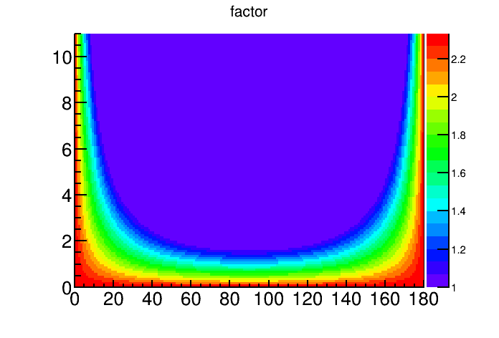
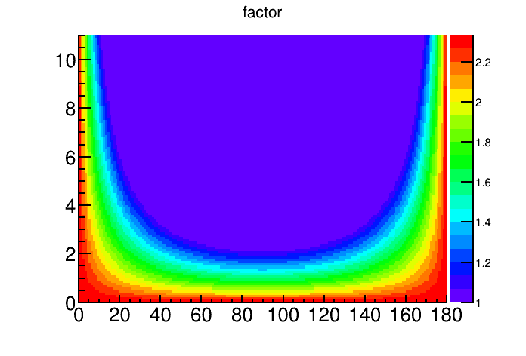
Xin’s He3 wiser pion correction factor (Mom VS theta) for 11GeV and 6GeV
factor = 2.33369*exp(-0.508963*mom*sin(theta/180.*3.1415926)*
sqrt(0.938*0.938+2.*0.938*5.892)/sqrt(0.938*0.938+2.*0.938*ebeam));
if (factor<=1) factor=1
At 10 deg and 1GeV, it is 2.14 for 6GeV beam, 2.19 for 11GeV beam
At 10 deg and 2GeV, it is 1.96 for 6GeV beam, 2.04 for 11GeV beam
At 16 deg and 2.35GeV, it’s 1.68 for 6GeV beam (6GeV Transversity condition)
6GeV
11GeV

Slide 10
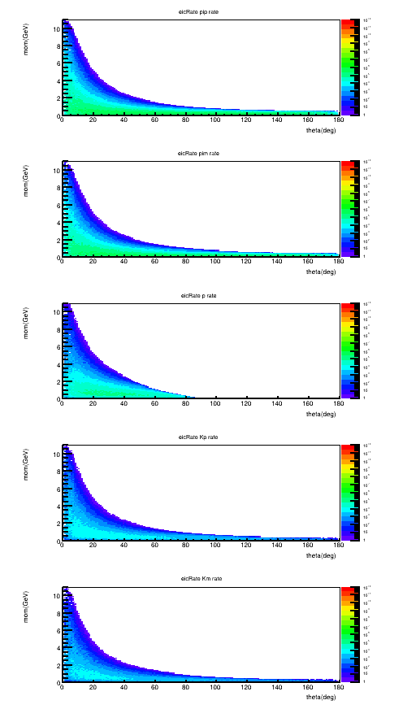
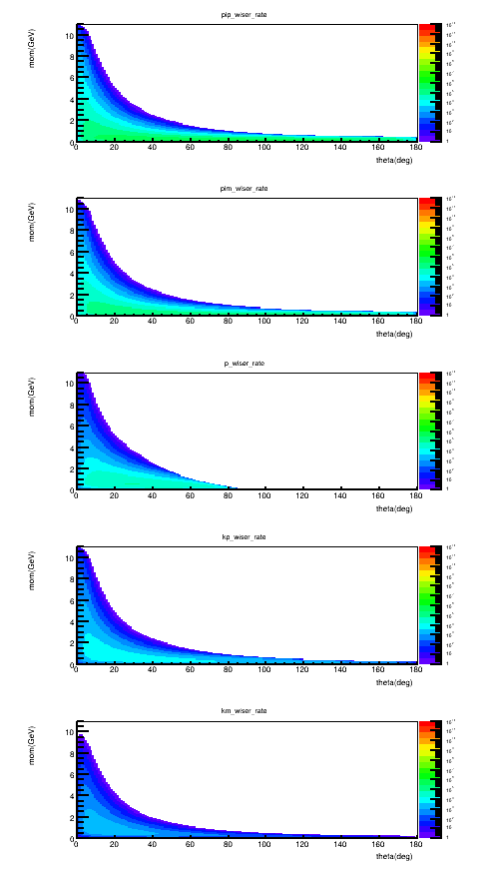
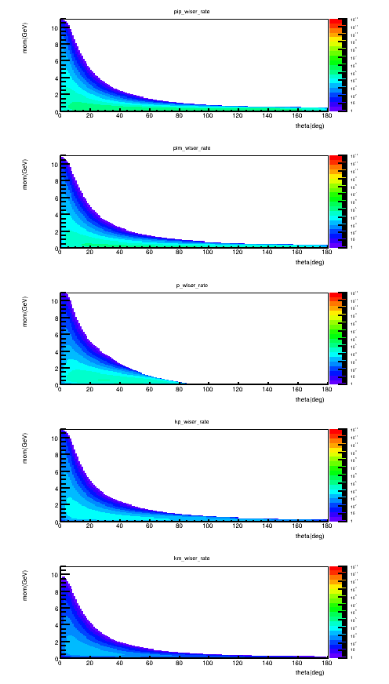
He3 Hadron rate
eicrate
Single_rate w/o factor
Single_rate with factor
pip
pim
p
Kp
Km

Slide 11
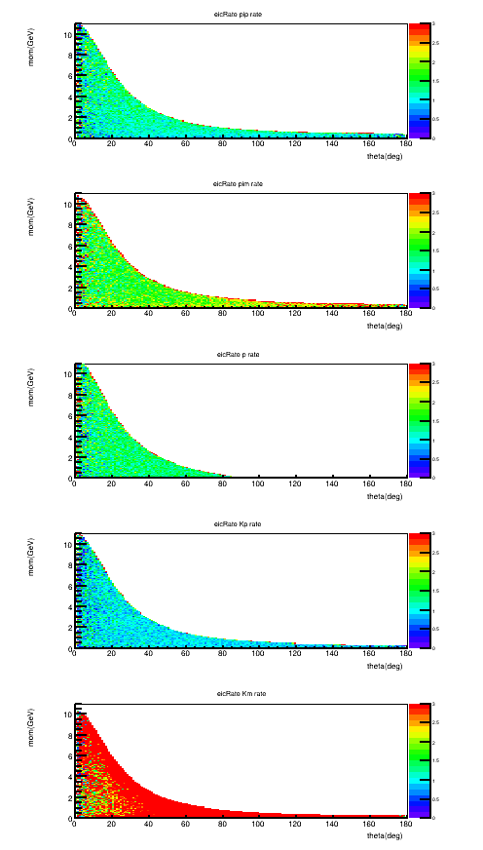
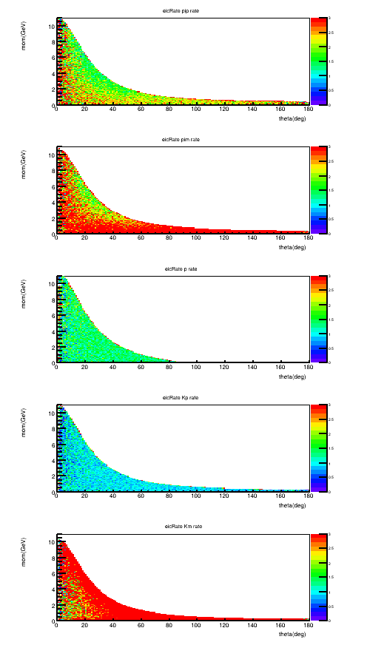
He3 Hadron rate ratio
eicrate /(Single_rate w/o factor)
eicrate/(single_rate with factor)
pip
1.5 on average
3 on average
pim
p
Kp
Km

Slide 12
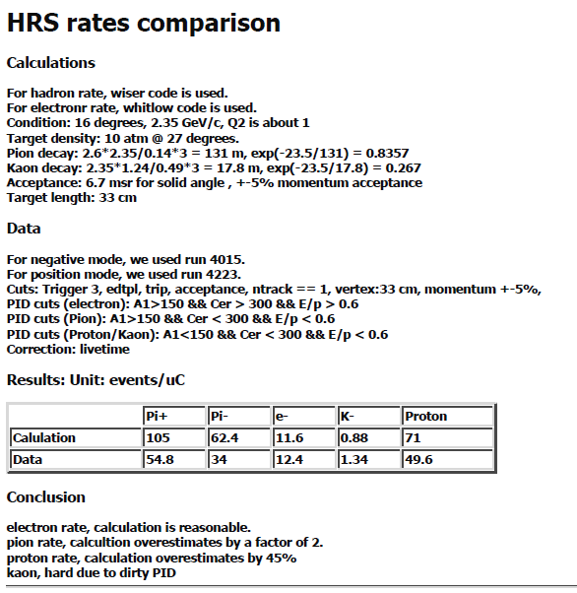
My calculation using “single_rate” for 6GeV Transversity Condition
Xin’s summary
method
Calculate Xsec at one fixed kinematic point,
then multiply by luminosity and phase space
No radiative correction
same method used by Xin
Assume
6 GeV beam, theta 16 deg, Mom 2.35GeV
Current 10uA, target 33cm 10amg He3 target
nuclei Lumi 0.557e36/cm2/s
= 10e-6/1.6e-19*33*1.345e-3*6.02e23/3
Phase space 0.0013 according to Zhihong’s simulation
(comparing to Xin’s estimation 0.0016 = 6.7msr*2.35GeV*10%)
Result
e- rate by whitlow fit, hadron rate by wiser fit with radlen=10.63
Get rate by “./main 0 557 6 1 1 1.85 2.85 15.5 16.5” on proton and “./main 1 557 6 1 1 1.85 2.85 15.5 16.5” on deuteron, add both to get rate on He3.
(sin(16/180*3.1416)*1/180*3.1416*2*3.1416)*1 =0.0302 is phase space used in the code
10uA current is 10uC/s
Pion decay 0.8357, kaon decay 0.267
For example (1.46e-3+8.08e-4)*1e6/0.0302*0.0013/10=9.73 /uC for e-
 | e- | Pi+ | Pi- | K+ | K- | p
Xsec (nb/GeV-sr) | 134 | 1540 | 916 | 309 | 4.2 | 889
Rate(uC) | 9.73 | 93.19 | 55.4 | 5.95 | 0.81 | 64.36
Data | 12.4 | 54.8 | 34 |  | 1.34 | 49.6

Slide 13
He3 hadron rate
“eicRate” over “single_rate w/o correction” has a factor 1.24
single_rate correction factor is 2 on average
“eicRate” over “6GeV Transversity data” is a factor 2.48=1.24*2
So we may use 40% (~ 1/2.5) hadron rate from “eicRate” for 6GeV beam
but it’s not clear how it would be for 11GeV
It would be good to do a direct comparison between “eicrate” and data

Slide 14
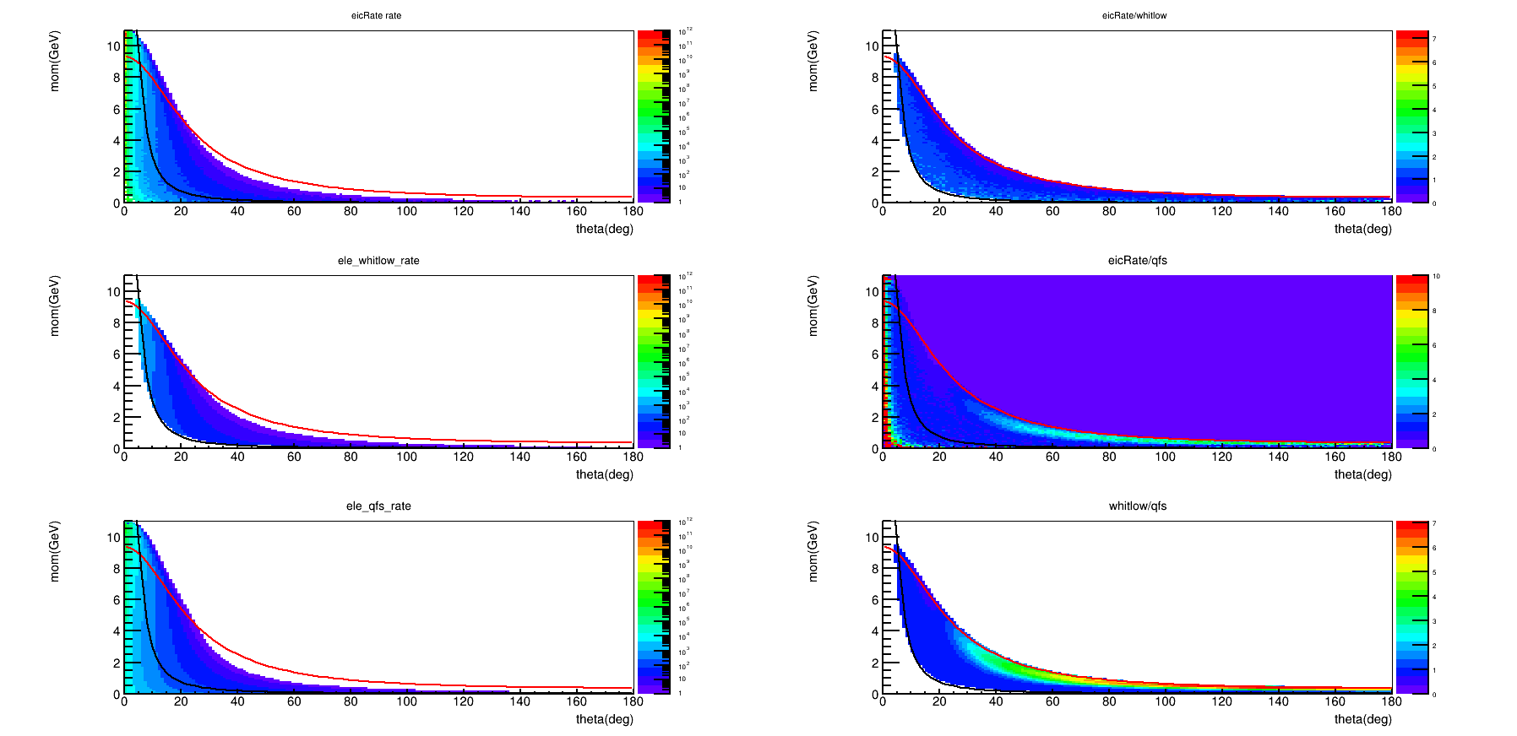
He3 e rate W=2 red line, Q2=1 black line
“single_rate” whitlow covers DIS only, no output for Q2<1 or W<2
In DIS, “eicrate” and “single_rate” whitlow ratio is around 1
Compare sum of rate between of 7-24 degree and W>2, Q2>1. The result of “eicRate” is 1.2 times of “single_rate” whitlow

Slide 15
He3 e rate
“eicRate” and “single_rate” use different fit to estimate, “eicRate” over “single_rate” is 1.2 for SoLID kinematics
“single_rate” whitlow comparing to 6GeV Transversity data needs a correction factor 1.25
If we can combine these two, “eicRate” is close to data now
It would be good to do a direct comparison between “eicrate” and data

Slide 16
Rate on LD2

Slide 17
LD2 hadron rate difference between “eicRate” and “single_rate” with 6GeV beam
Both are based on wiser fit, but use it differently, so they have different distribution and normalization factor
“eicRate” has rad_len=6.14 for 20cm LD2
“eicRate” uses “nucleon luminosity =A*nuclei luminosity” for normalization where A=2
“eicRate” assumes “pip or pim rate on proton = pim or pip rate on neutron“, so its distribution is NOT exactly like wiser fit
its pip rate ~ (1/2 pip_wiser+1/2pim_wiser)
its pim rate ~ (1/2 pim_wiser+1/2pip_wiser)
“single_rate” uses rad_len=7.06
“single_rate” uses “nuclei luminosity” for normlization
“single_rate” treats rate on neutron the same as proton, so its distribution is exactly like wiser fit
At least, “eicRate” over “single_rate” has a factor 1.74=6.14*2/7.06

Slide 18
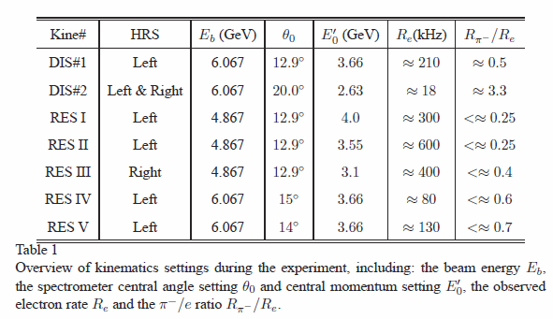
My calculation using “single_rate” for 6GeV PVDIS Condition “DIS#1”
method
Calculate Xsec at one fixed kinematic point,
then multiply by luminosity and phase space
No radiative correction
same method used by Xin
Assume
6.067 GeV beam
Current 100uA, target 20cm LD2
nuclei Lumi 0.635e39/cm2/s
=100e-6/1.6e-19*20*0.169*6.02e23/2
Phase space by Zhihong’s simulation: 0.0022 for DIS#1, 0.0015 for DIS#2
Result
e- rate by whitlow fit, hadron rate by wiser fit with radlen=7.06
Get rate by “./ main 1 0.635e6 6.067 1 1 3.16 4.16 12.4 13.4” for DIS#1, “./main 1 0.635e6 6.067 1 1 2.13 3.13 19.5 20.5” for DIS#2
(sin(12.9/180*3.1416)*1/180*3.1416*2*3.1416)*1=0.0245 for DIS#1 and (sin(20.0/180*3.1416)*1/180*3.1416*2*3.1416)*1=0.0375 for DIS#2, phase space used in the code
Pion decay 0.8357, kaon decay 0.267
For example, 3.51*1e6/0.0245*0.0022/1e3=315kHz for e-
Xiaochao’s summary of data
DIS#1 | e- | Pi+ | Pi- | K+ | K- | p
Xsec (nb/GeV-sr) | 225.25 | 135.75 | 80.25 | 43.75 | 2.875 | 80.25
Rate (kHz) | 315.25 | 158.75 | 93.5 | 16.675 | 1.065 | 112.25
Data | 210 |  | 105
DIS#2 | e- | Pi+ | Pi- | K+ | K- | p
Xsec (nb/GeV-sr) | 30.2 | 124.4 | 75.6 | 33.1 | 3.1 | 121
Rate (kHz) | 28.8 | 99.5 | 60.5 | 8.38 | 0.802 | 116
Data | 18 |  | 59.4

Slide 19
LD2 hadron rate
“eicRate” over “single_rat” has a factor 1.74
single_rate seems reproduce 6GeV PVDIS data at DIS region well
“eicRate” over “6GeV PVDIS data” is a factor 1.74
So we may 60% (~ 1/1.74) hadron rate from “eicRate” for 6GeV beam
but it’s not clear how it would be for 11GeV
It would be good to do a direct comparison between “eicrate” and data

Slide 20
LD2 e rate (unfinished)
“eicRate” and “single_rate” use different fit to estimate
“single_rate” whitlow comparing to 6GeV PVDIS data needs a correction factor 0.65
It would be good to do a direct comparison between “eicrate” and data

Slide 21
backup

Slide 22
Code “single_rate” result
[zwzhao@lily single_rate]$ ./main 0 557 6 1 1 1.85 2.85 15.5 16.5
use mom and theta as variables
mom_min 1.85000002 mom_max 2.84999990 theta_min_deg 15.5000000 theta_max_deg 16.5000000
Electron from whitlow : 8.07928212E-04 MHz
Electron from qfs : 7.99543574E-04 MHz
Positive Pion from wiser: 8.67747795E-03 MHz
Negative Pion from wiser: 5.17326035E-03 MHz
Proton from wiser : 5.01987291E-03 MHz
Positive Kaon from wiser: 1.74075132E-03 MHz
Negative Kaon from wiser: 2.36223714E-04 MHz
zwzhao@lily single_rate]$ ./main 1 557 6 1 1 1.85 2.85 15.5 16.5
use mom and theta as variables
mom_min 1.85000002 mom_max 2.84999990 theta_min_deg 15.5000000 theta_max_deg 16.5000000
Electron from whitlow : 1.46477344E-03 MHz
Electron from qfs : 1.72863191E-03 MHz
Positive Pion from wiser: 1.71696413E-02 MHz
Negative Pion from wiser: 1.02360398E-02 MHz
Proton from wiser : 9.93254315E-03 MHz
Positive Kaon from wiser: 3.44432797E-03 MHz
Negative Kaon from wiser: 4.67402628E-04 MHz
[zwzhao@lily single_rate]$ ./main 1 0.635e6 6.067 1 1 3.16 4.16 12.4 13.4
use mom and theta as variables
mom_min 3.16000009 mom_max 4.15999985 theta_min_deg 12.3999996 theta_max_deg 13.3999996
Electron from whitlow : 3.50617242 MHz
Electron from qfs : 4.11271048 MHz
Positive Pion from wiser: 2.11581039 MHz
Negative Pion from wiser: 1.24890971 MHz
Proton from wiser : 1.24679077 MHz
Positive Kaon from wiser: 0.682648838 MHz
Negative Kaon from wiser: 4.33244333E-02 MHz
[zwzhao@lily single_rate]$ ./main 1 0.635e6 6.067 1 1 2.13 3.13 19.5 20.5
use mom and theta as variables
mom_min 2.13000011 mom_max 3.13000011 theta_min_deg 19.5000000 theta_max_deg 20.5000000
Electron from whitlow : 0.719959378 MHz
Electron from qfs : 0.921629548 MHz
Positive Pion from wiser: 2.96858835 MHz
Negative Pion from wiser: 1.81487012 MHz
Proton from wiser : 2.89821553 MHz
Positive Kaon from wiser: 0.783541083 MHz
Negative Kaon from wiser: 7.48522878E-02 MHz

Slide 23
Zhihong Ye’ simulation of HRS acceptance
6GeV Transversity (16deg, 2.35GeV) Deltap = ± 6% Theta = ± 90mrad Phi = ± 45mrad VZ = ± 16.5 cm acceptance of this phase space 0.276781
effective phase space 0.00126
=180e-3*90e-3*0.276781*2.35*0.12
6GeV PVDIS Phase Space is: Dp = ± 6%, Theta = ± 90mrad, Phi = ± 45mrad, VZ = 20cm
DIS #1, P0 = 3.66, Theta = 12.9, the acceptance is 0.304386
effective phase space 0.0022=180e-3*90e-3*0.304386*3.66*0.12
DIS #2, P0 = 2.63, Theta = 20.0, the acceptance is 0.292408 effective phase space 0.0015=180e-3*90e-3*0.292408*2.63*0.12
NOTE that I use a much larger phase space that the HRS can accepted so we can cover any possible way the events going through the HRS, like using very long target. If we use a smaller phase space, the acceptance value could be smaller, but the effective phase space ( = full phase space*acceptance) should be a constant.

Slide 24
Seamus’s slides about “eicRate”

Slide 29
other

Slide 30
(outdated) My calculation using “eicrate” for 6GeV Transversity Condition
Method
eicrate generate a distribution, find the event within HRS acceptance, then count the rate
Should be more accurate comparing to calculation at a fixed point
Assume
HRS P range (2.2325,2.4675)
HRS solid angle is a cone with half angle 2.65 deg
6.7e-3=2*3.1416*(1-cos(2.65/180*3.1416))
Result
2857/10*0.8357= 238 uC for pip
2753/10*0.8357= 230 uC for pim

