Slide 1
SoLID SIDIS He3 Detection
Zhiwen Zhao
2017/01/31

Slide 2
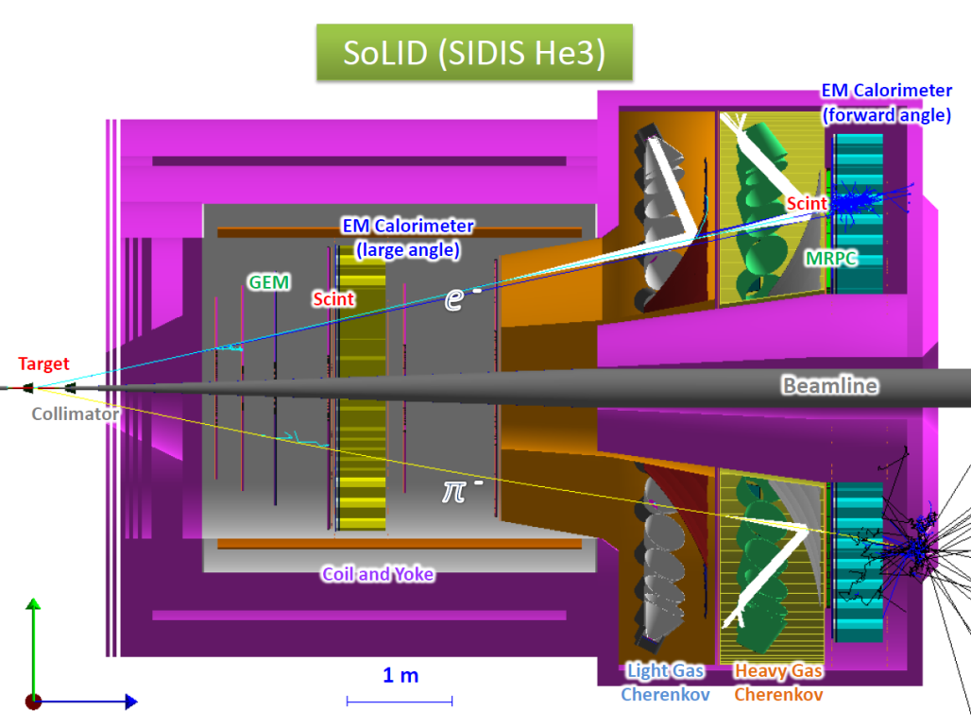
Setup
Use full fimulation with all sub-systems
Same output files used for trigger study

Slide 3
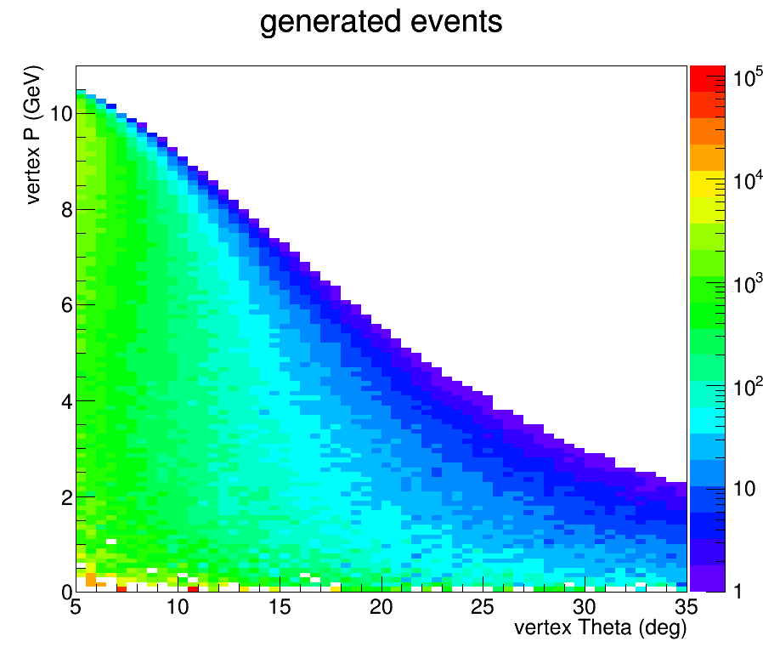
DIS e- generated

Slide 4
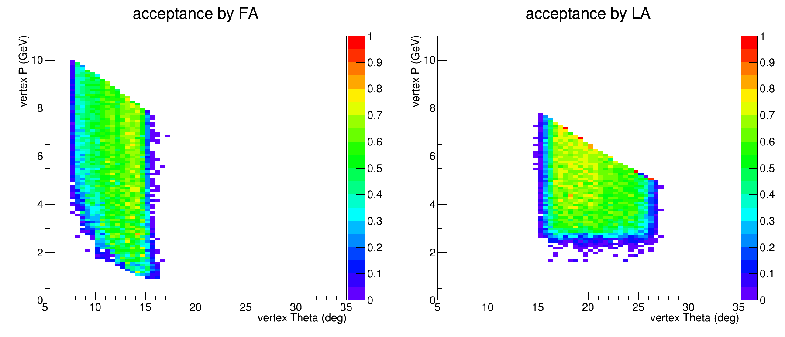
Acceptance of DIS e- (with LGC)
With SIDIS_He3 trigger condition
FAEC+GEM+FASPD+LGC
LAEC+GEM+LASPD

Slide 5
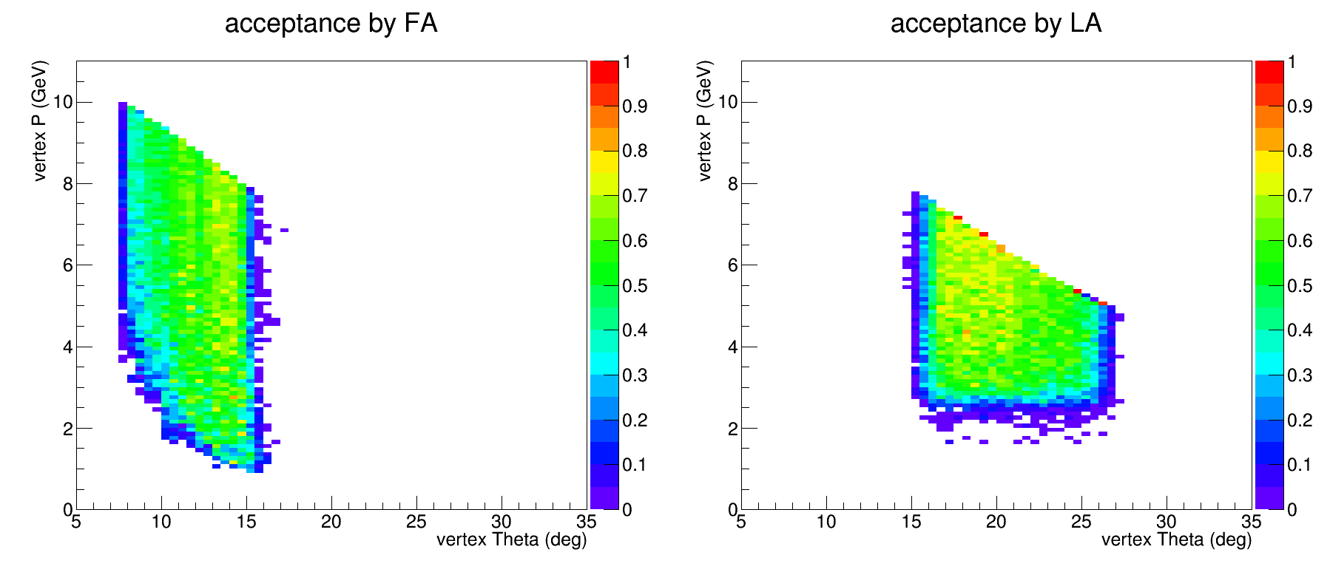
Acceptance of DIS e- (w/o LGC)
With SIDIS_He3 trigger condition
FAEC+GEM+FASPD (no LGC)
LAEC+GEM+LASPD

Slide 6
Efficiency
e- at FA: 79%
EC (95%) GEM (91%) SPD (98%) LGC (93%)
e- at LA: 84%
EC (95%) GEM (91%) SPD (98%)
charged pion at FA: 82% (<2.5GeV<) 86%
GEM (91%) HGC (95%) MRPC (95%) is about 82%.
These are estimated average efficiency with offline analysis condition, which should be lower than efficiency with trigger condition.
We can study them as individual detectors first, and then use full simulation by turning them on and off.

