Slide 1
SoLID SIDIS He3 efficiency and acceptance
Zhiwen Zhao
2017/03/20

Slide 2
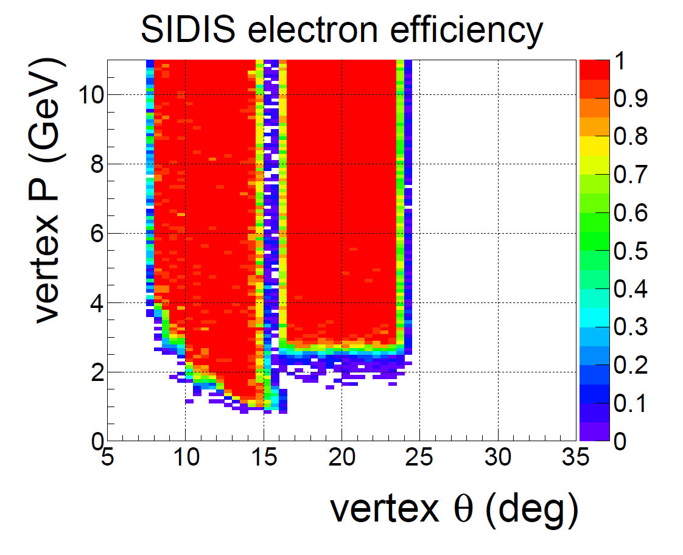
EC only simulation, vz(-355,-345)cm eff_EC > 98%
Trigger condition

Slide 3
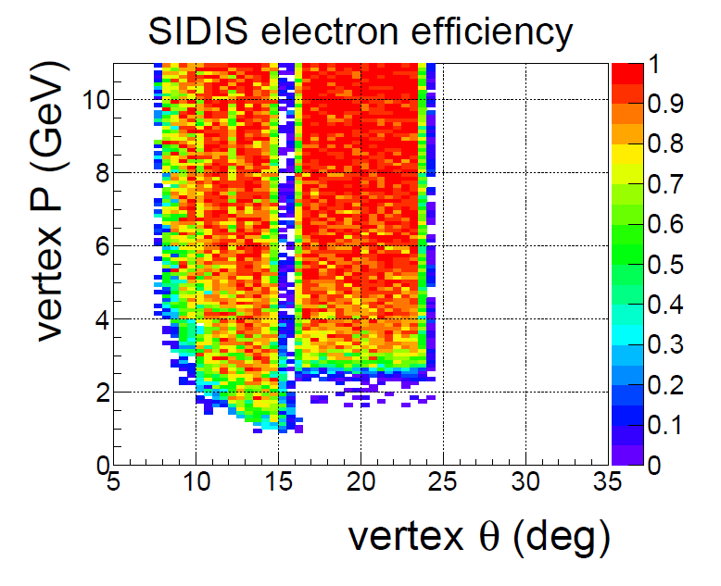
full simulation, vz(-355,-345)cm (eff_FAEC & eff_LGC & eff_FASPD) > 88%, (eff_LAEC & eff_LASPD) > 95%
Trigger condition

Slide 4
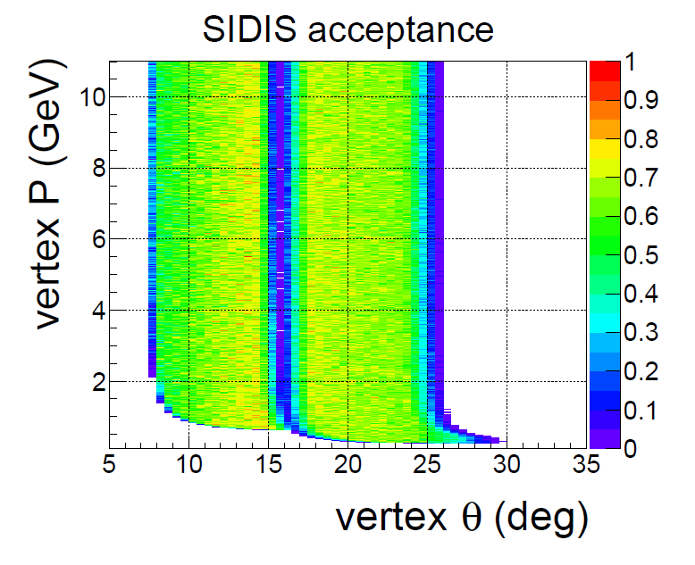
No material simulation, vz(-370,-330)cm acc > 70%

Slide 5
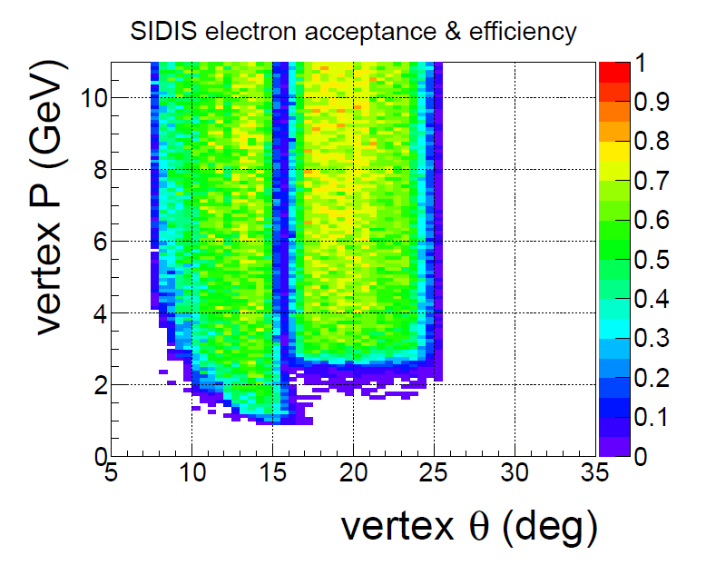
full simulation, vz(-370,-330)cm (eff_FAEC&eff_LGC&eff_FASPD)&acc>60%, (eff_LAEC&eff_LASPD)&acc>70%
Trigger condition

