Slide 1
SoLID SIDIS NH3 efficiency and acceptance
Zhiwen Zhao
2017/10/10
2017/10/31
2017/11/07
2017/11/14

Slide 2
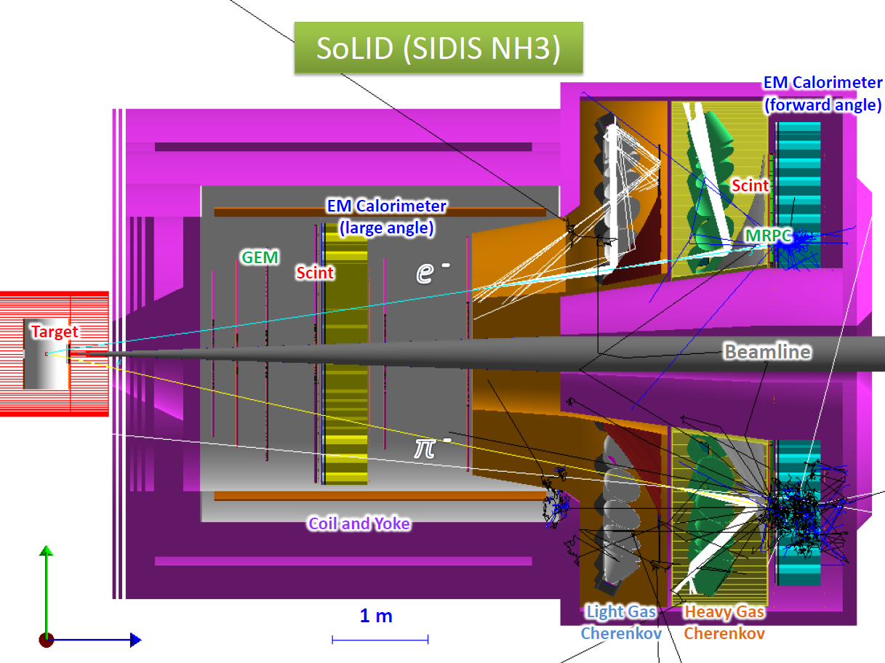
Setup
Target field +Bz along +x axis which is parallel to the hall floor
g2p field map with hallb coil “g2p_ptarget.dat” is calculated by Biot-Savart Law with a 2-D current density distribution in a fortran code and it gives result within 1% of measurement
The wrong target field map “solenoid_ptarget.dat” was converted incorrectly from g2p field map with hallb coil. It was used in GEMC until 2017/10. it has same max field 5T, but ~50% larger field integral for beam than g2p field
The field map “magnet_3.map“ used in Comgeant for proposal was converted from g2p field map with hallb coil. It has some small conversion errors also and caused ~10% larger field integral for beam integral than g2p field
The field map “oxford_ptarget.dat” is calculated according to Oxford design and has ~15% larger field integral for beam integral than g2p field

Slide 3
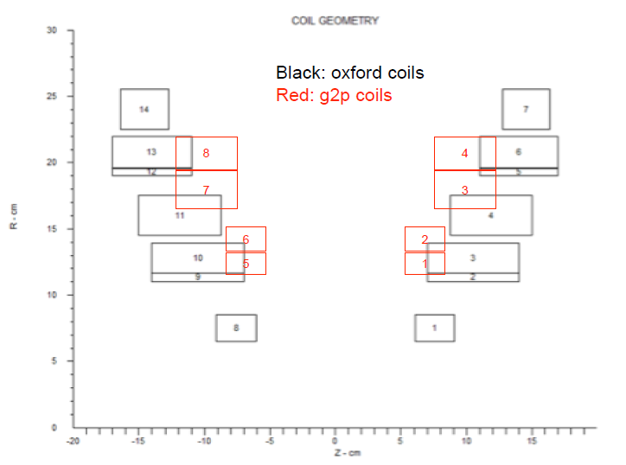
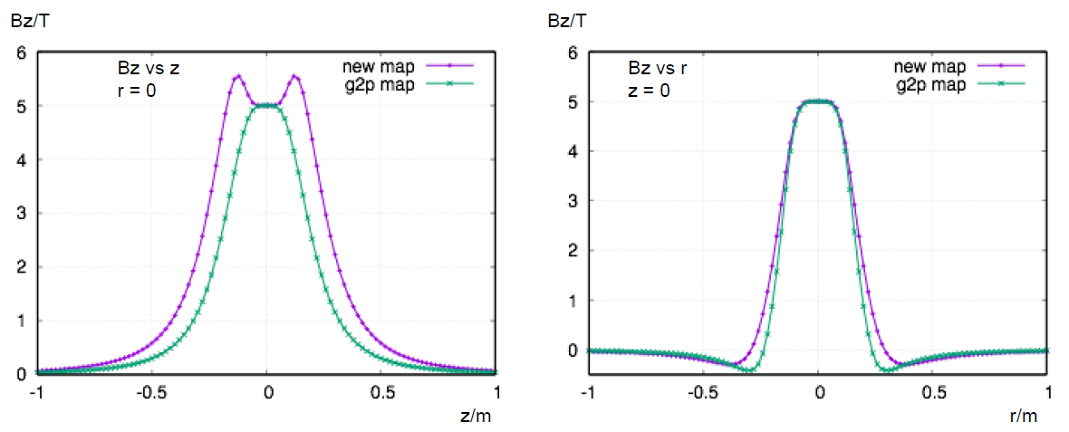
Oxford 2012 field map
Details in backup slides
It has 7 pairs of coils instead of 4 pairs g2p hallb magnet has.
The max field is 5T with ~10^{^-4} homogeneity and an opening angle of ± 25 deg
Chao Gu created a map by modify the g2p hallb fortran code with the oxford coil position and current. It has ~15% more field integral along beam direction

Slide 4
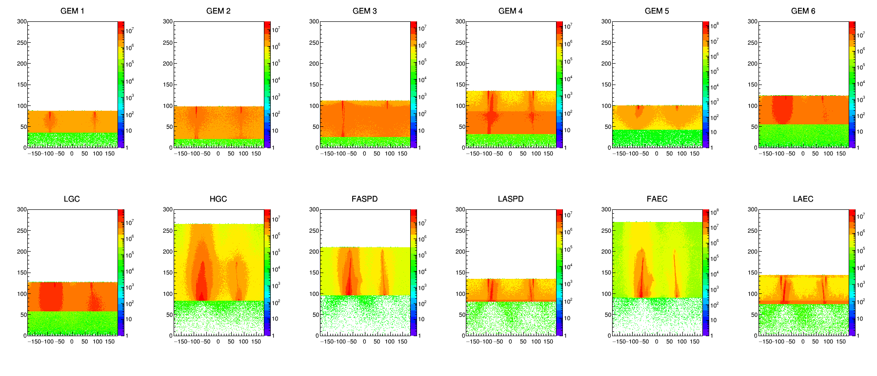
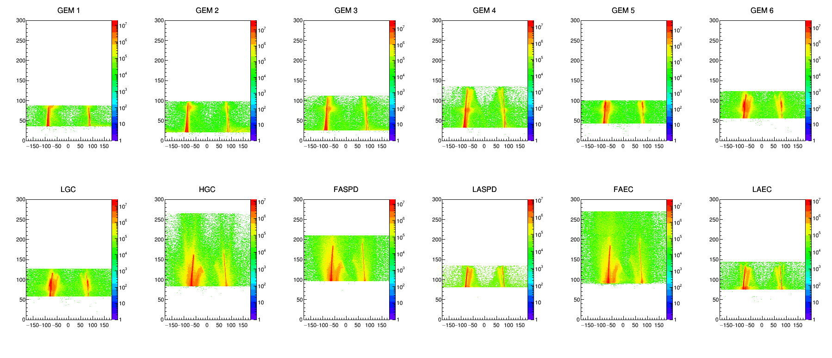
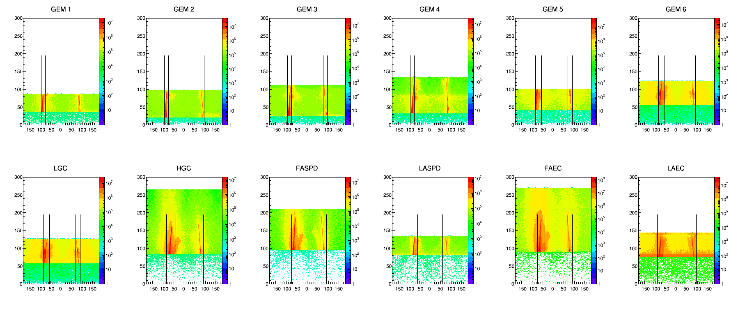
NH3
Oxford field
photon
Particle rate at detector entrance from BeamOnTarget in R vs Phi
Rate of (e- and e+ and photon*0.5) is just a guess, real digitization would give better answers.
Max rate for He3 reach 1e6 on GEM
NH3 reaches 1e7 in red color, cut away red to keep the max 1e6 like He3
e- and
e+
e- and e+
And photon*0.5 (except EC)

Slide 5
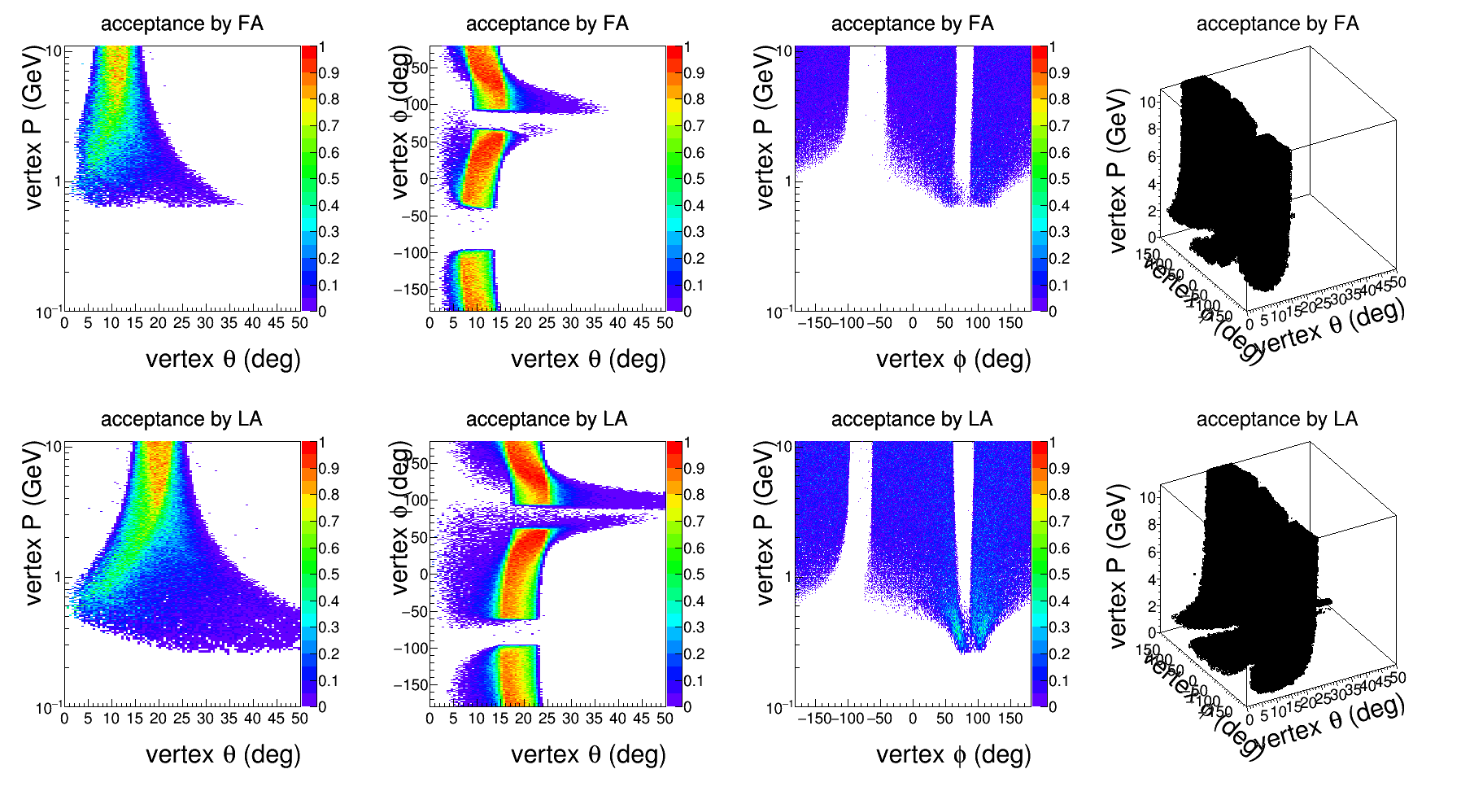
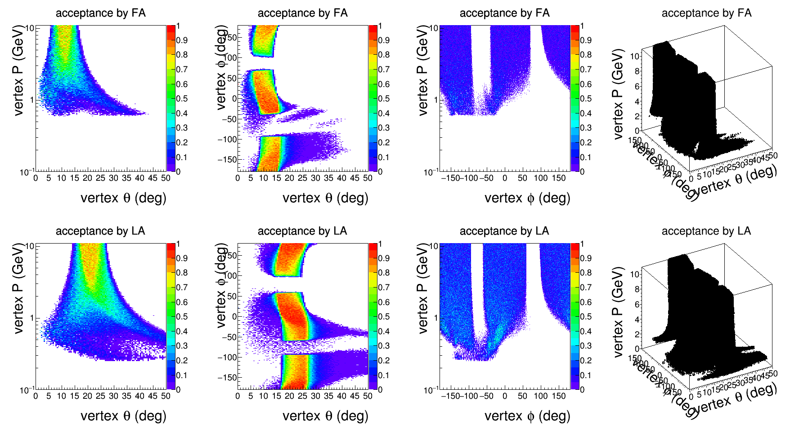
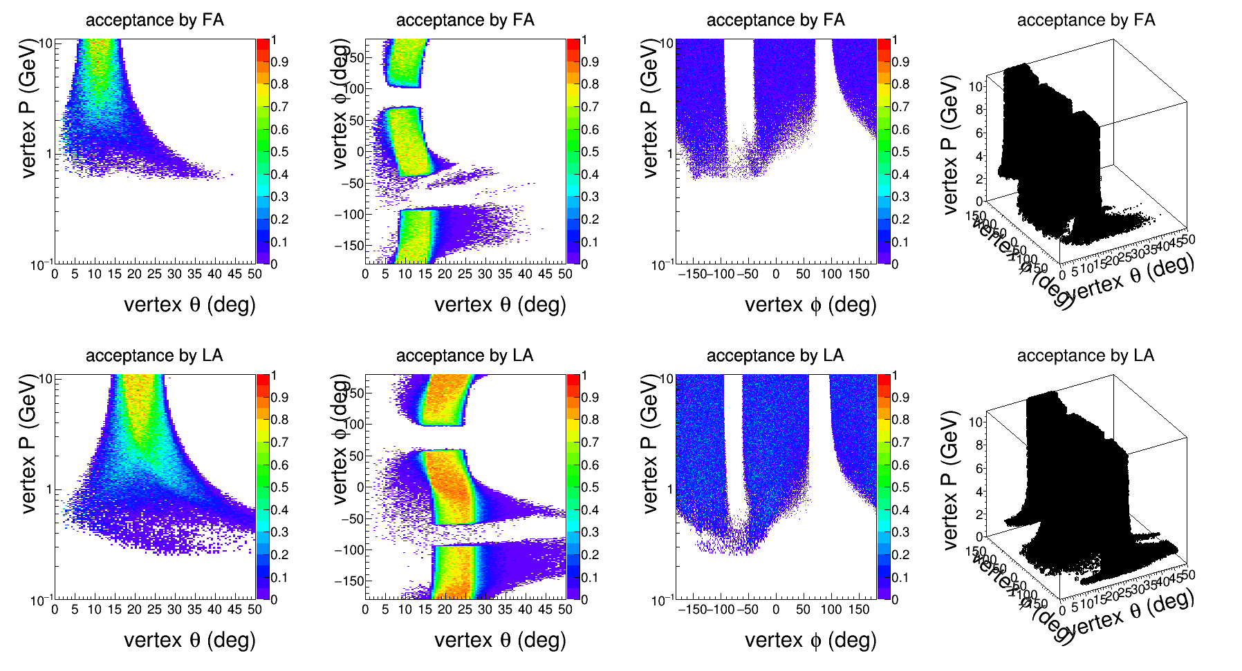
Acceptance
Oxford field
e-
With sheet of flame cut
No material, just field and geometry effect
No PID cut
Assume cut on FAMRPC is same as FASPD
Detection
e-, GEM+LGC+FASPD+FAEC or GEM+LASPD+LAEC
Pion, GEM+HGC+FASPD or GEM+LASPD
kaon, GEM+FASPD or GEM+LASPD
Pi+
K+

Slide 6
Compare ptarget magnet

Slide 7
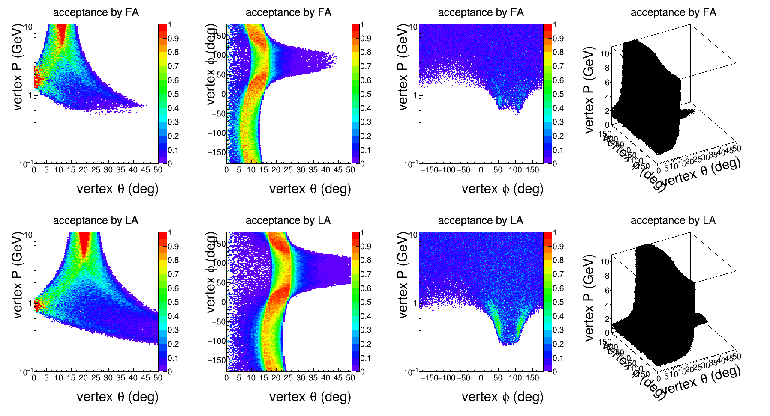
Pi- Acceptance without sheet of flame cut
Wrong field

Slide 8
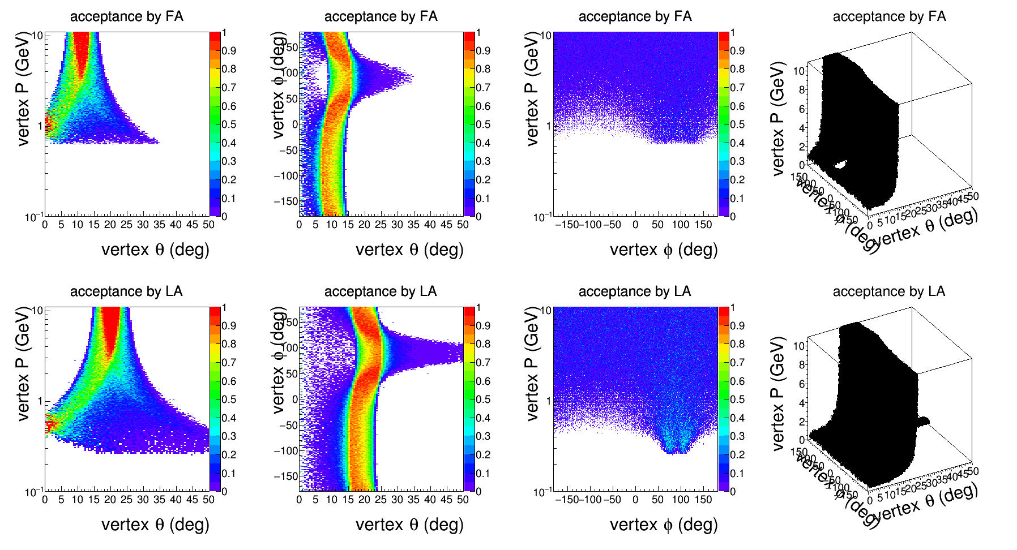
Pi- Acceptance without sheet of flame cut
g2p field

Slide 9
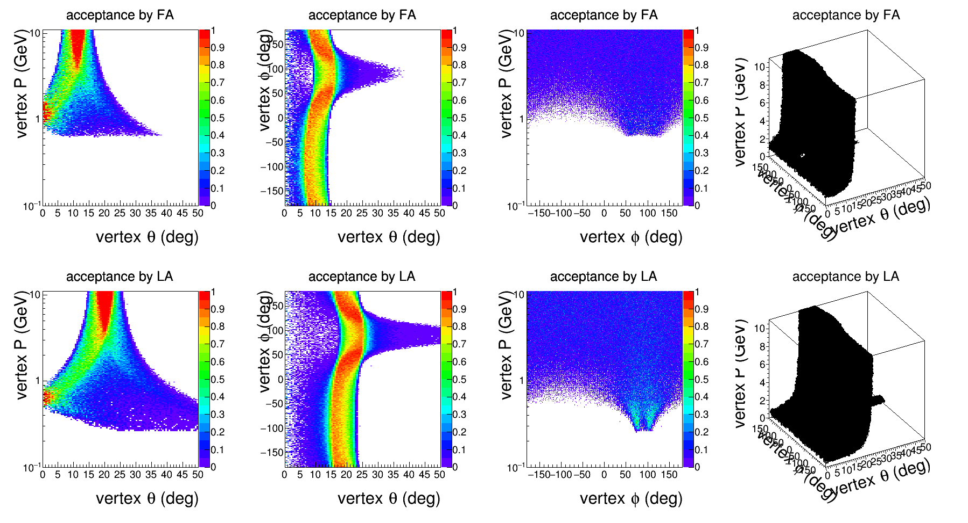
Pi- Acceptance without sheet of flame cut
Oxford field

Slide 10
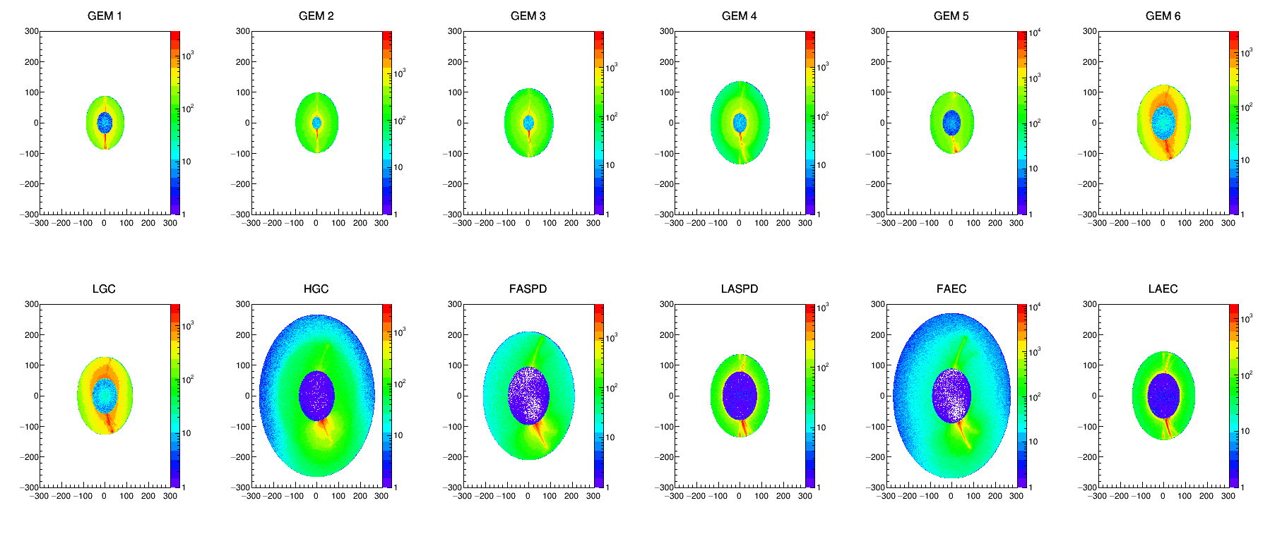
Particle counts at detector entrance from BeamOnTarget in Y vs X
Wrong field

Slide 11
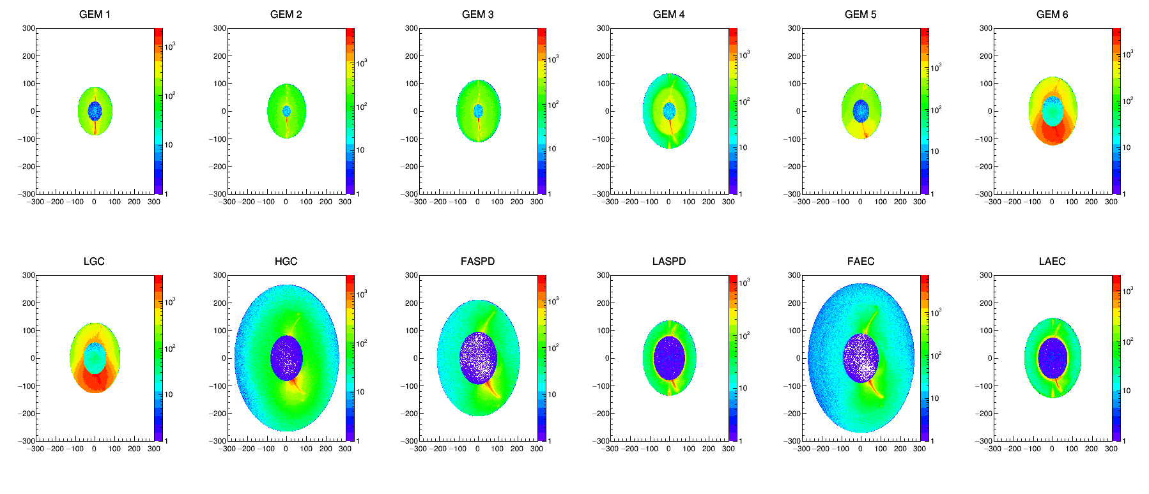
Particle counts at detector entrance from BeamOnTarget in Y vs X
g2p field

Slide 12
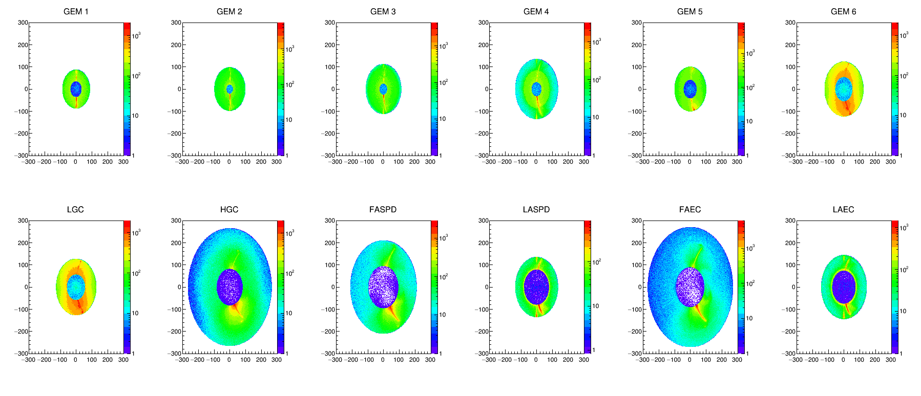
Particle counts at detector entrance from BeamOnTarget in Y vs X
Oxford field

Slide 13
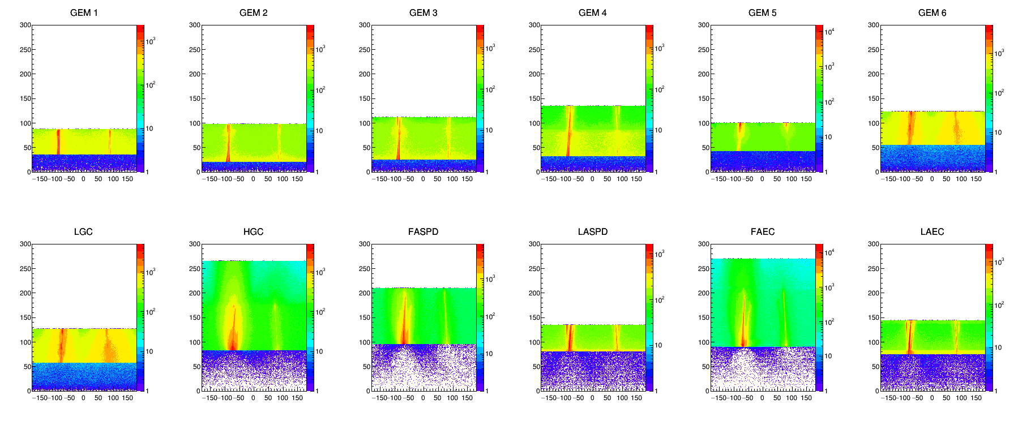
Particle counts at detector entrance from BeamOnTarget in R vs Phi
Wrong field

Slide 14
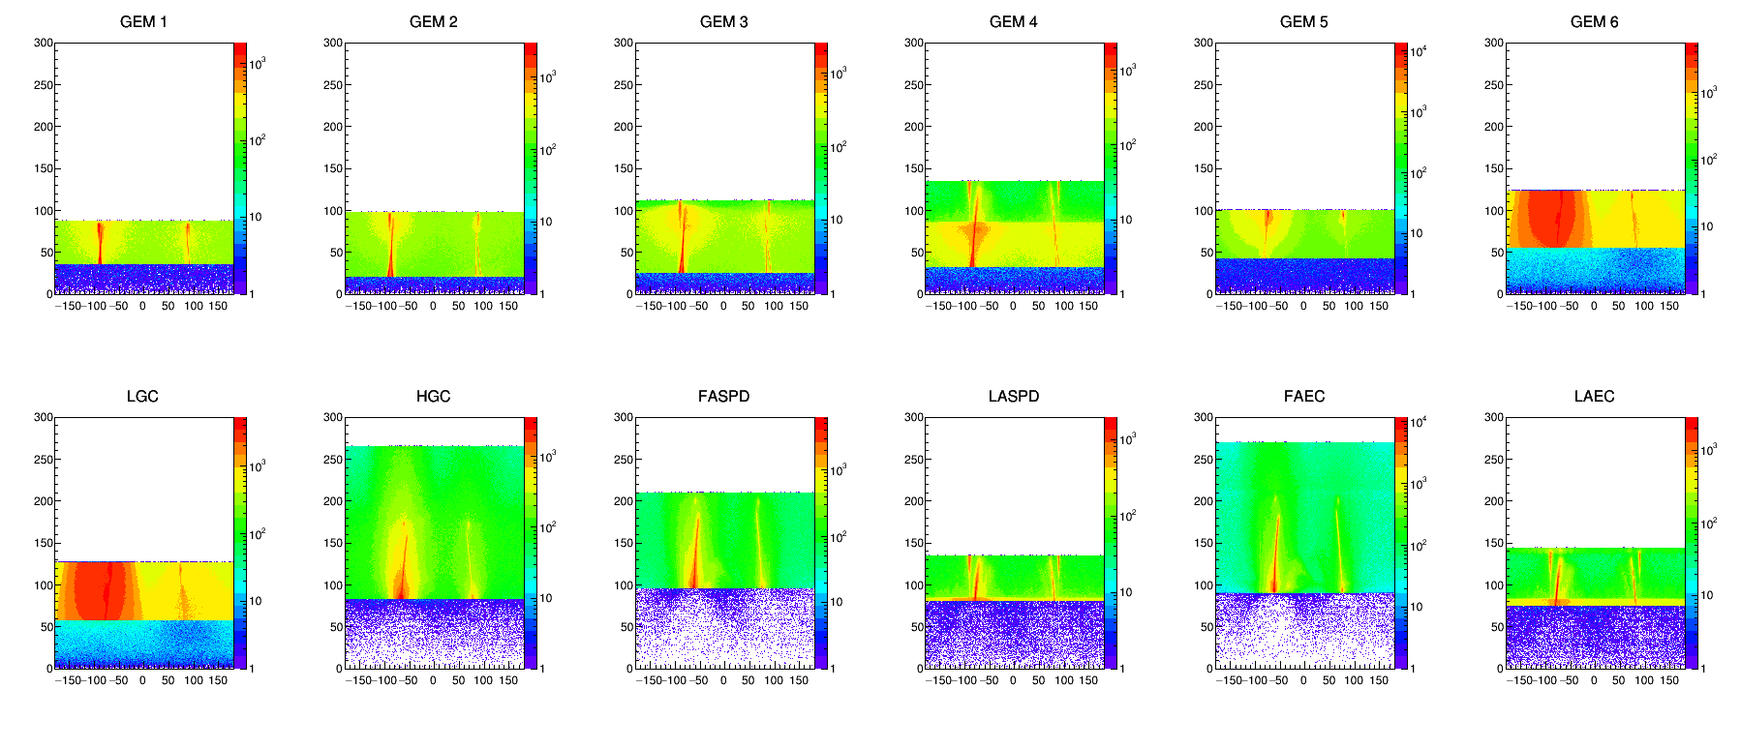
Particle counts at detector entrance from BeamOnTarget in R vs Phi
g2p field

Slide 15
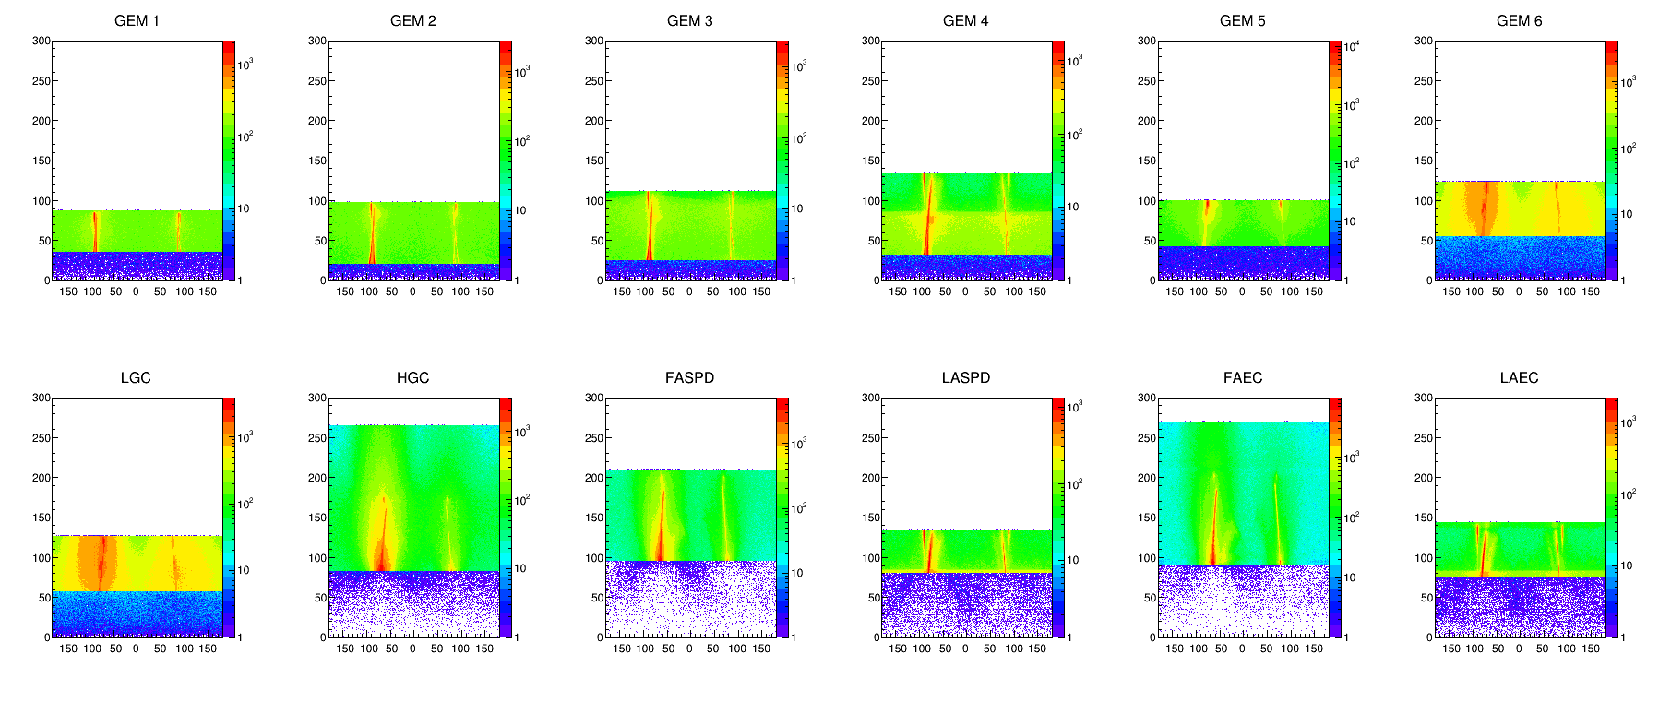
Particle counts at detector entrance from BeamOnTarget in R vs Phi
Oxford field

Slide 16
Oxford magnet detail

Slide 17
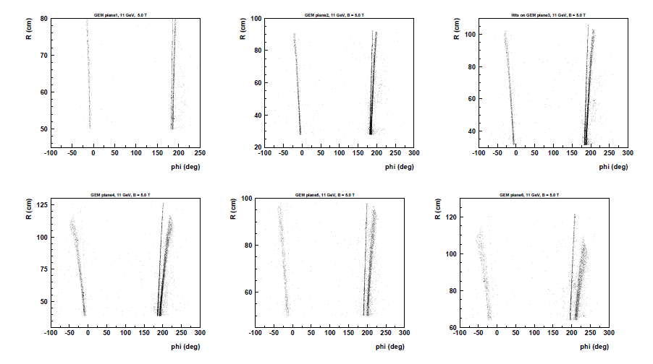
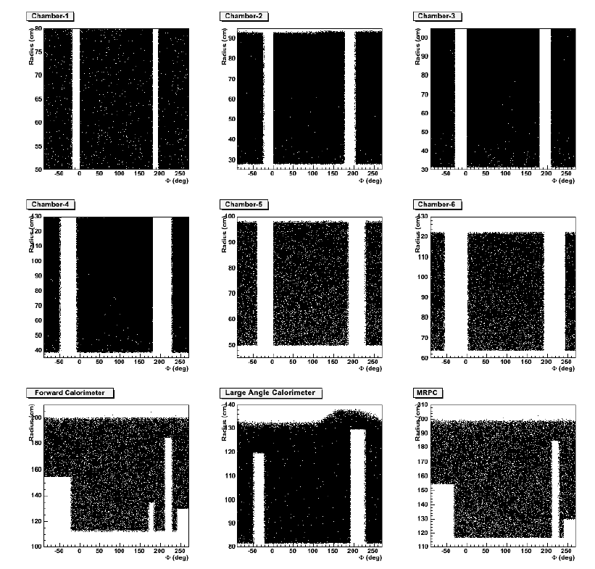
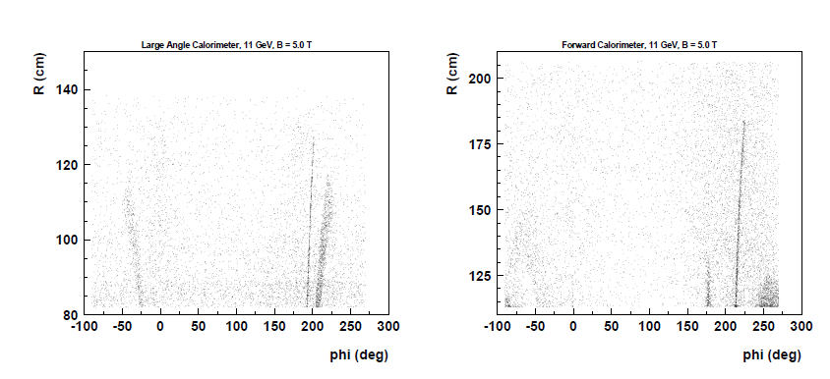
g2p target field is used in the proposal stage, but its map has some errors and cause about 10% larger field integral
Chao Gu and Chao Peng
update in 2012
Original proposals in 2011

Slide 18
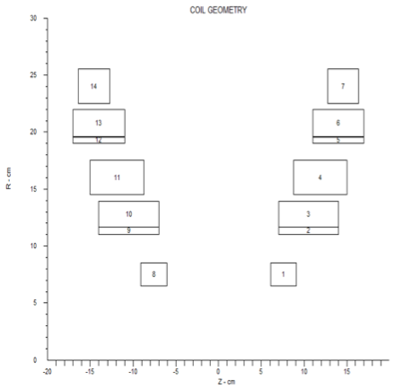
Oxford 2012 field map
Chao Gu
New Helmholtz coil set for SoLID NH3 target designed by Oxford
The currently using field map is the g2p target field map
No ferromagnetism material and cylindrical symmetric, the field map could be calculated by Biot-Savart Law with a 2-D current density distribution
g2p has a code to do this calculation, it is updated with the characteristics of the new coil set
Black: new coils
Red: g2p coils
8
4
7
3
6
2
5
1

Slide 19
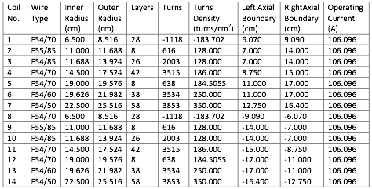
Oxford 2012 field map
Chao Gu
The calculation is consistent
From the design report, the central field of the new coil set is 5.0 T at 106.0958 A current (this is the only known field value for this coil in the design report)
The central field calculated with the code reads 4.9996 T, so it is consistent with the design report
Coil Characteristics

Slide 20
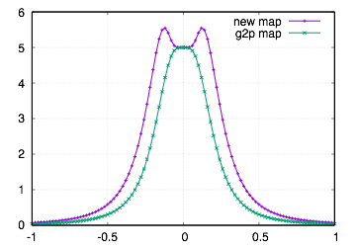
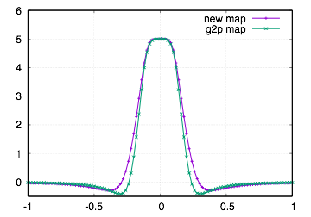
Oxford 2012 field map
Chao Gu
Compare the field map of this new field with the g2p field map, the symmetric axis of the coils is along z axis in the lab system
The integrated BdL of the new field map is
42% larger than the g2p field map (longitudinal setting)
15% larger than the g2p field map (transverse setting)
Bz/T
Bz/T
Bz vs z
r = 0
Bz vs r
z = 0
z/m
r/m

Slide 21
backup

Slide 22
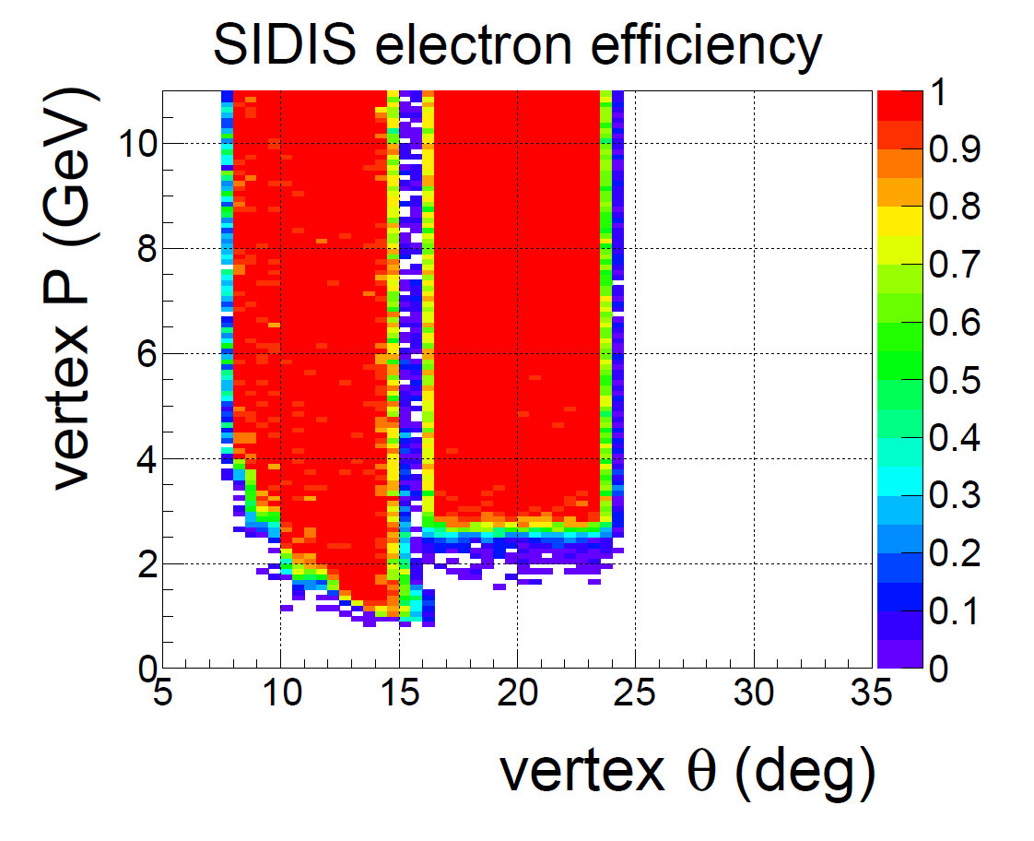
EC only simulation, vz(-355,-345)cm eff_EC > 98%
Trigger condition

Slide 23
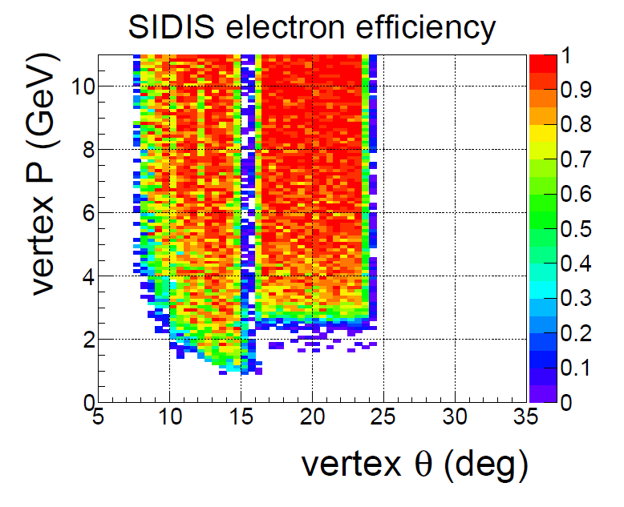
full simulation, vz(-355,-345)cm (eff_FAEC & eff_LGC & eff_FASPD) > 88%, (eff_LAEC & eff_LASPD) > 95%
Trigger condition

Slide 24
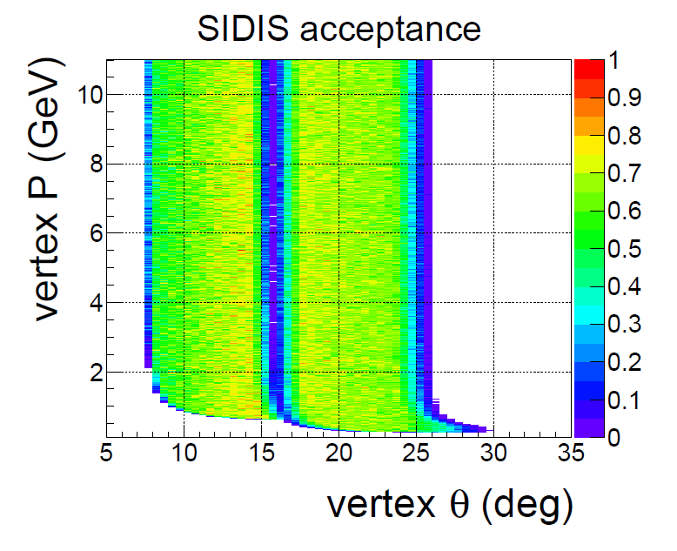
No material simulation, vz(-370,-330)cm acc > 70%

Slide 25
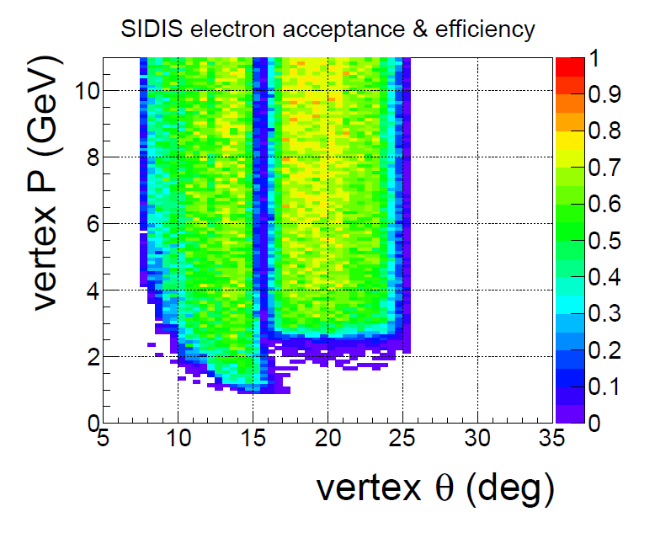
full simulation, vz(-370,-330)cm (eff_FAEC&eff_LGC&eff_FASPD)&acc>60%, (eff_LAEC&eff_LASPD)&acc>70%
Trigger condition

Slide 26
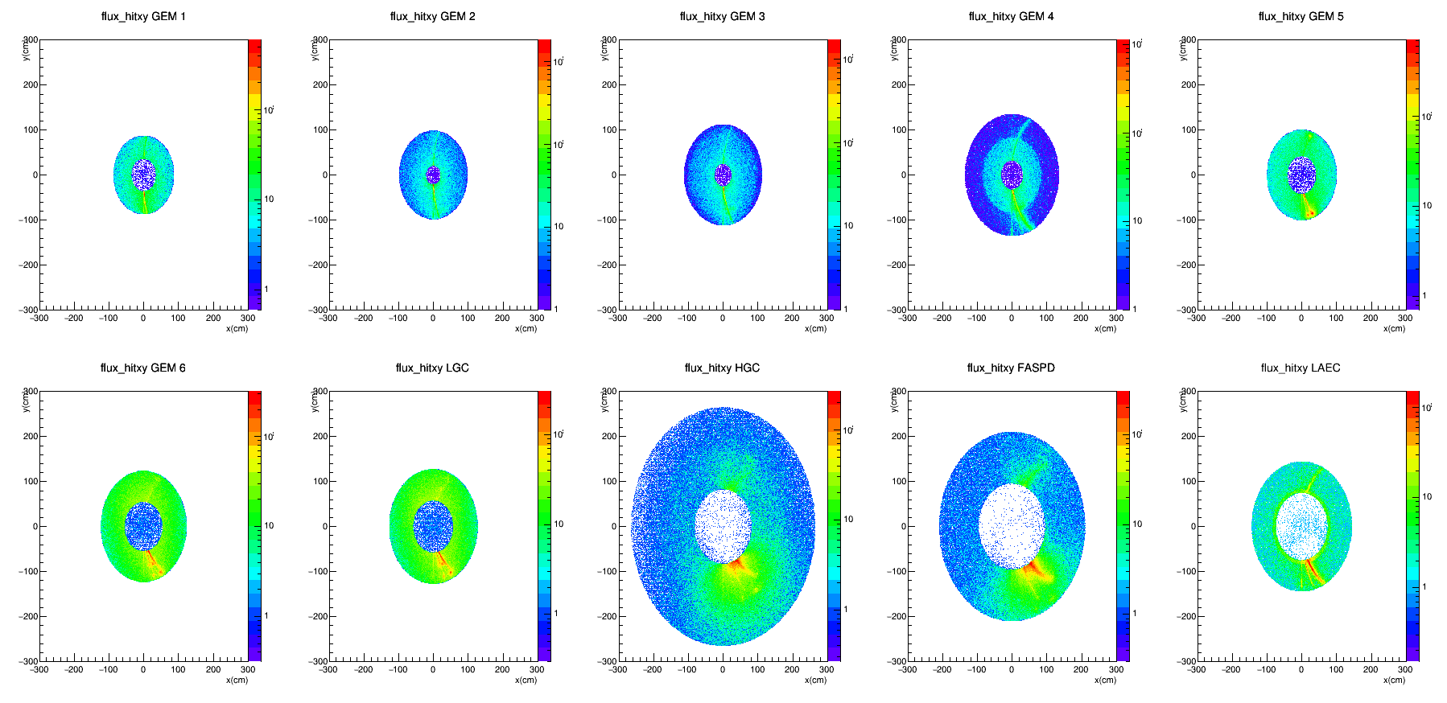
hits

Slide 27
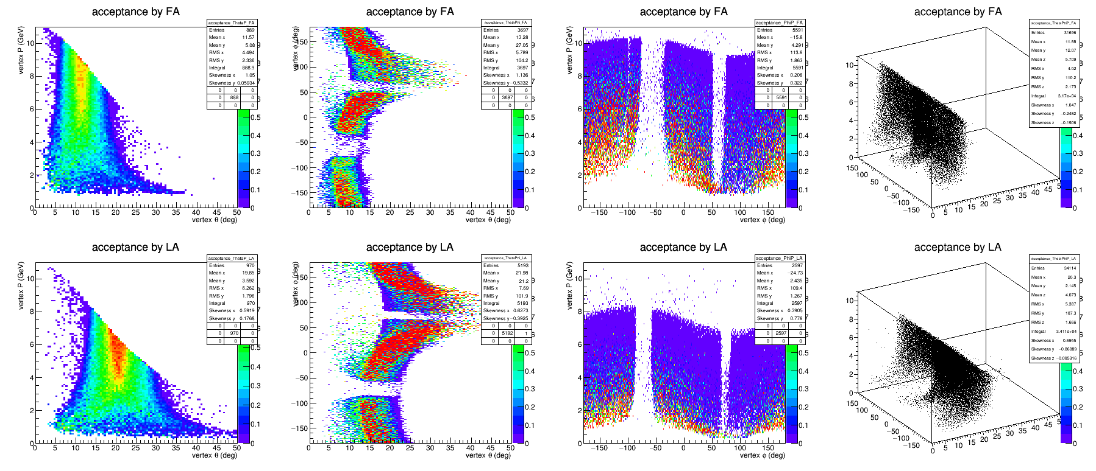
eDIS accepted by EC and GEM after cutting on sheet of flame

