Slide 1
SIDIS Background and Trigger
Zhiwen Zhao
2013/11/18 Created
2014/07/06 Updated

Slide 2
Intro
“Zhiwen” study
Use latest SIDIS He3 configuration and GEMC and CLEO magnet
“Xin” study
Xin’s latest study in 2012/06 with Comgeant and Babar magnet
Detector configuration is very similar to “Zhiwen”
https://hallaweb.jlab.org/dvcslog/SoLID/25

Slide 3
SIDIS EC electron trigger (flat)
Electron trigger Assumption
trig_eff (P>Max)=trig_eff(P=Max)
trig_eff (P<Min)=0
trig_eff_Proton = 0.5*trig_eff_pion

Slide 4
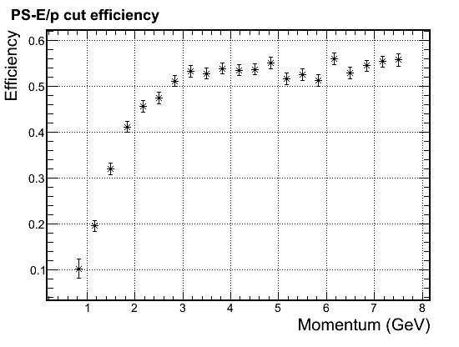
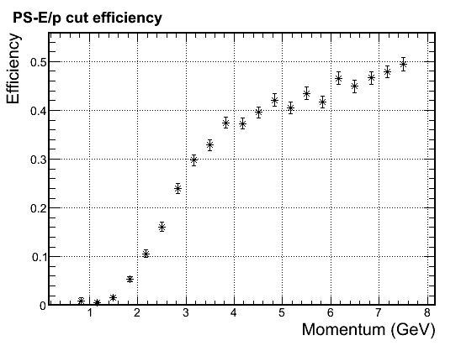
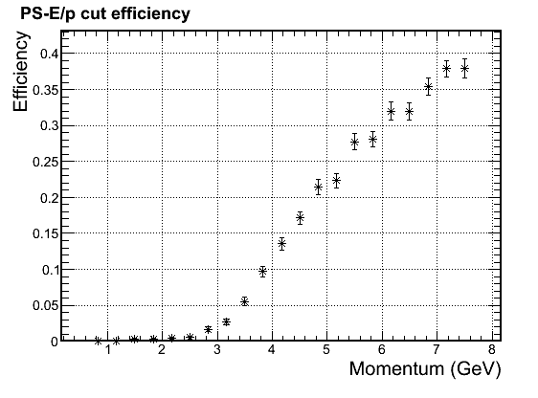
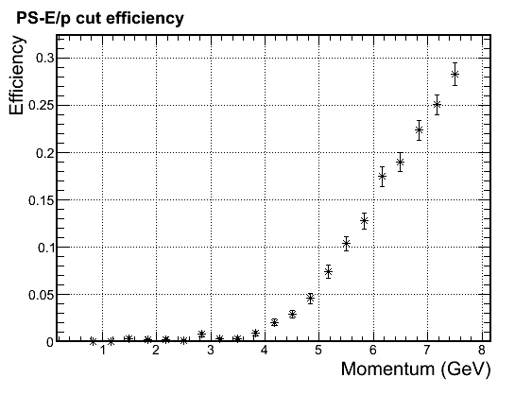
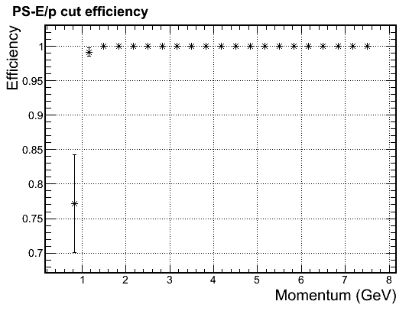
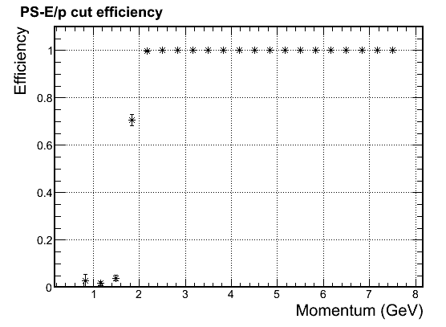
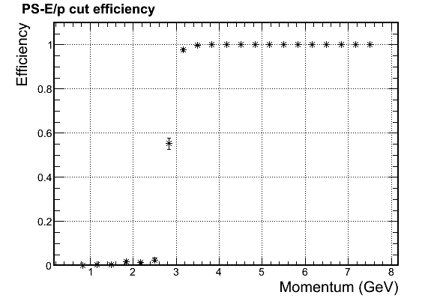
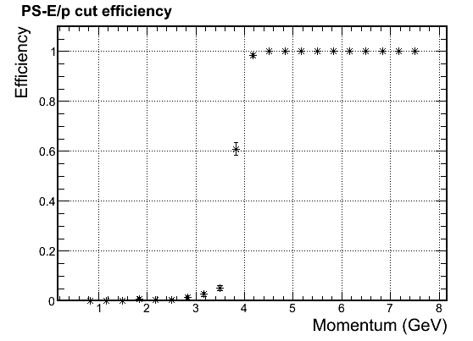
SIDIS FAEC electron trigger (radial below Q2=1)
Electron trigger Assumption
trig_eff (P>Max)=trig_eff(P=Max)
trig_eff (P<Min)=0
trig_eff_Proton = 0.5*trig_eff_pion
Radius(cm) P Threshold (GeV)
90 - 110 4.0
110 - 125 3.0
125 - 145 2.0
145 - 230 1.0
4 points cut, about 0.5GeV below Q2=1 line
Acceptance for SoLID CLEO and 40 long target

Slide 5
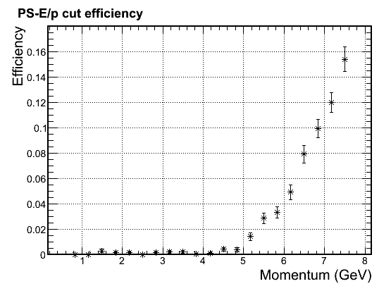
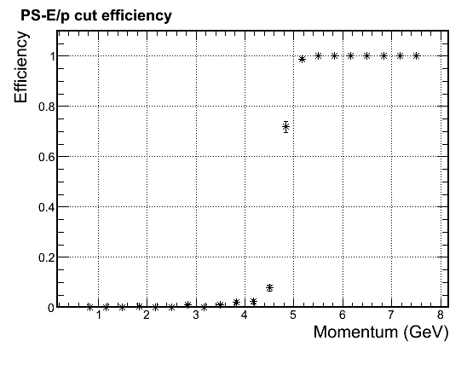
SIDIS FAEC electron trigger (radial on Q2=1)
Electron trigger Assumption
trig_eff (P>Max)=trig_eff(P=Max)
trig_eff (P<Min)=0
trig_eff_Proton = 0.5*trig_eff_pion
If (trig_eff<0.01) trig_eff = 0
Radius(cm) P Threshold (GeV)
90 - 105 5.0
105 - 115 4.0
115 - 130 3.0
130 - 150 2.0
150 - 200 1.0
200 - 230 2.0
6 point cut, right on Q2=1 line and field bend line
Acceptance for SoLID CLEO and 40 long target

Slide 6
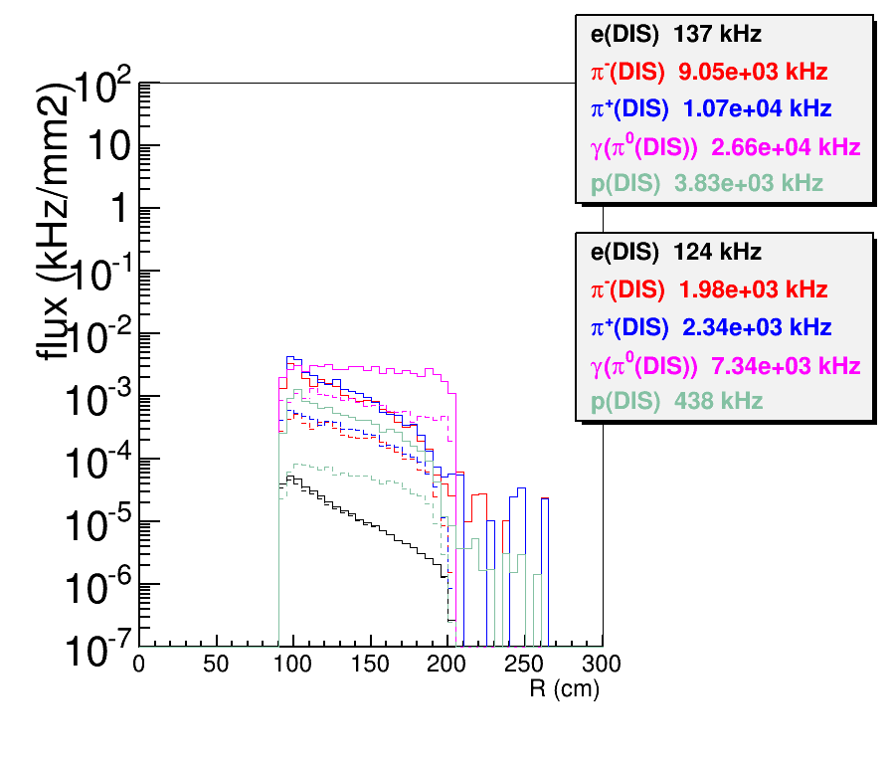
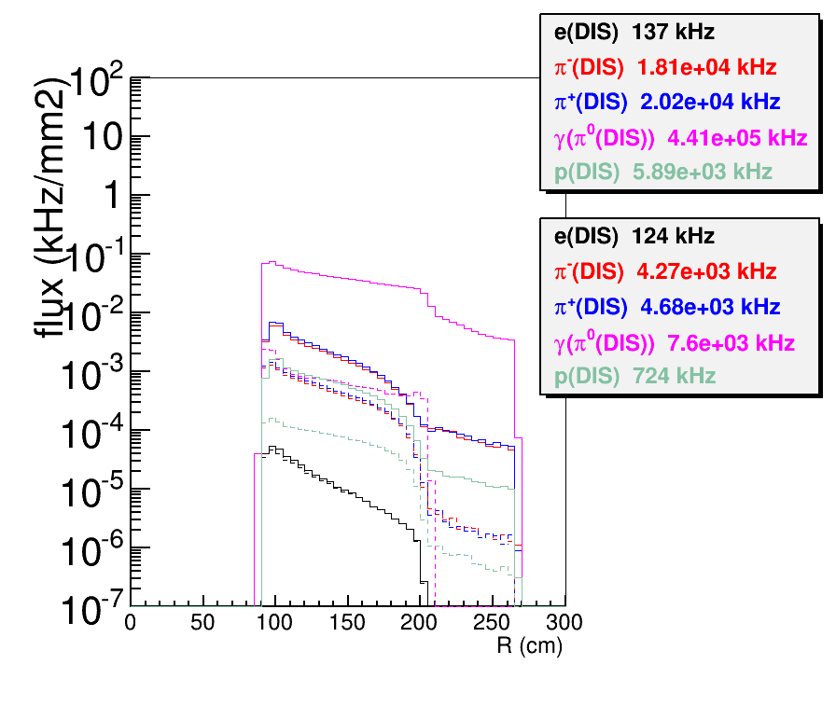
FAEC electron trigger rate (flat)
FAEC geometry: Z_front=415cm, R(90,230)cm
Shows rate before and after trigger cut
“Kryptonite”: all rate from He3 by eicRate, everything is kryptonite including target collimator, so no secondary
“Tungsten”: all rate from He3 and target window by eicRate, everything is real material including target collimator as Tungsten, so secondary are present. Only “eDIS” is like “Kryptonite” case
Kryptonite
Tungsten

Slide 7
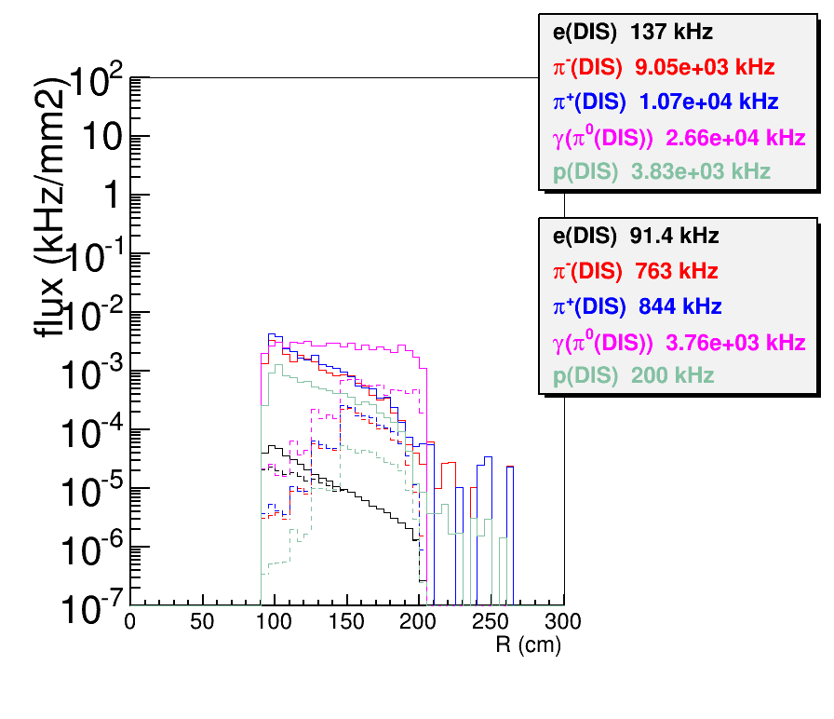
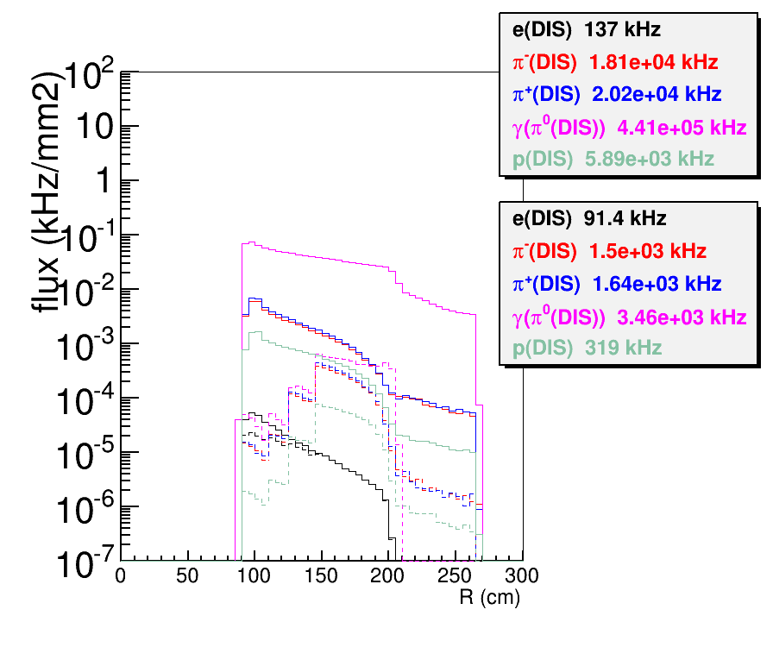
FAEC electron trigger rate (radial below Q2=1)
FAEC geometry: Z_front=415cm, R(90,230)cm
Shows rate before and after trigger cut
“Kryptonite”: all rate from He3 by eicRate, everything is kryptonite including target collimator, so no secondary
“Tungsten”: all rate from He3 and target window by eicRate, everything is real material including target collimator as Tungsten, so secondary are present. Only “eDIS” is like “Kryptonite” case
Kryptonite
Tungsten

Slide 8
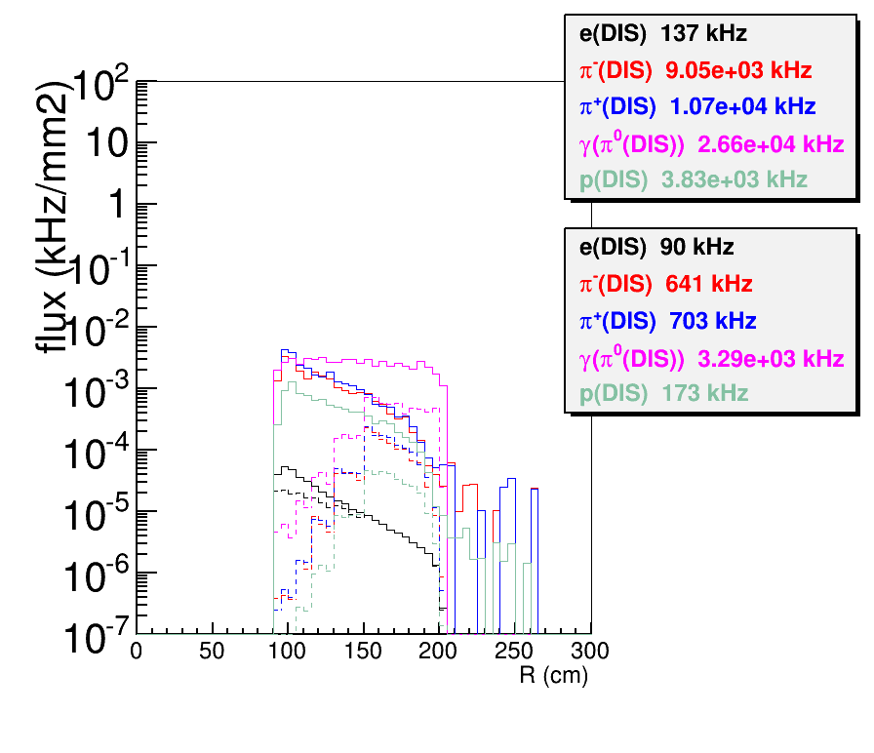
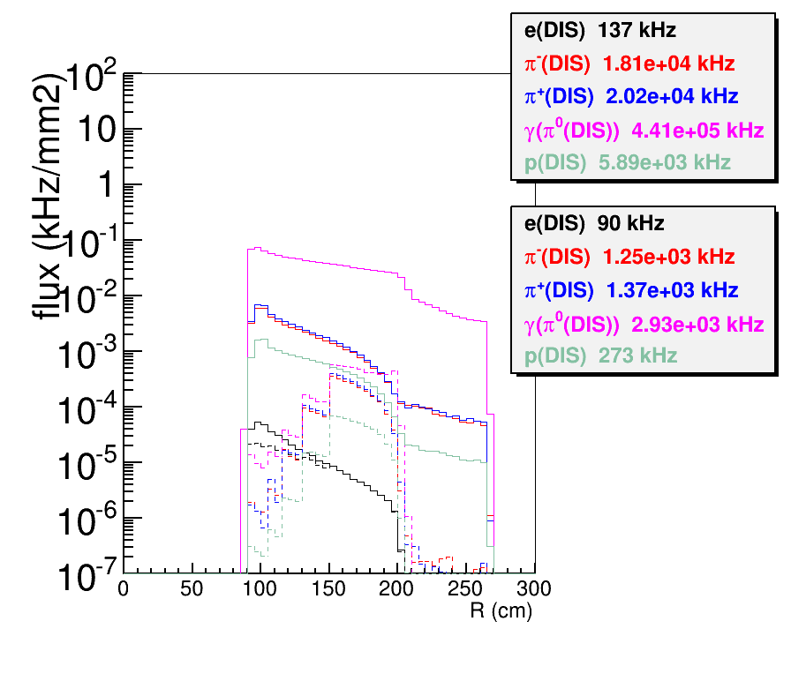
FAEC electron trigger rate (radial on Q2=1)
FAEC geometry: Z_front=415cm, R(90,230)cm
Shows rate before and after trigger cut
“Kryptonite”: all rate from He3 by eicRate, everything is kryptonite including target collimator, so no secondary
“Tungsten”: all rate from He3 and target window by eicRate, everything is real material including target collimator as Tungsten, so secondary are present. Only “eDIS” is like “Kryptonite” case
Kryptonite
Tungsten

Slide 9
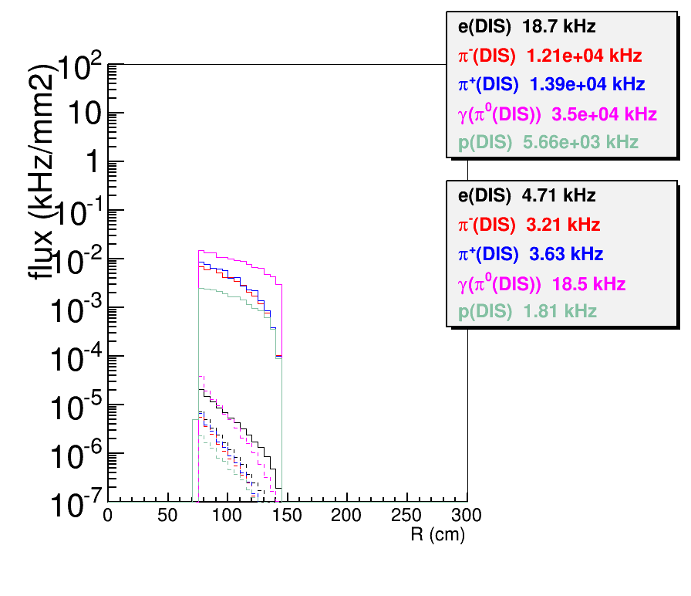
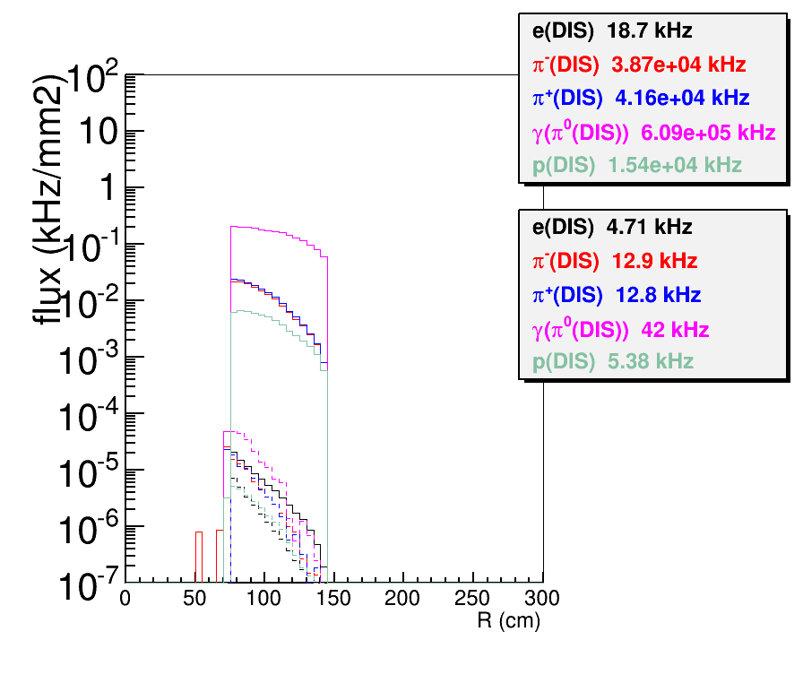
LAEC electron trigger rate (flat)
LAEC geometry: Z_front=-65cm, R(80,140)cm
Shows rate before and after trigger cut
“Kryptonite”: all rate from He3 by eicRate, everything is kryptonite including target collimator, so no secondary
“Tungsten”: all rate from He3 and target window by eicRate, everything is real material including target collimator as Tungsten, so secondary are present. Only “eDIS” is like “Kryptonite” case
Kryptonite
Tungsten

Slide 10
Rate (kHz) full azimuthal |  | FAEC |  |  |  | LAEC
 |  | Zhiwen |  |  | Xin | Zhiwen | Xin
e-(W>2) | Kry | 137 |  |  | 55 | 18.7
π- | Kry | 9.05e3 |  |  |  | 1.21e4
 | Tung | 1.81e4 |  |  | 5.4e3 | 3.87e4
π⁺ | Kry | 1.07e4 |  |  |  | 1.39e4
 | Tung | 2.02e4 |  |  | 9.0e3 | 4.16e4
γ(π⁰) | Kry | 2.66e4 |  |  | 605 | 3.50e4
 | Tung | 4.41e5 |  |  |  | 6.09e5
e (π⁰) | Kry | 38.4 |  |  |  | 39.3
 | Tung | 2.1e4 |  |  |  | 5.1e3
p | Kry | 3.83e3 |  |  |  | 5.65e3
 | Tung | 5.89e3 |  |  |  | 1.54e4
e-(W>2) | kry | 124 | 91.4 | 90 | 41 | 4.7 | 13
π- | Kry | 1.98e3 | 763 | 641 |  | 3.21
 | Tung | 4.27e3 | 1.50e3 | 1.25e3 | 2.9e3 | 12.9 | 41/20
π⁺ | Kry | 2.34e3 | 844 | 703 |  | 3.63
 | Tung | 4.68e3 | 1.64e3 | 1.37e3 | 4.8e3 | 12.8 | 58/20
γ (π⁰) | Kry | 7.34e3 | 3.76e3 | 3.29e3 | 462 | 18.5 | 31
 | Tung | 7.60e3 | 3.46e3 | 2.93e3 |  | 42
e (π⁰) | Kry |  |  | 4.8 |  | 0
 | Tung |  |  | 202 |  | 0.8
p | Kry | 438 | 200 | 173 |  | 1.81
 | Tung | 724 | 319 | 273 | 2e3 | 5.38
Total | Tung | 17.4e3 | 7.0e3 | 6.3e3 |  | 77.8 | 44
Top section:
EC untriggered rate
Bottom section:
EC triggered rate with electron single trigger
Gamma from pi0
trigger rate should
divide by a number 1- 2 as both photons give
one trigger only.
Need more study with FAEC and LAEC together
eDIS(W>2,Q2>1) from “eicRate”
at FAEC has 76kHz before trigger, 76kHz after trigger radial on Q2=1
at LAEC has 14.3kHz before trigger, 4.7kHz after trigger flat
flat
Radial below
Radial on
flat

Slide 11
Background from π⁰
tungsten, trigger radial on Q2=1
A lot of high energy electron,positron,gamma from pi0 on FAEC, dominant by target, not window
Some of them should from target cell wall and other materials in flight path
Rate (kHz) full azimuthal | He3 | Windown upstream | Window Downstream | Total
γ (π⁰) FAEC | 2.83e3 | 4.85 | 95.2 | 2.93e3
e (π⁰) FAEC | 192 | 0.30 | 9.7 | 202
γ (π⁰) LAEC | 14.6 | 16.4 | 11.0 | 42
e (π⁰) LAEC | 0.52 | 0.25 | 0.07 | 0.8
γ (π⁰) LGCC |  |  |  | 1.41e3
e (π⁰) LGCC |  |  |  | 55
If we assume LGCC and FAEC has about same angle vs radius relation, we have about 55kHz electron and positron produced before LGCC and they will trigger FAEC and can’t be rejected by LGCC
LGCC and FAEC angle vs radius relation doesn’t hold that well because charged particles are turning in-between, This rate needs more study.
e(pi0)
pi-
Tung
pi+
γ(pi0)
p
FAEC,
Before
cut
FAEC,
After
cut

Slide 12
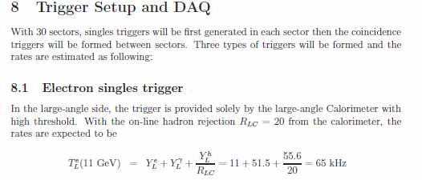
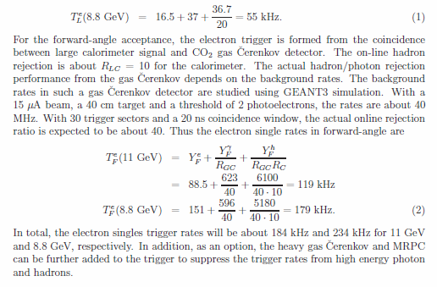
electron single trigger rate
PAC35 proposal text
Try similar method from PAC35 proposal
Assume
SPD reject gamma by 10, SPD and MRPC together to reject gamma from pi0 by 20
Add EC preshower cut will reduce hadron by 2, electron and gamma by 5%
LGCC with p.e. >=2 and random coincidence reject by
4=1/(30*(220kHz+65kHz)*30ns) for whole area
40 for 3 sectors
120 for 1 sector
LGCC with p.e.>2 for correlated coincidence for hadron reject by
55=1/(30*20kHz*30ns) for whole area
FAEC (trigger radial on Q2=1)
215kHz
=90+55+(202-55)/40+2930/20/40+2900/2/40+2900/2/55
=90(eDIS)+
55(e(π⁰) front)+3.6(e(π⁰) back) +3.7(γ(π⁰))+
36(hadron rand. coin.)+ 26(hadron corr. coin.)
LAEC (trigger flat)
41kHz
= 4.7+0.8+42/10+31.1
= 4.7(eDIS)+0.8(e(π⁰))+8.4(γ(π⁰))+31.1(hadron)
Xin’s study
Single electron trigger @ 11 GeV:
–Forward angle: 41 kHz (electron) + 9.7 MHz (hadron)/ 400 + 462 (photon)/40 ~ 77 kHz.
–Large angle: 14.3 kHz (electron) + 31 kHz (photon) ~ 44 kHz.
•Total: 121 kHz.

Slide 13
SIDIS EC MIP Trigger (rough)
MIP trigger Assumption
trig_eff (P>Max)=trig_eff(P=Max)
trig_eff (P<0.22GeV) = 0
trig_eff (0.22GeV<P<Min)=0.8*trig_eff (P=Min)
trig_eff_Proton = trig_eff_pion

Slide 14
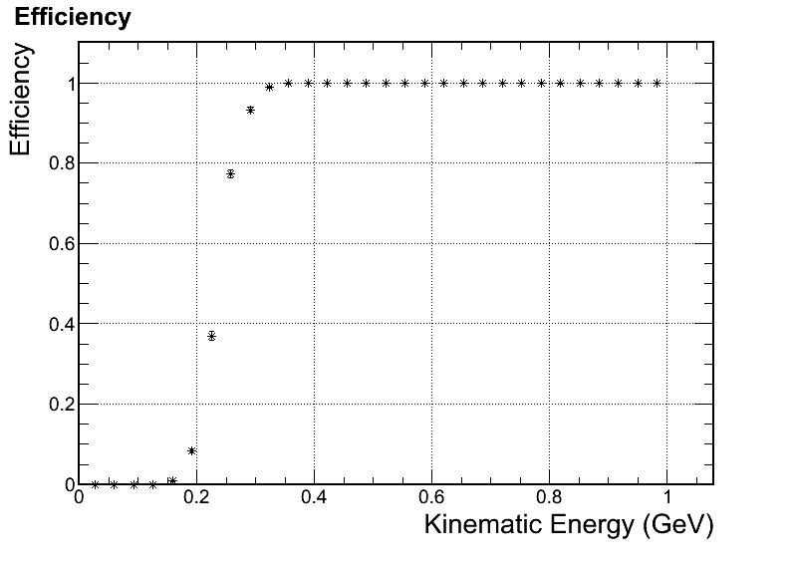
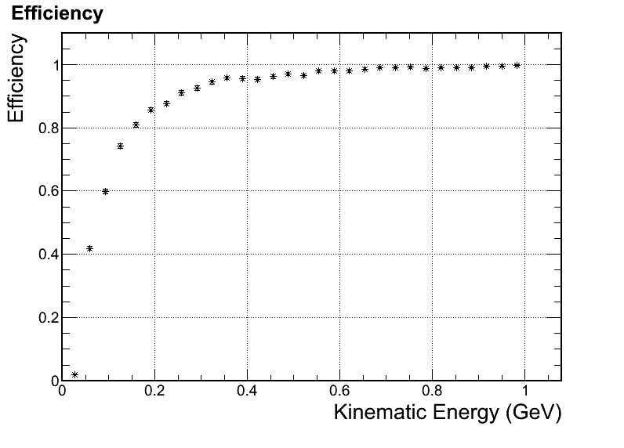
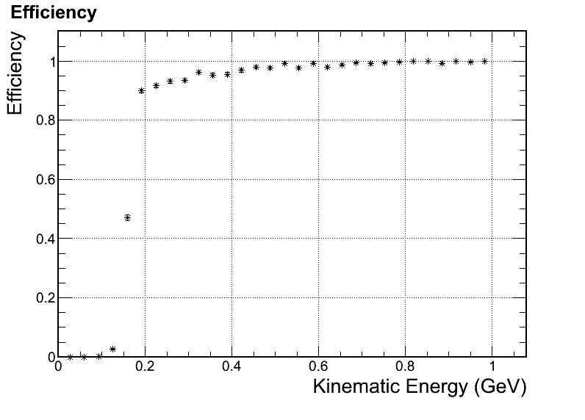
SIDIS EC MIP Trigger (100%)
Detailed study at low energy, cut at ~200MeV to ensure pion eff is 100% at Ek=1GeV
Independent curve for all 4 particles
MIP trigger Assumption
trig_eff (Ek>Max)=trig_eff(P=Max)
trig_eff (Ek<Min)=0
If (trig_eff<0.01) trig_eff = 0
e
gamam
pion
p

Slide 15
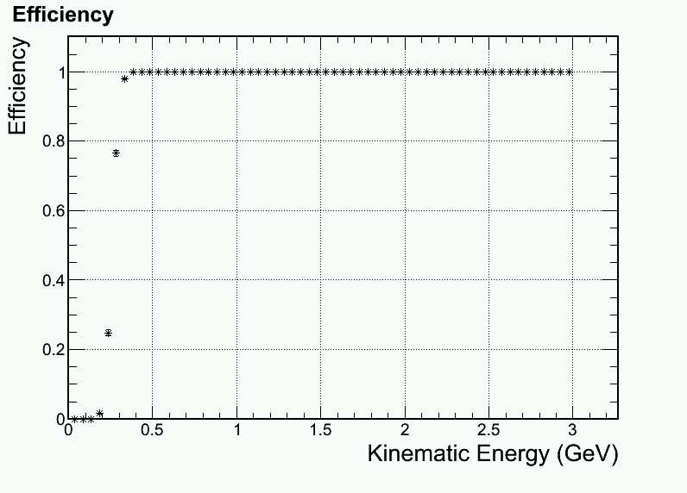
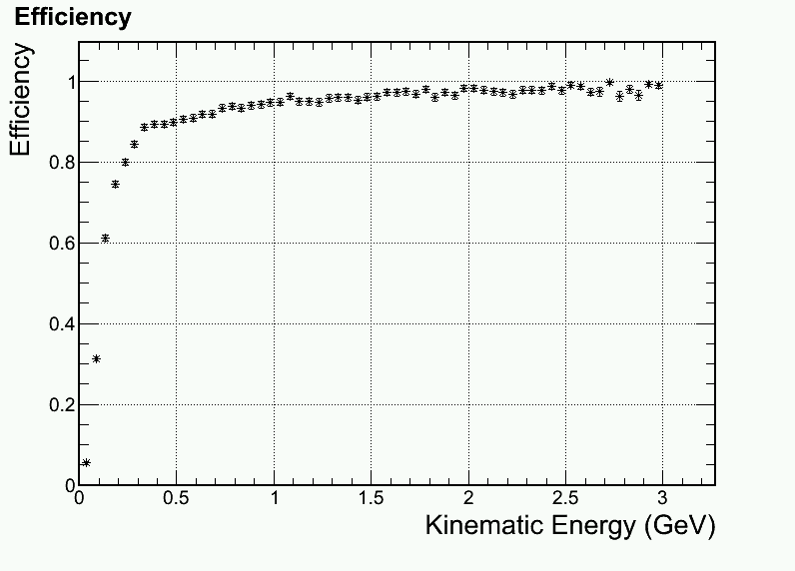
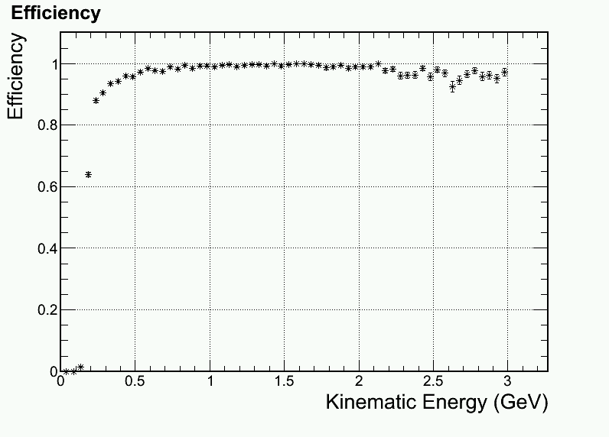
SIDIS EC MIP Trigger (95%)
Detailed study at low energy, cut a bit higher than ~200MeV to ensure pion eff is 95% at Ek=1GeV
Independent curve for all 4 particles
MIP trigger Assumption
trig_eff (Ek>Max)=trig_eff(P=Max)
trig_eff (Ek<Min)=0
If (trig_eff<0.01) trig_eff = 0
e
gamam
pion
p

Slide 16
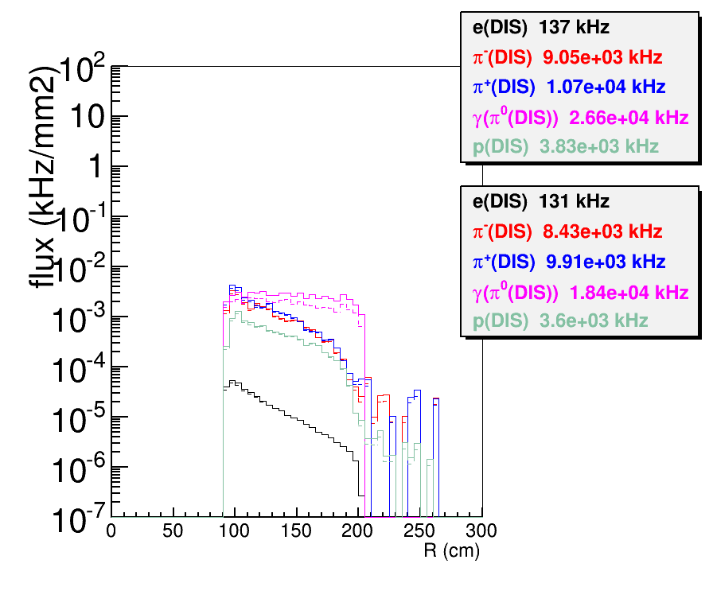
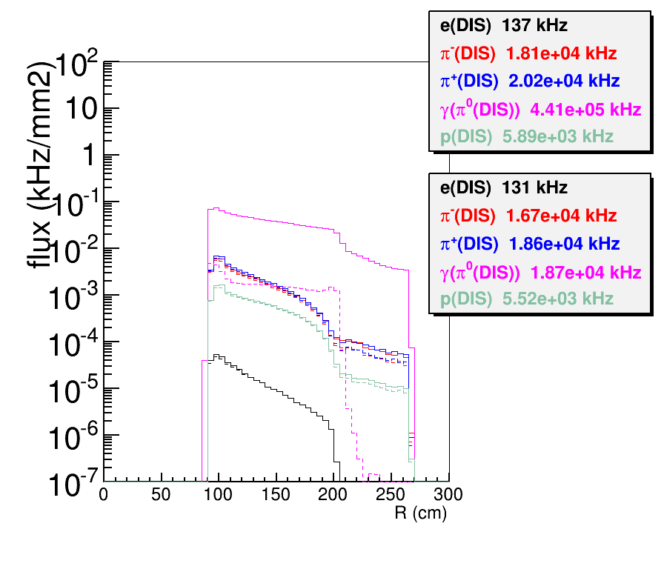
FAEC MIP trigger rate (rough)
FAEC geometry: Z_front=415cm, R(90,230)cm
Shows rate before and after trigger cut
“Kryptonite”: all rate from He3 by eicRate, everything is kryptonite including target collimator, so no secondary
“Tungsten”: all rate from He3 and target window by eicRate, everything is real material including target collimator as Tungsten, so secondary are present. Only “eDIS” is like “Kryptonite” case
Kryptonite
Tungsten

Slide 17
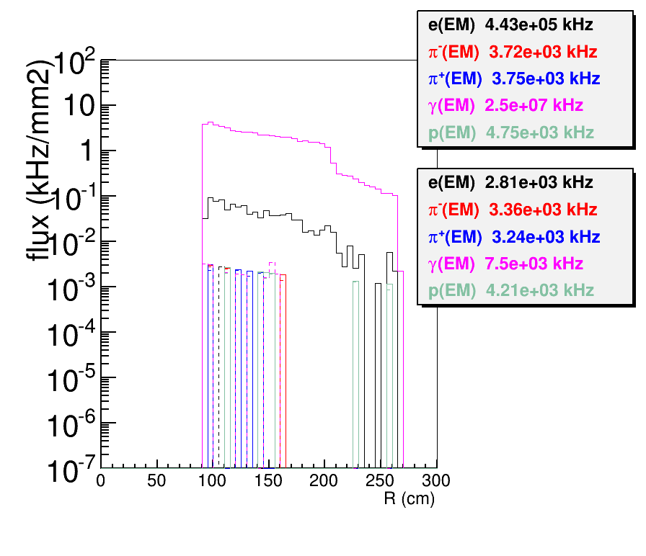
FAEC MIP trigger rate by EM photon
We ran 1e8 electron on target with all real materials and all physics
For 15 uA running condition, the normalization factor is 1e6=15e-6/1.6e-19/1e8
There is too small enough statistics of gamma passing the cut to have an accurate estimate, need a lot more
We might be able to claim no photon in EM process pass the cut
High energy gamma might be from pi0 production and thus over counting.
But PAC35 proposal has 200MHz soft photon passing 200MeV cut, comparing to 600kHz hard photon from pi0

Slide 18
Rate (kHz) full azimuthal |  | FAEC
 |  | Zhiwen |  |  | Xin
e-(W>2) | Kry | 137
π- | Kry | 9.05e3
 | Tung | 1.81e4
π⁺ | Kry | 1.07e4
 | Tung | 2.02e4
γ(π⁰) | Kry | 2.66e4
 | Tung | 4.41e5
e (π⁰) | Kry | 38.4
 | Tung | 2.1e4
p | Kry | 3.83e3
 | Tung | 5.89e3
e-(W>2) | kry | 131 | 137 | 137
π- | Kry | 8.43e3 | 8.93e3 | 8.48e3
 | Tung | 1.67e4 | 1.77e4 | 1.68e4 | 5.7e3 (all neg hadron
π⁺ | Kry | 9.91e3 | 1.05e4 | 1.00e4
 | Tung | 1.86e4 | 1.97e4 | 1.87e4 | 12.6e3 (all pos hadron)
γ (π⁰) | Kry | 1.84e4 | 2.06e4 | 1.99e4
 | Tung | 1.87e4 | 2.11e4 | 2.02e4
e (π⁰) | Kry |  | 38 | 38
 | Tung |  | 2.5e3 | 2.36e3
p | Kry | 3.60e3 | 3.61e3 | 3.49e3
 | Tung | 5.52e3 | 5.41e3 | 5.23e3
Total | Tung | 6.2e4 | 6.7e4 | 6.1e4 | 20e3
Top section:
EC untriggered rate
Bottom section:
EC triggered rate with MIP trigger
Gamma from pi0
trigger rate should
divide by a number 1- 2 as both photons give
one trigger only.
Need more study with FAEC and LAEC together
rough
100%
95%

Slide 19
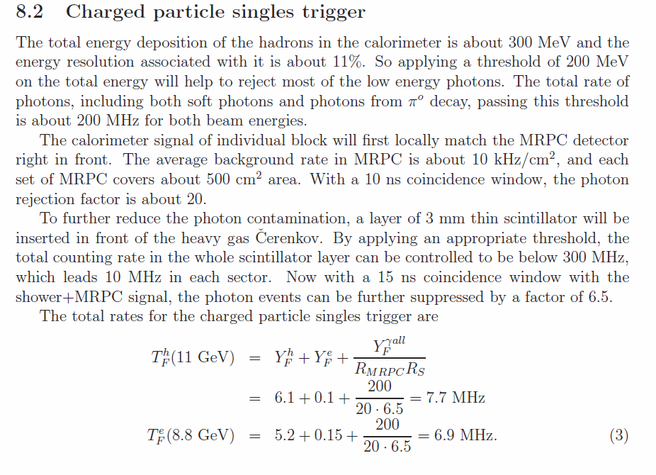
Charged particle single trigger rate
Try similar method from PAC35 proposal
Question about PAC35 proposal
Why EM photon pass 200MeV cut has 200Mhz rate?
Assume
EM photon can’t pass trigger (???)
SPD and MRPC together to reject gamma from pi0 by 20
HGCC can give a factor of ???
FAEC (trigger 100%)
46.5MHz
=0.137+42.8+2.5+21.1/20
= 0.137(eDIS)+42.8(hadron)+2.5(e(π⁰))+1.1(γ(π⁰))
Xin’s study
Single hadron trigger @ 11 GeV:
–~20 MHz

Slide 20
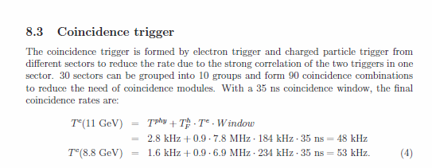
Coincidence trigger rate
2.8kHz+0.9*256kHz*46.5Mhz*30ns = !!!
Try similar method from PAC35 proposal
Borrow PAC35 SIDIS physics rate 2.8kHz
electron single trigger rate, FEAC 215kHz, LAEC 41kHz, total 256kHz
Charged particle single trigger rate, FEAC 40MHz
Time window 30ns
Xin’s study
121e3*20e6 * 35e-9 ~ 85 kHz

Slide 21
Trigger with 40% of hadron from eicrate
Dec 2013
Electron trigger
FAEC (trigger radial on Q2=1)
140kHz
=90+(55+(202-55)/40+2930/20/40+2900/2/40+2900/2/55)*0.4
=90(eDIS)+22(e(π⁰) front)+1.47(e(π⁰) back) +1.47(γ(π⁰))+14.5(hadron rand. coin.)+10.65(hadron corr. coin.)
LAEC (trigger flat)
19.1kHz
= 4.7+(0.8+42/10+31.1)*0.4
= 4.7(eDIS)+0.32(e(π⁰))+1.68(γ(π⁰))+12.44(hadron)
Charged particle trigger
FAEC (trigger 100%)
18.7MHz
=0.137+(42.8+2.5+21.1/20)*0.4
= 0.137(eDIS)+17.1(hadron)+1(e(π⁰))+0.4(γ(π⁰))
Coincidence trigger
Random coincidence rate 89.3kHz = (140+19.1)kHz*18.7Mhz*30ns
SIDIS physics rate 2.8kHz (need update)
Total rate 92.1kHz
This has not included the impact on other detector rate and rejection other than EC,
so the rate should be less.

Slide 22
Background from π⁰
Update Jan 2014
tungsten, trigger radial on Q2=1
A lot of high energy electron,positron,gamma from pi0 on FAEC, dominant by target, not window
Some of them should from target cell wall and other materials in flight path
Rate (kHz) full azimuthal | He3 | Windown upstream | Window Downstream | Total | Total (Zhiwen)
γ (π⁰) FAEC | 2.55e3 | 4 | 84.3 | 2.64e3 | 2.93e3
e (π⁰) FAEC | 110.1 | 0.3 | 3.8 | 115 | 202
γ (π⁰) LAEC | 6.28 | 5.88 | 7.38 | 20 | 42
e (π⁰) LAEC | 0.23 | 0 | 0.14 | 0.4 | 0.8
γ (π⁰) LGCC | 1.93e3 | 2.5 | 2.7 | 2e3 | 1.41e3
e (π⁰) LGCC | 37.4 | 0 | 2.3 | 40 | 55
p
Based on Zhihong ‘s event-by-event analysis of π⁰ background with same EC trigger condition and no double counting
Comparing to previous Zhiwen study, this removing the possibility of having multiple triggers for one event and the LGCC and EC correlation is treated correctly.
This is only study for FAEC ele trigger, NOT FAEC MIP trigger yet which has small contribution to total FAEC trigger anyhow

Slide 23
Trigger with 40% of hadron from eicrate
Update Jan 2014
Electron trigger
FAEC (trigger radial on Q2=1)
126.8kHz
=90+(40+(115-40)/40+2640/20/40+2900/2/40+2900/2/(55/0.4))*0.4
=90(eDIS)+16(e(π⁰) front)+0.75(e(π⁰) back) +1.32(γ(π⁰))+14.5(hadron rand. coin.)+4.22(hadron corr. coin.)
LAEC (trigger flat)
18.1kHz
= 4.7+(0.4+20/10+31.1)*0.4
= 4.7(eDIS)+0.16(e(π⁰))+0.8(γ(π⁰))+12.4(hadron)
Charged particle trigger
FAEC (trigger 100%)
18.7MHz
=0.137+(42.8+2.5+21.1/20)*0.4
= 0.137(eDIS)+17.1(hadron)+1(e(π⁰))+0.4(γ(π⁰))
Coincidence trigger
Random coincidence rate 81.3kHz = (126.8+18.1)kHz*18.7Mhz*30ns
SIDIS physics rate 2.8kHz (need update)
Total rate 84kHz
Update include new π⁰ background analysis and factor 0.4 for hadron correlated coincidance

Slide 24
Summary
geometry (use full size of EC for background and trigger study)
FAEC : Z_front=415cm, R(90,230)cm
LAEC : Z_front=-65cm, R(80,140)cm
electron trigger
FAEC use “radial on Q2=1” threshold, LAEC use flat 3GeV threshold
FA uses EC(PS+S)+LGCC+SPD+MRPC, LA uses EC(S)+SPD
Charged particle trigger
FAEC uses “100%” trigger threshold
FA uses EC(S)+SPD+MRPC

Slide 25
If EC preshower NOT in ele FAEC trigger, remove factor 2 on hadron rate reduction at FAEC
Dec 2013
FAEC (trigger radial on Q2=1)
165kHz =90+(55+(202-55)/40+2930/20/40+2900/40+2900/55)*0.4
Random coincidence rate
103.3kHz = (165+19.1)kHz*18.7Mhz*30ns
Update Jan 2014
FAEC (trigger radial on Q2=1)
145.5kHz =90+(40+(115-40)/40+2640/20/40+2900/40+2900/(55/0.4))*0.4
Random coincidence rate
91.8kHz = (145.5+18.1)kHz*18.7Mhz*30ns

Slide 26
Rate (kHz) full azimuthal |  | FAEC (ele trigger) |  | FAEC (MIP trigger)
 |  | old | new | old | new
e-(W>2) | Kry | 137 | 93.4 | 137 | 93.4
π- | Kry | 9.05e3 |  | 9.05e3
 | Tung | 1.81e4 | 1.34e4 | 1.81e4 | 1.34e4
π⁺ | Kry | 1.07e4 |  | 1.07e4
 | Tung | 2.02e4 | 1.49e4 | 2.02e4 | 1.49e4
γ(π⁰) | Kry | 2.66e4 |  | 2.66e4
 | Tung | 4.41e5 | 3.81e5 | 4.41e5 | 3.81e5
e (π⁰) | Kry | 38.4 |  | 38.4
 | Tung | 2.1e4 | 1.63e4 | 2.1e4 | 1.63e4
p | Kry | 3.83e3 |  | 3.83e3
 | Tung | 5.89e3 | 4.65e3 | 5.89e3 | 4.64e3
e-(W>2) | kry | 90 | 70.5 | 137 | 93.4
π- | Kry | 641 |  | 8.93e3
 | Tung | 1.25e3 | 1.25e3 | 1.77e4 | 1.31e4
π⁺ | Kry | 703 |  | 1.05e4
 | Tung | 1.37e3 | 1.37e3 | 1.97e4 | 1.45e4
γ (π⁰) | Kry | 3.29e3 |  | 2.06e4
 | Tung | 2.93e3 | 2.92e3 | 2.11e4 | 1.69e4
e (π⁰) | Kry | 4.8 |  | 38
 | Tung | 202 | 201 | 2.5e3 | 1.93e3
p | Kry | 173 |  | 3.61e3
 | Tung | 273 | 273 | 5.41e3 | 4.33e3
Total | Tung
Study how EC range affect trigger rate
Update Jul 2014
Top section:
EC untriggered rate
Bottom section:
EC triggered rate
(left) electron single trigger with “radial on Q2=1”
(right) MIP trigger with “100%”
Old
LAEC at R(80,140)cm
FAEC at R(90,230)cm
New
LAEC at R(80,140)cm
FAEC at R(105,235)cm ,8 degree relative to target downstream end
e and gamma from pi0 trigger has over counting problem, need Zhhong’s event-by-event study

Slide 27
Background from π⁰
Study how EC range affect trigger rate
tungsten, trigger radial on Q2=1
Update Jul 2014
A lot of high energy electron,positron,gamma from pi0 on FAEC, dominant by target, not window
Some of them should from target cell wall and other materials in flight path
Rate (kHz) full azimuthal | He3 | Windown upstream | Window Downstream | Total | Total (Zhiwen)
γ (π⁰) FAEC | 2.55e3 | 4 | 84.3 | 2.64e3 | 2.93e3
e (π⁰) FAEC | 110.1 | 0.3 | 3.8 | 115 | 202
γ (π⁰) LAEC | 6.28 | 5.88 | 7.38 | 20 | 42
e (π⁰) LAEC | 0.23 | 0 | 0.14 | 0.4 | 0.8
γ (π⁰) LGCC | 1.93e3 | 2.5 | 2.7 | 2e3 | 1.41e3
e (π⁰) LGCC | 37.4 | 0 | 2.3 | 40 | 55
old
Old
LAEC at R(80,140)cm
FAEC at R(90,230)cm
New
LAEC at R(80,140)cm
FAEC at R(105,235)cm ,8 degree relative to target downstream end
Rate (kHz) full azimuthal | He3 | Windown upstream | Window Downstream | Total | Total (Zhiwen)
γ (π⁰) FAEC | 2.16e3 | 0.54 | 77.22 | 2.24e3 | 2.92e3
e (π⁰) FAEC | 101.49 | 0 | 3.36 | 104.9 | 201
γ (π⁰) LAEC | 10.53 | 13.24 | 7.4 | 31.2 | 42
e (π⁰) LAEC | 0.2 | 0.14 | 0 | 0.34 | 0.8
γ (π⁰) LGCC | 1.62e3 | 1.26 | 55.26 | 1.68e3
e (π⁰) LGCC | 37.16 | 0 | 3.66 | 40.8
p
new
Additional change:
Zhihong use normalization factor 241 for He3 and window in “old”, They are 212 for He3 and 136 for window as they should be in “new”, Most rate is from He3, so the effect is small.
Instead of use 1st particles in a event to trigger, Zhihong use particles with higest chance to trigger
Based on Zhihong ‘s event-by-event analysis of π⁰ background with same EC trigger condition and no double counting
Comparing to previous Zhiwen study, this removing the possibility of having multiple triggers for one event and the LGCC and EC correlation is treated correctly.
This is only study for FAEC ele trigger, NOT FAEC MIP trigger yet which has small contribution to total FAEC trigger anyhow

Slide 28
eDIS from window
Update Jul 2014
electron single trigger with “radial on Q2=1”
MIP trigger with “100%”
It was missing in previous calculation
Rate (kHz) full azimuthal | FAEC Window Donwstream | FAEC Windown Upstream | LAEC Window Donwstream | LAEC Windown Upstream
e (untrigger) | 3.43 | 2.16 | 14.3 | 13.6
e (ele trigger) | 2.24 | 1.46 | 2.81 | 4.17
e (MIP trigger) | 3.40 | 2.15
New
LAEC at R(80,140)cm
FAEC at R(105,235)cm ,8 degree relative to target downstream end

Slide 29
Trigger with 40% of hadron from eicrate
Update Jul 2014
Electron trigger
FAEC (trigger radial on Q2=1)
129.7kHz
=(70.5+2.24+1.46)+(40.8+(104.9-40.8)/40+2240/20/40+2900/40+2900/(55/0.4))*0.4
=74.2(eDIS)+16.32(e(π⁰) front)+0.64(e(π⁰) back) +1.12(γ(π⁰))+29(hadron rand. coin.)+8.44(hadron corr. coin.)
LAEC (trigger flat)
25.5kHz
= (4.7+2.81+4.17)+(0.34+31.2/10+31.1)*0.4
= 11.68(eDIS)+0.14(e(π⁰))+1.25(γ(π⁰))+12.4(hadron)
Charged particle trigger
FAEC (trigger 100%)
14MHz
=(0.0934+0.0034+0.00215)+(31.9+1.93+16.9/20)*0.4
=0.1(eDIS)+12.76(hadron)+0.77(e(π⁰))+0.338(γ(π⁰))
Coincidence trigger
Random coincidence rate 65.2kHz = (129.7+25.5)kHz*14Mhz*30ns
SIDIS physics rate 4kHz (new rate with CLEO configuration by Zhihong)
Total rate 69.2kHz
Remove preshower in FAEC ele trigger, with new FAEC R(105,235)cm, add eDIS from window

Slide 30
Summary
Update Jul 2014
geometry (use full size of EC for background and trigger study)
FAEC : Z_front=415cm, R(105,235)cm
LAEC : Z_front=-65cm, R(80,140)cm
electron trigger
FAEC use “radial on Q2=1” threshold, LAEC use flat 3GeV threshold
FA uses EC(S)+LGCC+SPD+MRPC, LA uses EC(S)+SPD
Charged particle trigger
FAEC uses “100%” MIP trigger threshold
FA uses EC(S)+SPD+MRPC

Slide 31
backup

Slide 32
SIDIS EC Acceptance
 | Z(cm) | R(cm) (module edge) | R(cm) (module center) | R(cm) (physics) | θ(º ) (Physics) (target center) | θ(º ) (Physics) (target up edge) | θ(º ) (Physics) (target down edge)
FAEC | 415,465 | 105,235 | 107,230 | 107,220 | 7.96,14.85 | 7.76,14.35 | 8.13,15.4
LAEC | -65,-15 | 80,144 | 83,140 | 83,127 | 16.24,24 | 15.22,22.6 | 17.40,25.6
Coil center at z=0
Target center at z=-350cm, 40cm long
CoilCollarDownstream edge r=144cm,z=193cm, θ=14.85º relative to target center
HGCC tank inner edge r=83cm,z=306cm, θ=7.2º relative to target center
LGCC tank inner edge r=58cm,z=97cm, θ=7.4º relative to target center

Slide 33
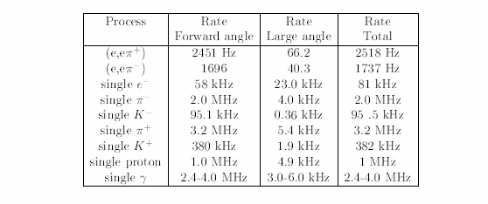
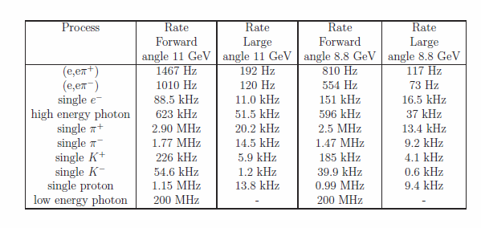
Rate in proposal
SIDIS PAC34: BaBar,60% eff, any cut(?)
SIDIS PAC35: CDF, 85% eff, FAEC electron trig cut 0.9GeV, FAEC MIP trigger cut 200(MeV)
LAEC cut 3.5GeV, SPD cut(?)

Slide 34
e DIS
pi-
pi+
γ(pi0)
p
Kry
FAEC,
Before
cut
Radial on Q2=1 e cut, FAEC
FAEC,
After
cut
Tung
FAEC,
Before
cut
FAEC,
After
cut

Slide 35
e DIS
pi-
pi+
γ(pi0)
p
Kry
FAEC,
Before
cut
Radial below Q2=1 e cut, FAEC
FAEC,
After
cut
Tung
FAEC,
Before
cut
FAEC,
After
cut

Slide 36
e DIS
pi-
pi+
γ(pi0)
p
Kry
FAEC,
Before
cut
Flat e cut, FAEC
FAEC,
After
cut
Tung
FAEC,
Before
cut
FAEC,
After
cut

Slide 37
e DIS
pi-
pi+
γ(pi0)
p
Kry
LAEC,
Before
cut
Flat e cut, LAEC
LAEC,
After
cut
Tung
LAEC,
Before
cut
LAEC,
After
cut

Slide 38
e DIS
pi-
pi+
γ(pi0)
p
Kry
FAEC,
Before
cut
MIP 95% cut,FAEC
FAEC,
After
cut
Tung
FAEC,
Before
cut
FAEC,
After
cut

Slide 39
e DIS
pi-
pi+
γ(pi0)
p
Kry
FAEC,
Before
cut
MIP 100% cut,FAEC
FAEC,
After
cut
Tung
FAEC,
Before
cut
FAEC,
After
cut

Slide 40
e DIS
pi-
pi+
γ(pi0)
p
Kry
FAEC,
Before
cut
MIP rough cut,FAEC
FAEC,
After
cut
Tung
FAEC,
Before
cut
FAEC,
After
cut

