Slide 1
SoLID Acceptance
Zhiwen Zhao
2016/7/28

Slide 2
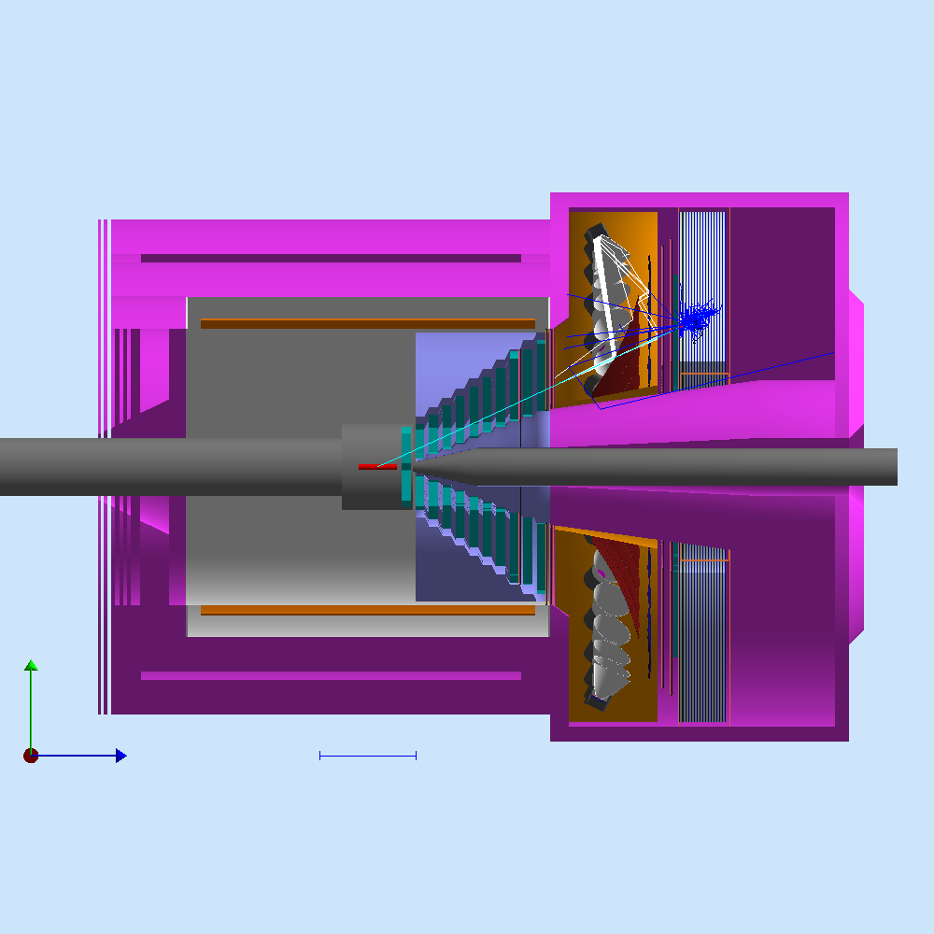
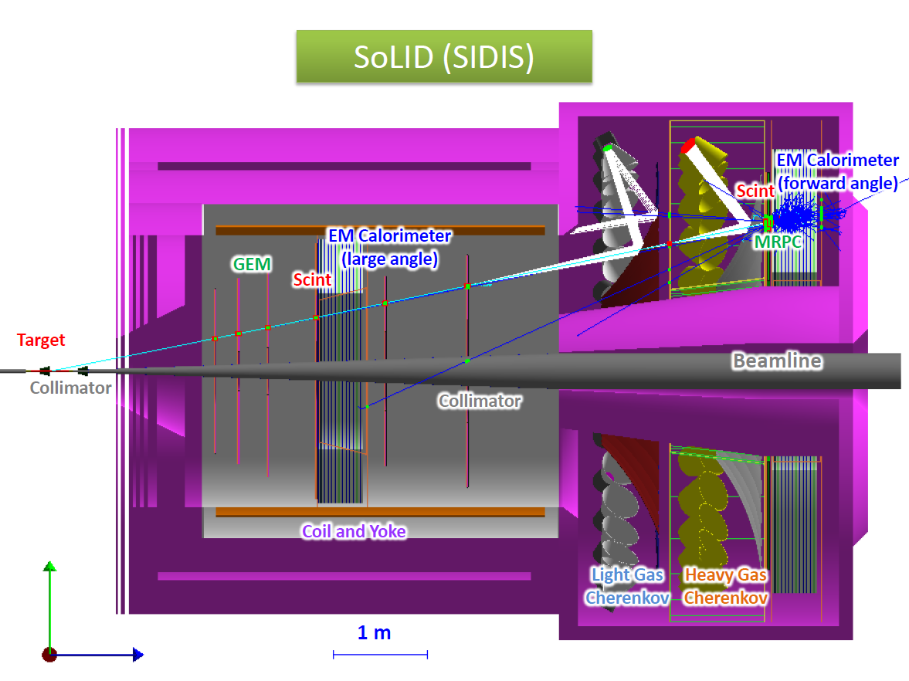
Full Simulation and file sharing
We run full simulation in “solid_gemc” with all subsystems and generate various files at a shared central location
They can used for studies like acceptance, trigger, background, GEM etc and ensure consistent results

Slide 3
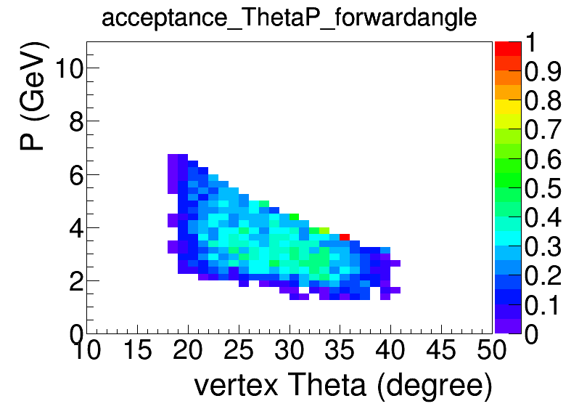
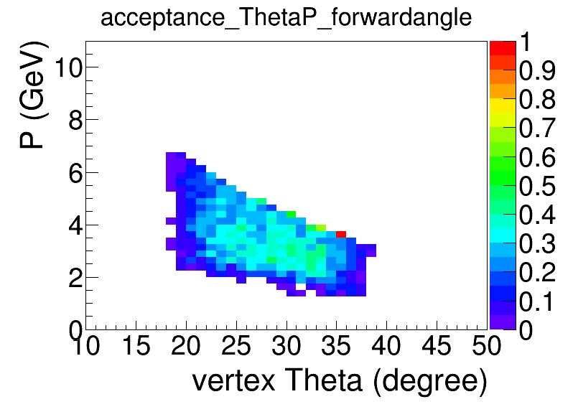
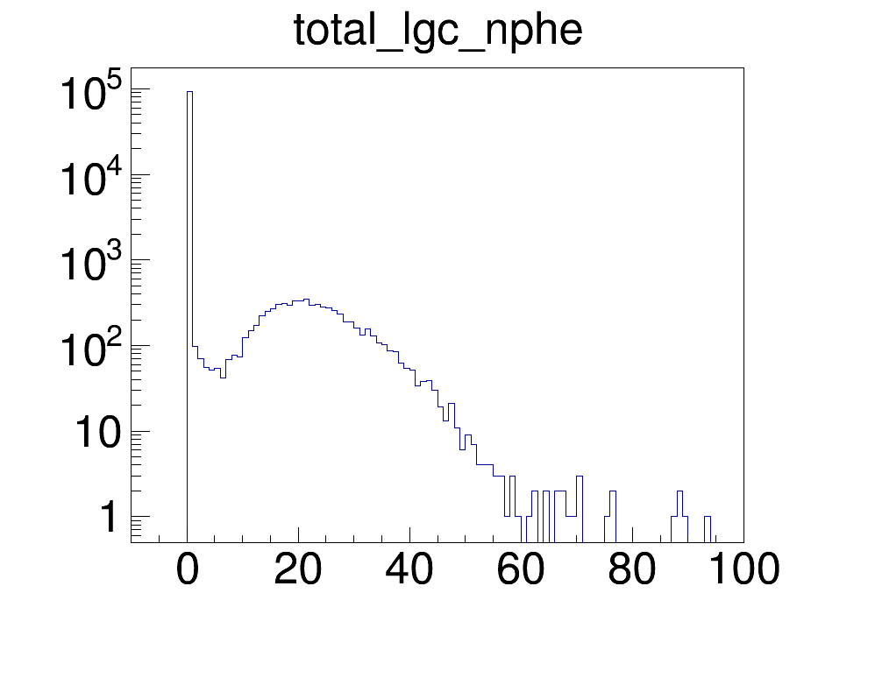
PVDIS acceptance
A simple test, not complete study
Throw eDIS into PVDIS full simulation, consider it’s accepted when
it passes all GEM planes and entering EC
In addition, LGC has number of total photons > 10
Essentially it will need to involve from a simple into a full reconstruction code
EC+GEM
EC+GEM+LGC

Slide 4
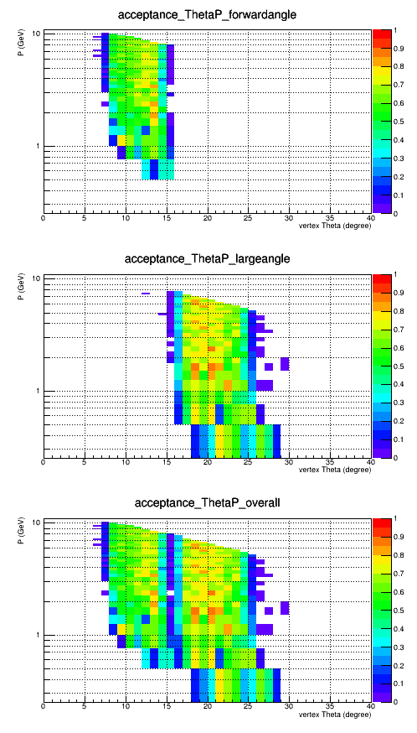
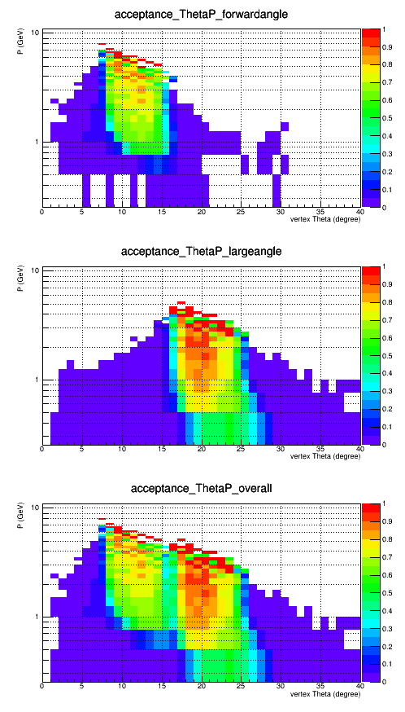
SIDIS_He3 acceptance
EC+GEM
e-
pi-
A simple test, not complete study
Throw eDIS or pimWiser into SIDIS_He3 full simulation, consider it’s accepted when
it passes all GEM planes and entering EC
In addition, LGC or HGC has number of total photons > 10
Essentially it will need to involve from a simple into a full reconstruction code

Slide 5
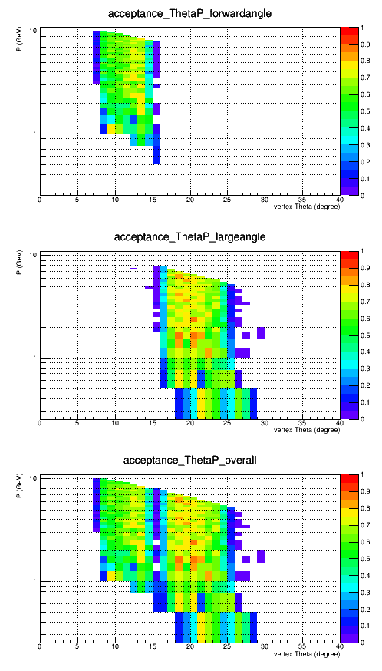
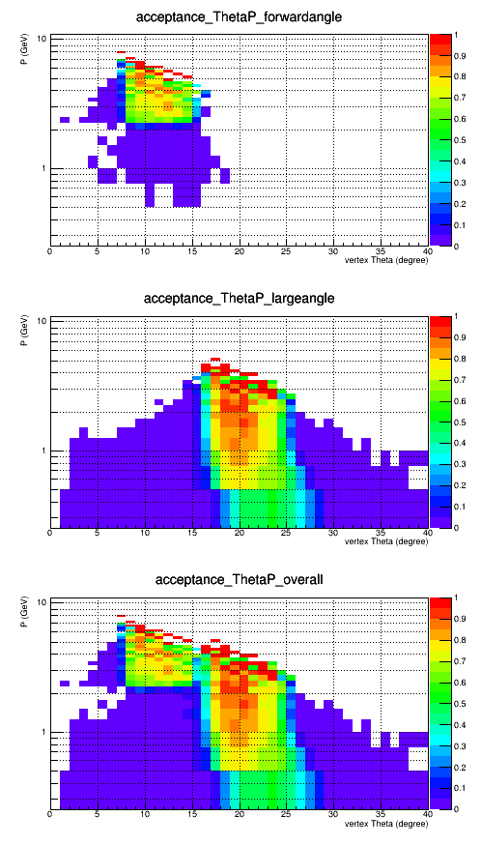
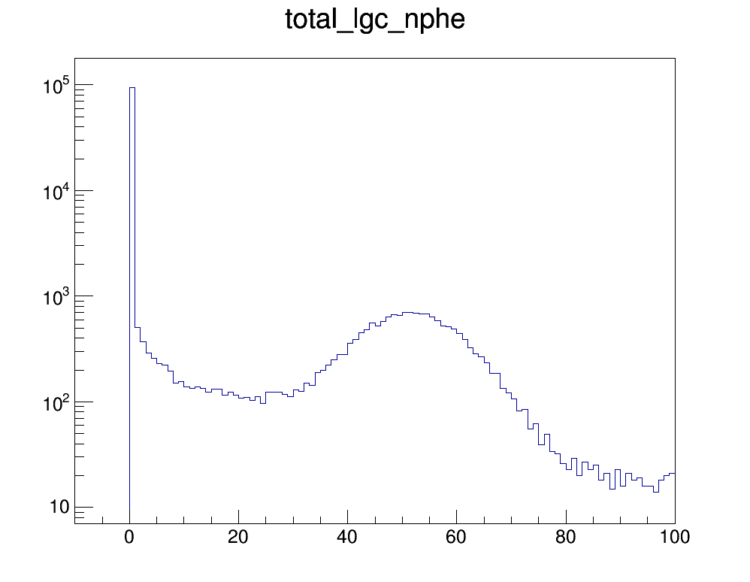
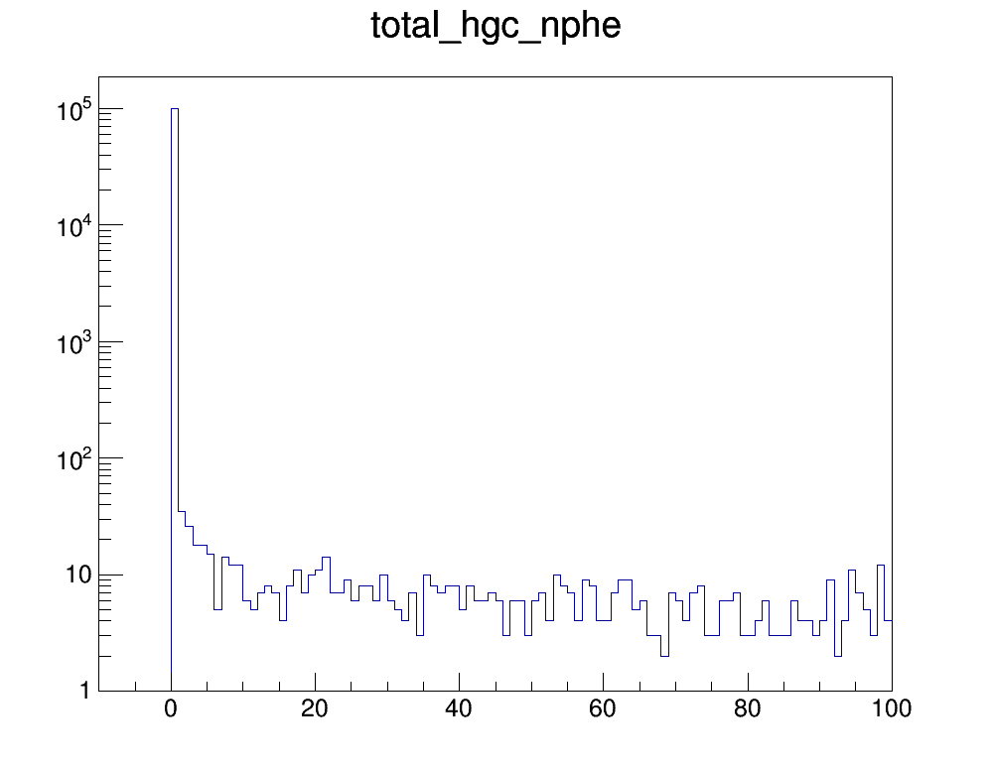
SIDIS_He3 acceptance
EC+GEM+LGC or HGC
e-
pi-

