Slide 1
SoLID JPsi_LH2 Hit and Occupancy
Zhiwen Zhao
2017/05/16

Slide 2
Introduction
“Hit”, look at detector response from different source particles to get hit rate
“Occupancy”, assume certain threshold cut on hit information to get event rate
We look at each detector channels (no GEM or MRPC yet)
We assume each particle entering a detector is independent, so no time window for integration yet
Simulation data of “JPsi_LH2_JLAB_VERSION_1.3/pass5” is used

Slide 3
All source
all source from target and windows
BeamOnTarget, BeamOnTargetEM by Geant4
eDIS, pions and proton by HallD
Occupancy threshold cut (low)
LGC > 0 N of p.e.
HGC > 0 N of p.e.
SPD_FA > 0.1MeV (1/5 of trigger cut 0.5MeV)
SPD_LA > 0.3MeV (1/5 of trigger cut 1.5MeV)
EC preshower > 0.4MeV
EC shower > 6MeV
Occupancy threshold cut (high)
LGC > 1 N of p.e.
HGC > 1 N of p.e.
SPD_FA > 0.25MeV (1/2 of trigger cut 0.5MeV)
SPD_LA > 0.75MeV (1/2 of trigger cut 1.5MeV)
EC preshower > 0.8MeV
EC shower > 12MeV

Slide 4
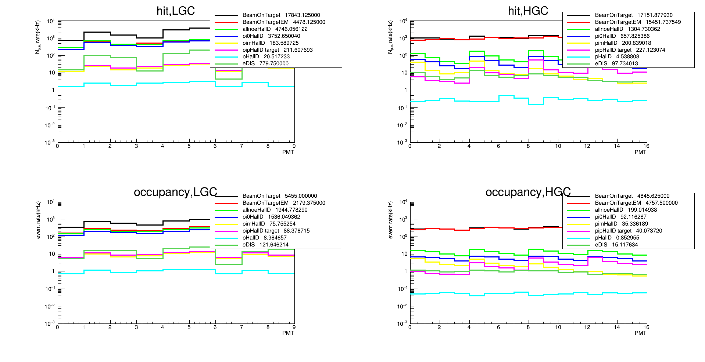
LGC and HGC
Occupancy cut (low), LGC > 0 N of p.e. HGC > 0 N of p.e.

Slide 5
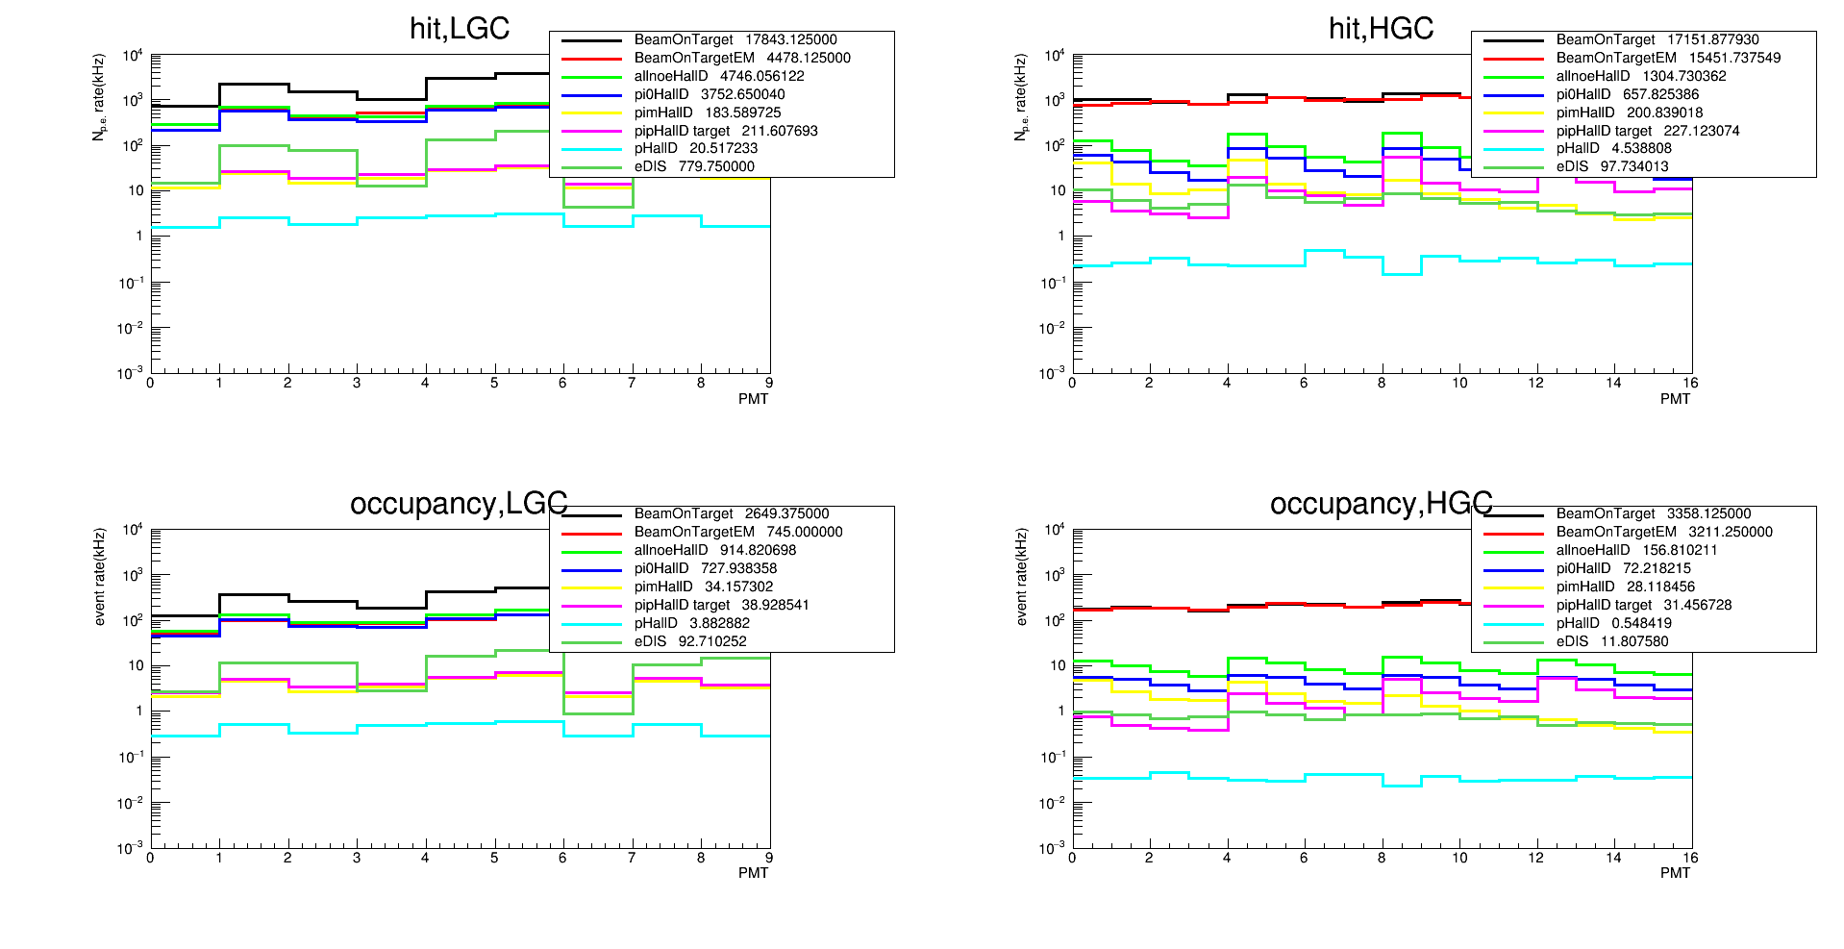
LGC and HGC
Occupancy cut (high), LGC > 1 N of p.e. HGC > 1 N of p.e.

Slide 6
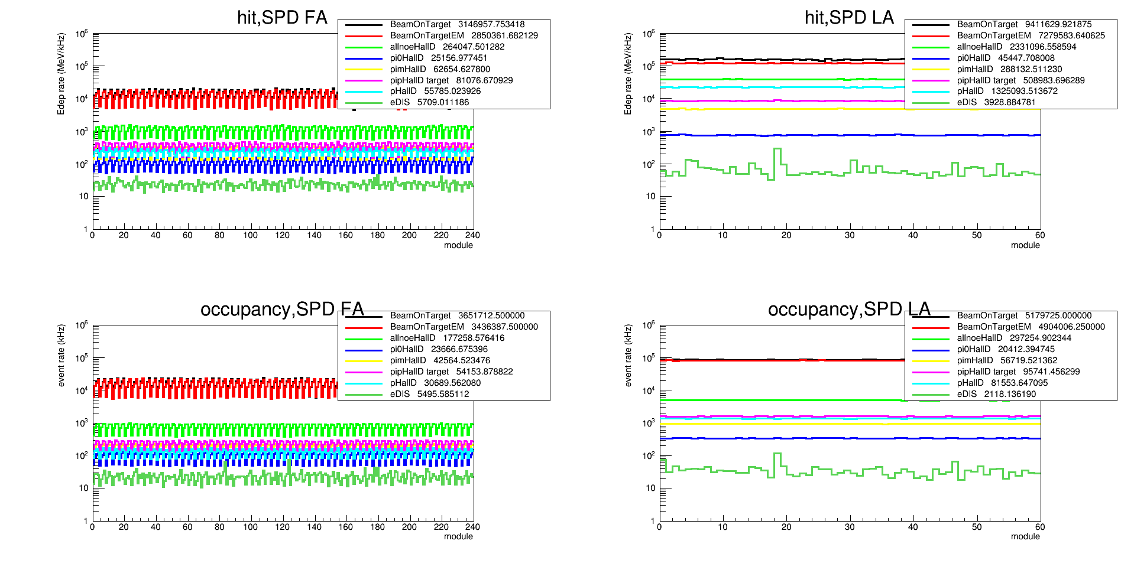
SPD
Occupancy cut (low), FA > 0.1 MeV, LA > 0.3 MeV

Slide 7
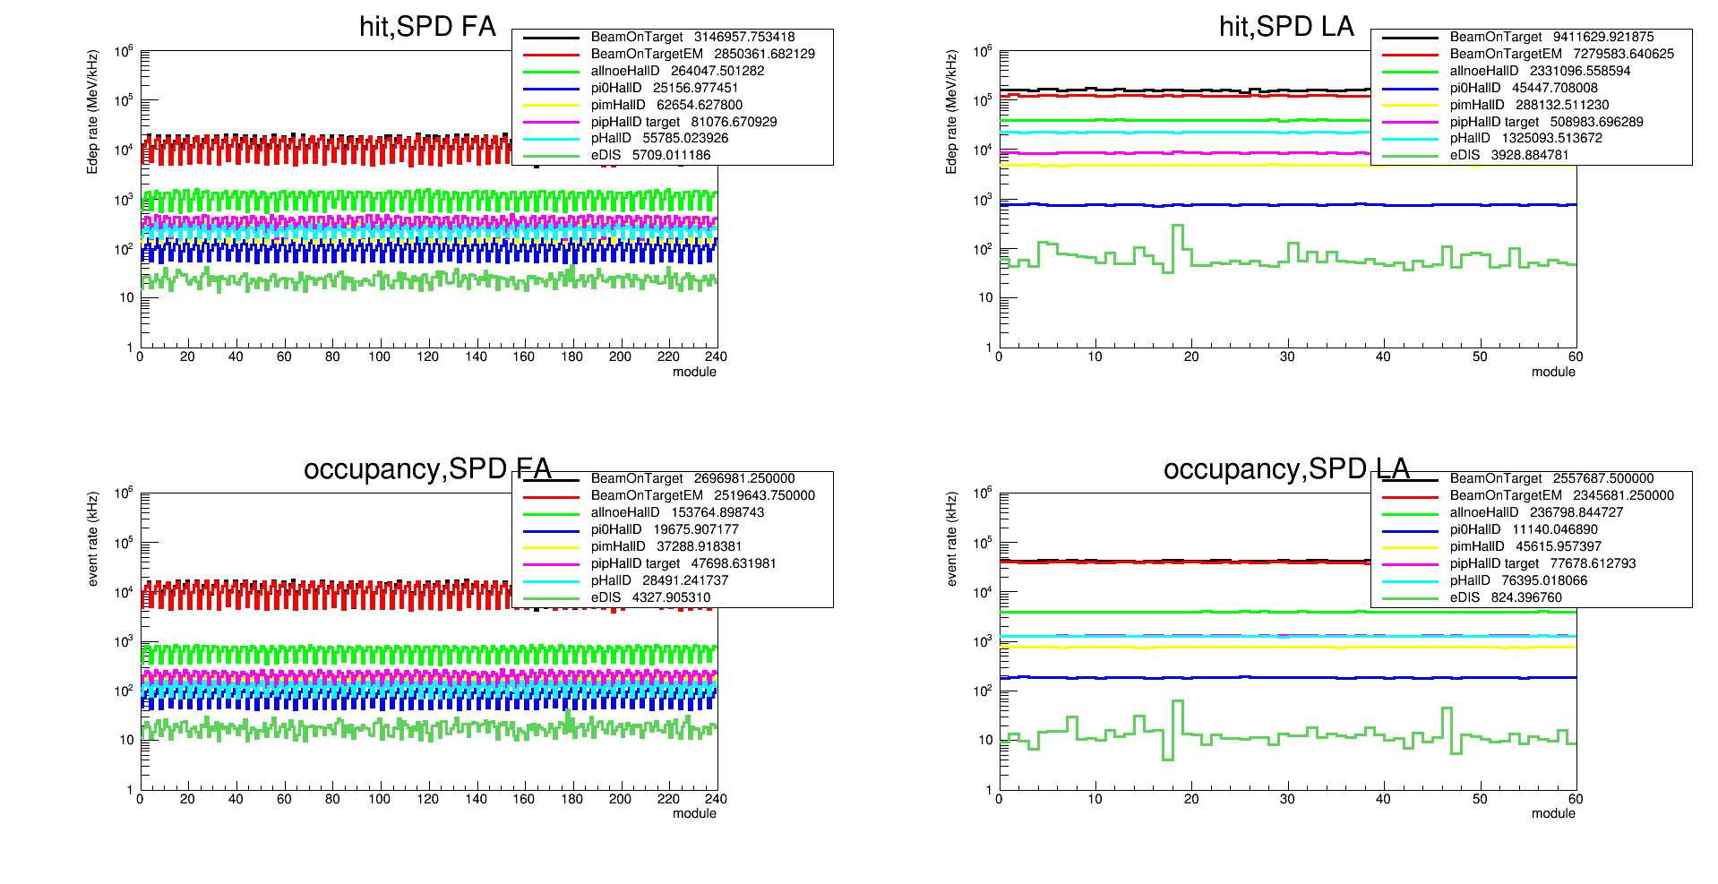
SPD
Occupancy cut (high), FA > 0.25 MeV, LA > 0.75 MeV

Slide 8
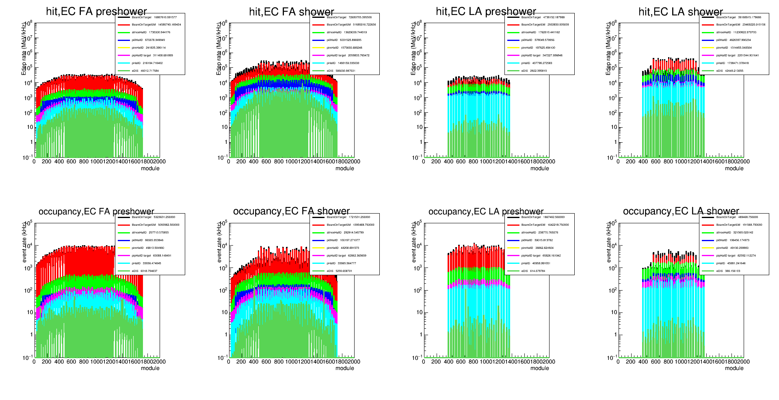
EC
Occupancy cut (low), preshower > 0.4 MeV, shower > 6 MeV

Slide 9
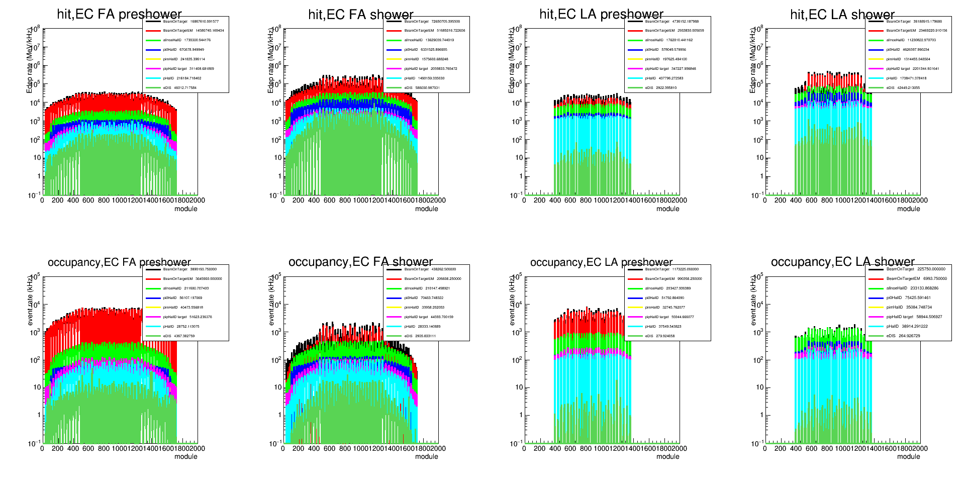
EC
Occupancy cut (high), preshower > 0.8 MeV, shower > 12 MeV

Slide 10
Occupancy Result: LGC and HGC
The table shows
For LGC: sum of 9 channels
For HGC: sum of 16 channels
Occ(kHz) | BeamOnTarget | BeamOnTargetEM | Pi0 Halld | allnoe HallD | eDIS Halld
LGC (>0) | 5455 | 2179 | 1536 | 1945 | 122
LGC (>1) | 2649 | 745 | 728 | 915 | 93
HGC (>0) | 4845 | 4757 | 92 | 199 | 15
HGC (>1) | 3358 | 3211 | 72 | 157 | 12
For LGC, EM and hadron contribute half and half
For HGC, EM is dominating

Slide 11
Occupancy Result: SPD
The table shows
For SPD_FA: sum of 240 channels
For SPD_LA: sum of 60 channels
Occ(kHz) | BeamOnTarget | BeamOnTargetEM
SPD_FA (>0.1) | 3.65e6 | 3.44e6
SPD_FA (>0.25) | 2.70e6 | 2.52e6
SPD_LA (>0.3) | 5.18e6 | 4.90e6
SPD_LA (>0.75) | 2.56e6 | 2.35e6
For SPD, EM is dominating

Slide 12
Occupancy Result: EC
The table shows
For EC_FA: sum of ~1300 channels
For EC_LA: sum of ~500 channels
Occ(kHz) | BeamOnTarget | BeamOnTargetEM
EC_preshower_FA (>0.4) | 5.32e6 | 5.00e6
EC_preshower_FA (>0.8) | 3.89e6 | 3.65e6
EC_shower_FA (>6) | 1.72e6 | 1.40e6
EC_shower_FA (>12) | 4.38e5 | 2.07e5
EC_preshower_LA (>0.4) | 1.87e6 | 1.64e6
EC_preshower_LA (>0.8) | 1.17e6 | 0.99e6
EC_shower_LA (>6) | 4.89e5 | 1.92e5
EC_shower_LA (>12) | 2.26e5 | 0.07e5
For shower, EM and hadron contribute half and half
For preshower, EM is dominating

Slide 13
Result Summary A
All values from “BeamOnTarget”
 | Max Occ(kHz/channel) low cut | Max Occ(kHz/channel) high cut | Average Occ(kHz/channel) low cut | Average Occ(kHz/channel) high cut | Number of channel | Total Occ(kHz) low cut | Total Occ(kHz) high cut
LGC | 954 | 503 | 606 | 294 | 270 | 16.4e4 | 7.95e4
HGC | 372 | 272 | 303 | 210 | 480 | 14.5e4 | 10.1e4
SPD_FA | 24.1e3 | 17.5e3 | 15.2e3 | 11.3e3 | 240 | 3.65e6 | 2.70e6
SPD_LA | 89.4e3 | 44.4e3 | 86.3e3 | 42.7e3 | 60 | 5.18e6 | 2.56e6
EC_preshower_FA | 10087 | 7650 | 4092 | 2992 | ~1300 | 5.32e6 | 3.89e6
EC_shower_FA | 9337 | 2344 | 1323 | 337 | ~1300 | 1.72e6 | 4.38e5
EC_preshower_LA | 12806 | 8119 | 3740 | 2340 | ~500 | 1.87e6 | 1.17e6
EC_shower_LA | 6562 | 1894 | 978 | 452 | ~500 | 4.89e5 | 2.26e5
Total |  |  |  |  | 4650 | 18.5e6 | 11.2e6

Slide 14
Result Summary B
All values from “BeamOnTarget”
 | Max Occ(kHz/channel) | Average Occ(kHz/channel) low cut | Number of channel | Total Occ(kHz)
GEM 1 |  |  | 906*30
GEM 2 |  |  | 1020*30
GEM 3 |  |  | 1166*30
GEM 4 |  |  | 1404*30
GEM 5 |  |  | 1040*30
GEM 6 |  |  | 1280*30
MRPC |  | 1210 | 33*50*2 | 4e6
Total |  |  | 207780

Slide 15
Other thoughts
So far all hit rates and particles rate are based on detector response from individual particles.
Some detector like SPD and EC have high rate. There are many particles entering them within their integration time windows. If we consider this, the hit rate, occupancy cut value, occupancy rate could be different

