Slide 1
SoLID SIDIS_He3
Hit and Occupancy
Zhiwen Zhao
2017/04/26

Slide 2
Introduction
“Hit”, look at detector response from different source particles to get hit rate
“Occupancy”, assume certain threshold cut on hit information to get event rate
We look at each detector channels (no GEM or MRPC yet)
We assume each particle entering a detector is independent, so no time window for integration yet
Simulation data of “SIDIS_He3_JLAB_VERSION_1.3/pass7” is used

Slide 3
Some sources as example
Look at only source from pi0, eDIS from target

Slide 4
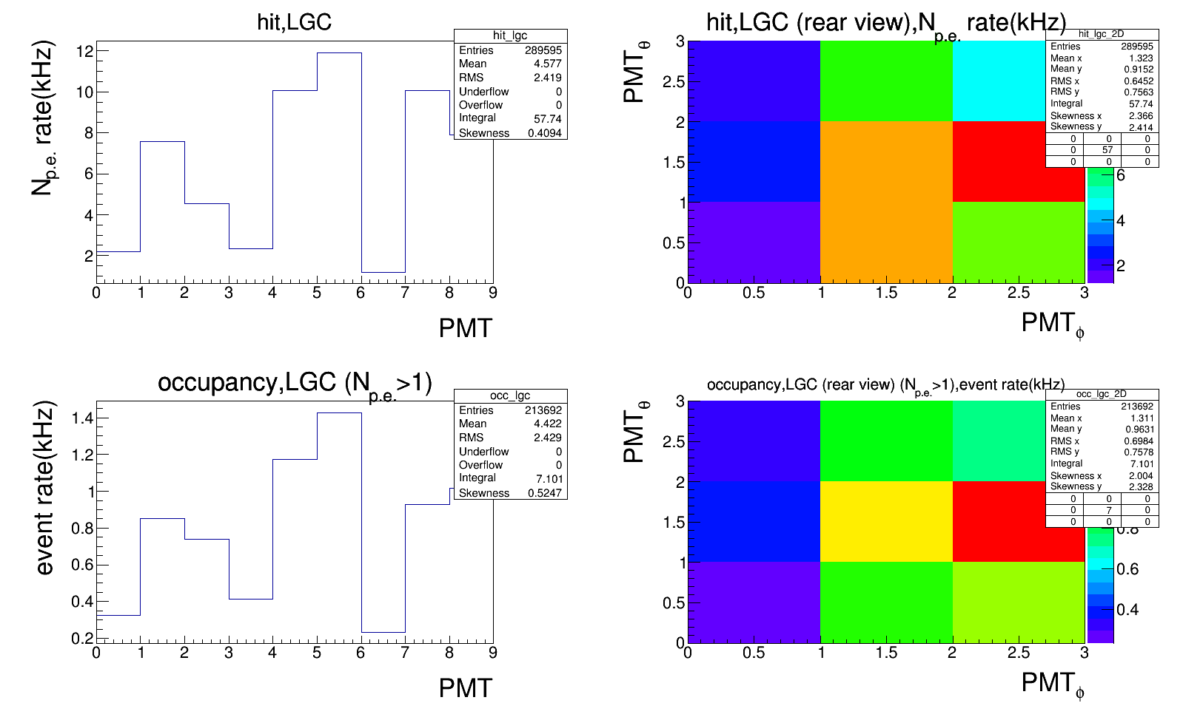
SIDIS_He3, gas (e DIS)
N_p.e. > 1 for occupancy

Slide 5
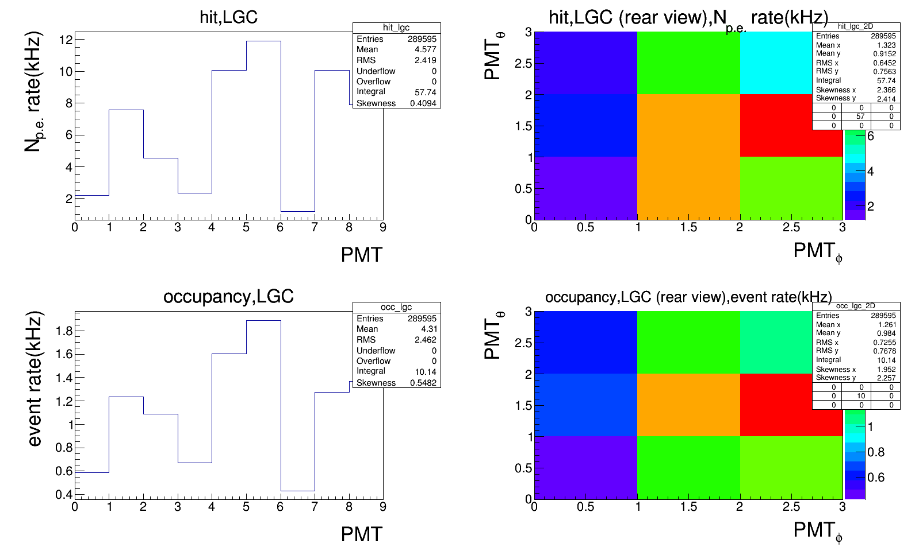
SIDIS_He3, gas (e DIS)
N_p.e. > 0 for occupancy

Slide 6
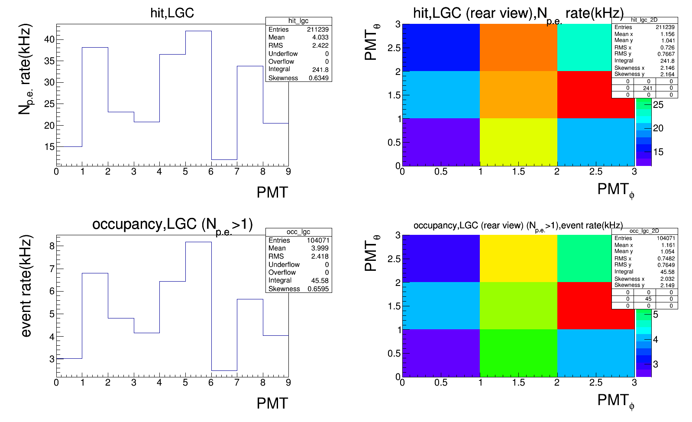
SIDIS_He3, gas (pi0)
N_p.e. > 1 for occupancy

Slide 7
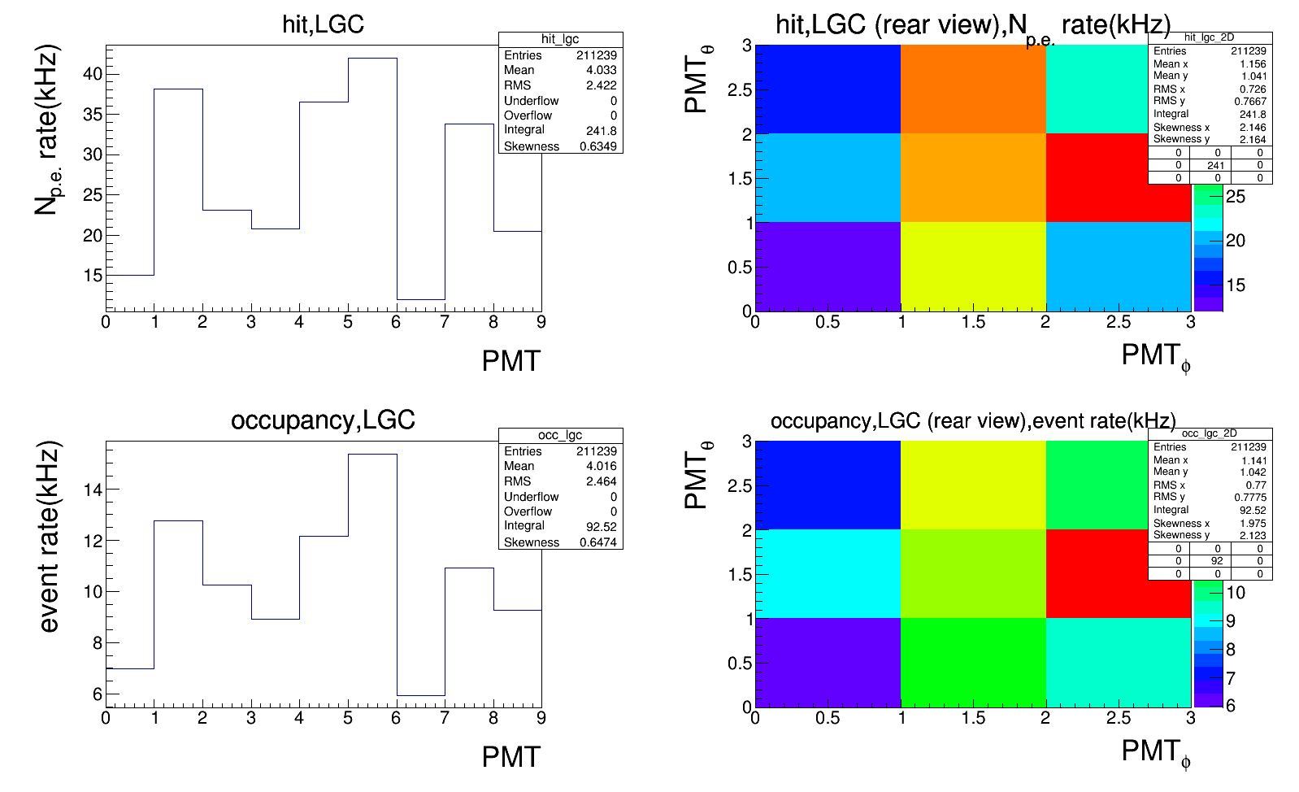
SIDIS_He3, gas (pi0)
N_p.e. > 0 for occupancy

Slide 8
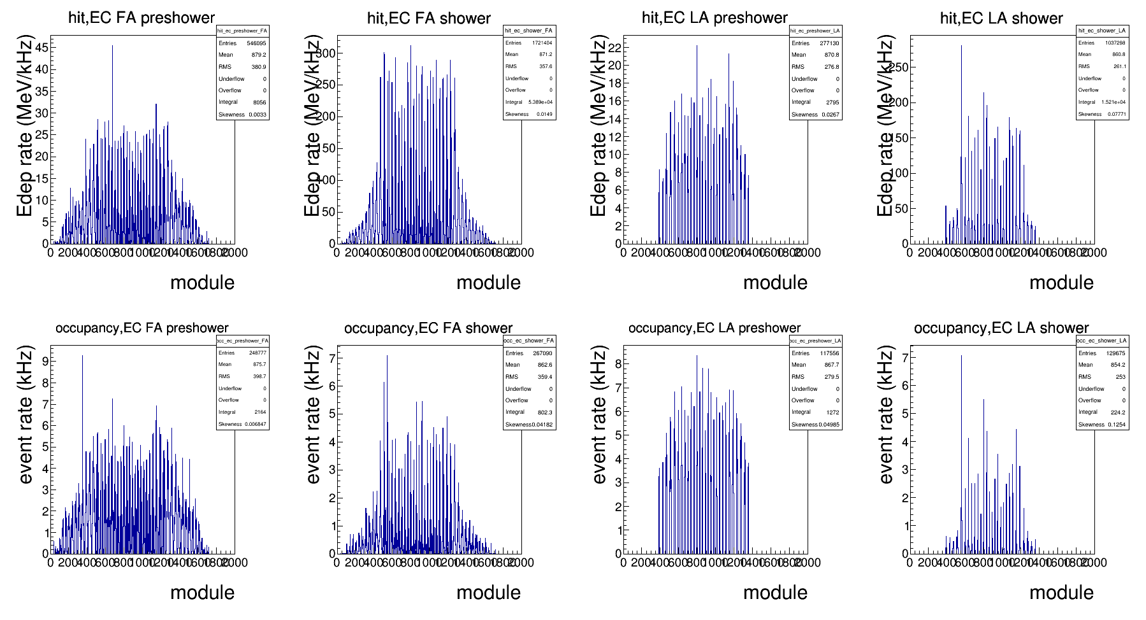
SIDIS_He3, gas (e DIS)
Occupancy cut, preshower>0.4MeV, shower>6MeV

Slide 9
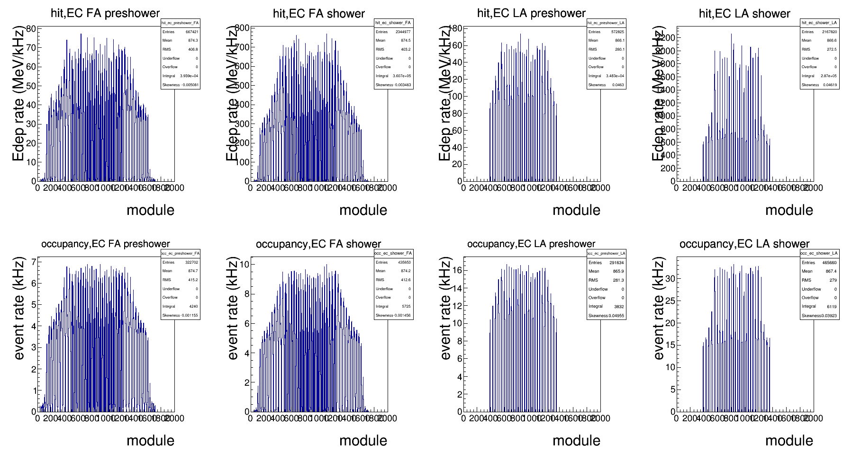
SIDIS_He3, gas (pi0)
Occupancy cut, preshower>0.4MeV, shower>6MeV

Slide 10
All source
all source from target and windows
  BeamOnTarget, BeamOnTargetEM by Geant4
  eDIS, pions and proton from target by HallD
  pions and proton from windows by Wiser
Occupancy threshold cut (low)
  LGC > 0 N of p.e.
  HGC > 0 N of p.e.
  SPD_FA > 0.1MeV (1/5 of trigger cut 0.5MeV)
  SPD_LA > 0.3MeV (1/5 of trigger cut 1.5MeV)
  EC preshower > 0.4MeV
  EC shower > 6MeV
Occupancy threshold cut (high)
  LGC > 1 N of p.e.
  HGC > 1 N of p.e.
  SPD_FA > 0.25MeV (1/2 of trigger cut 0.5MeV)
  SPD_LA > 0.75MeV (1/2 of trigger cut 1.5MeV)
  EC preshower > 0.8MeV
  EC shower > 12MeV

Slide 11
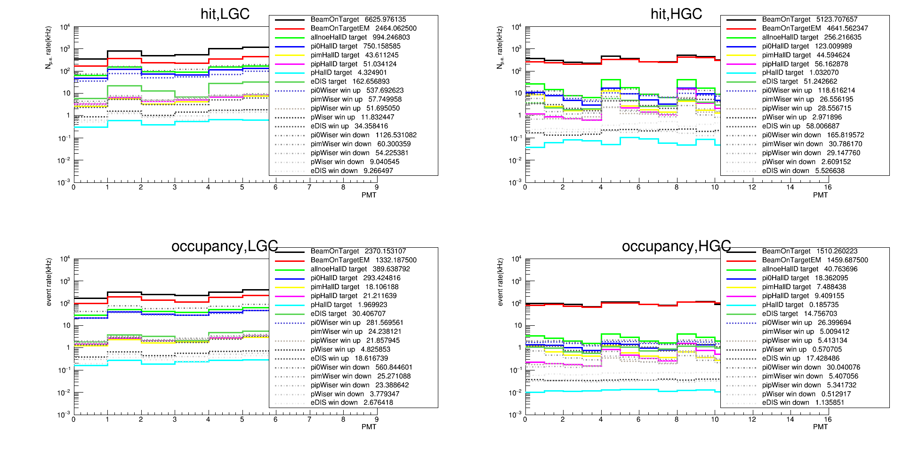
LGC and HGC
  Occupancy cut (low), LGC > 0 N of p.e. HGC > 0 N of p.e.

Slide 12
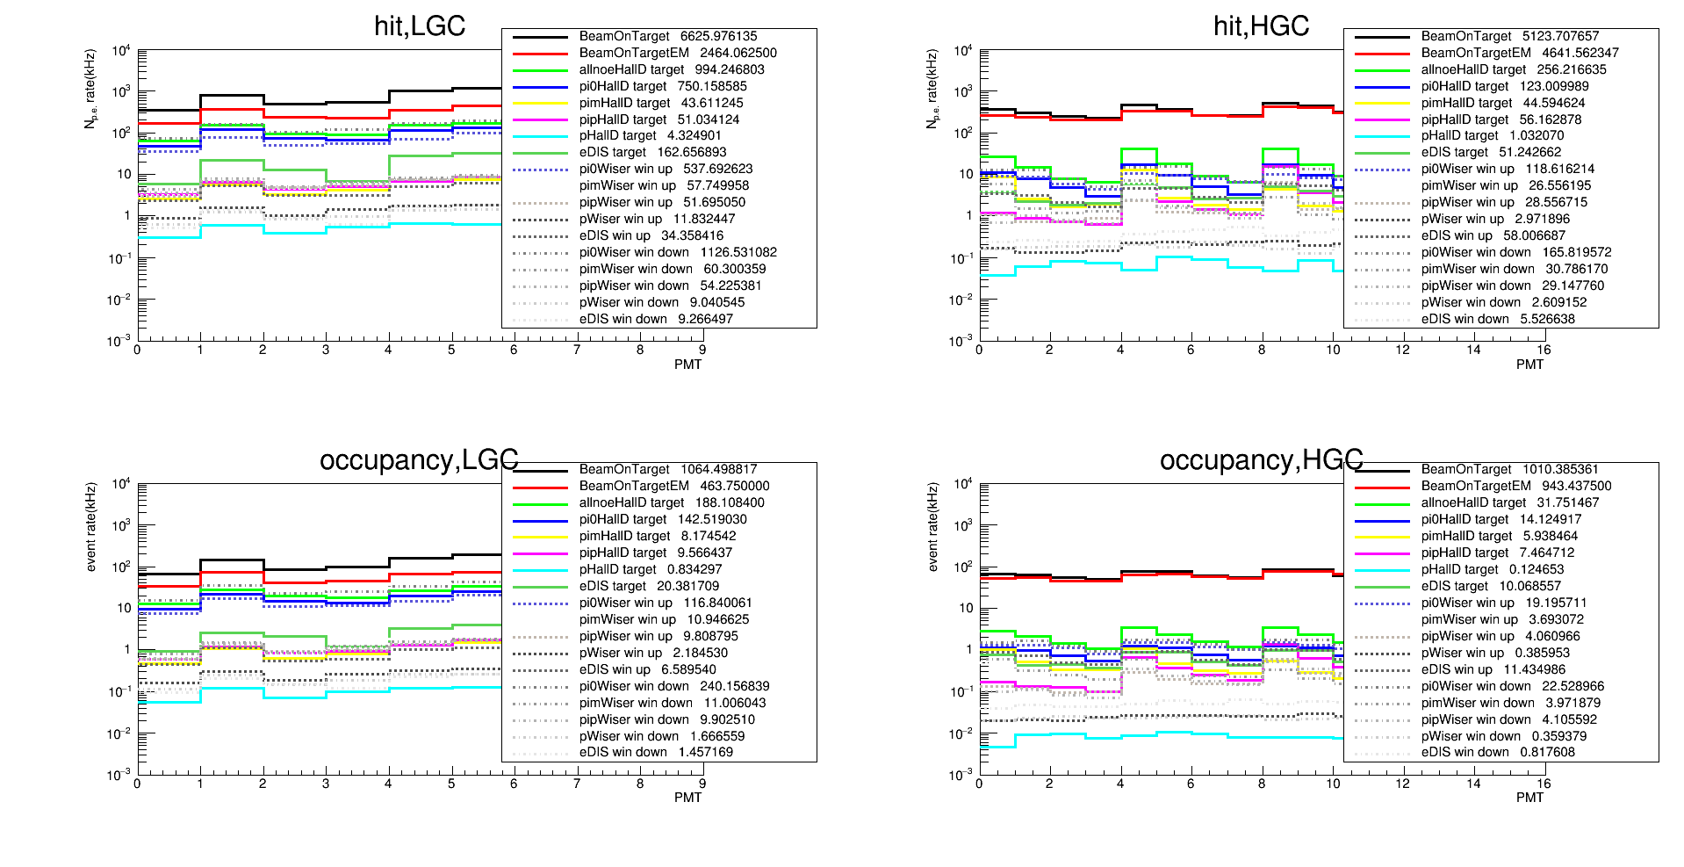
LGC and HGC
  Occupancy cut (high), LGC > 1 N of p.e. HGC > 1 N of p.e.

Slide 13
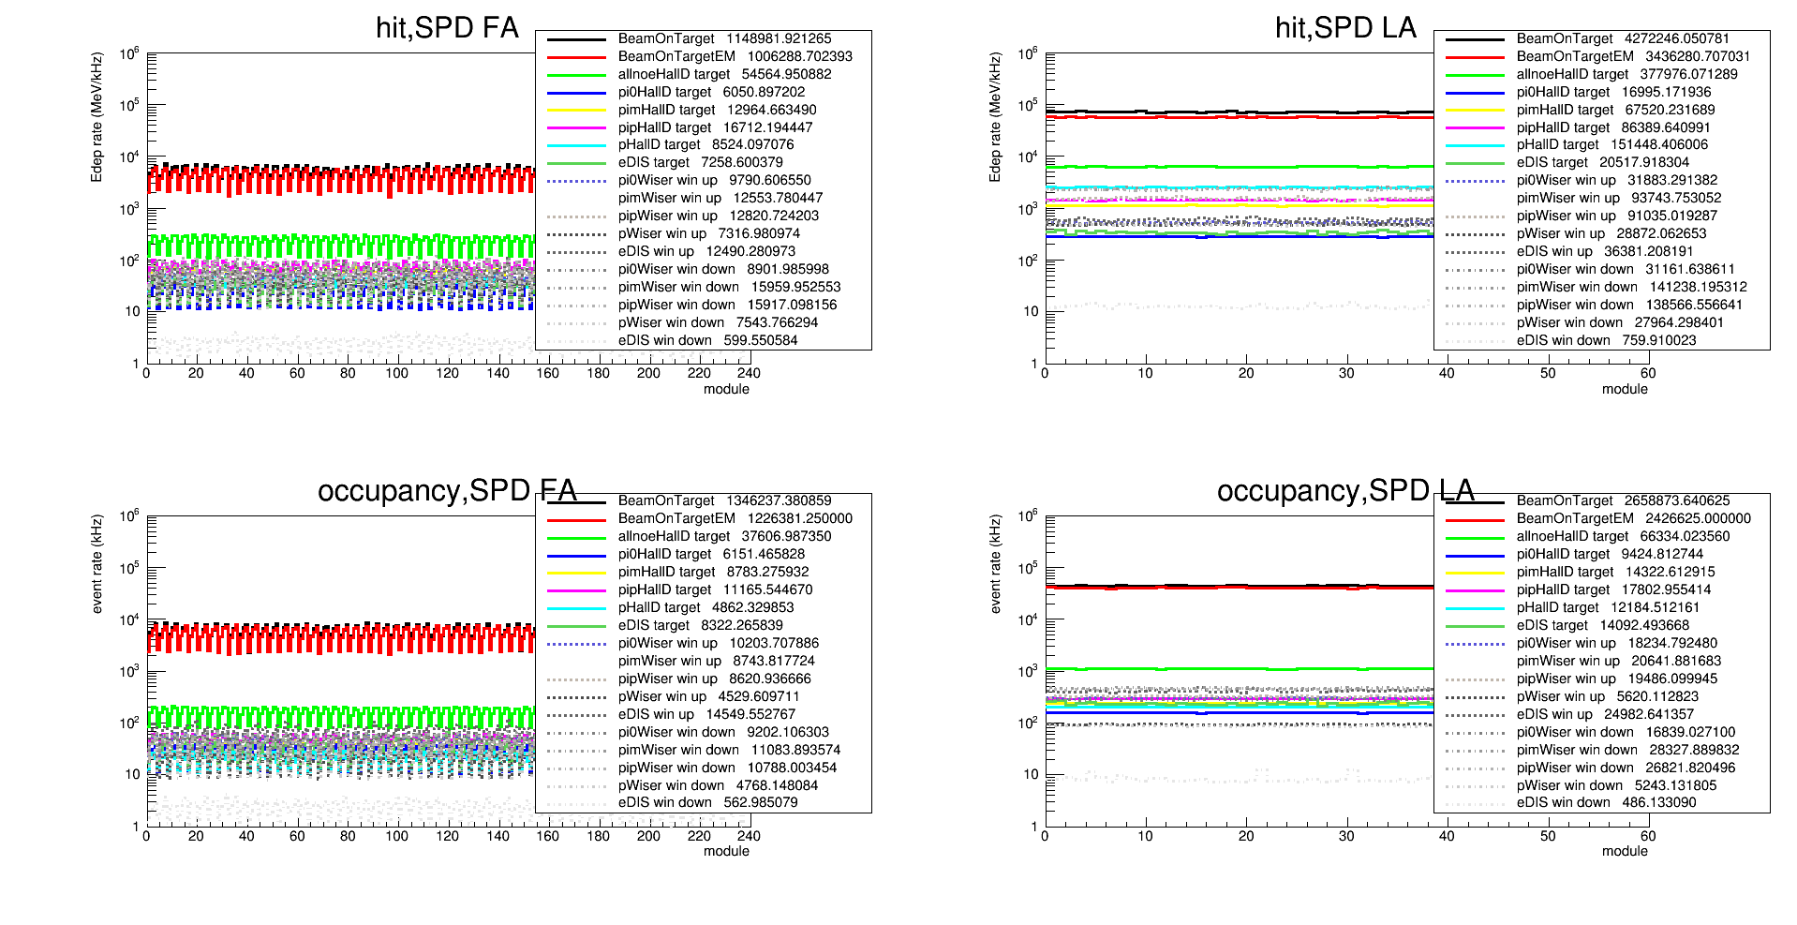
SPD
  Occupancy cut (low), FA > 0.1 MeV, LA > 0.3 MeV

Slide 14
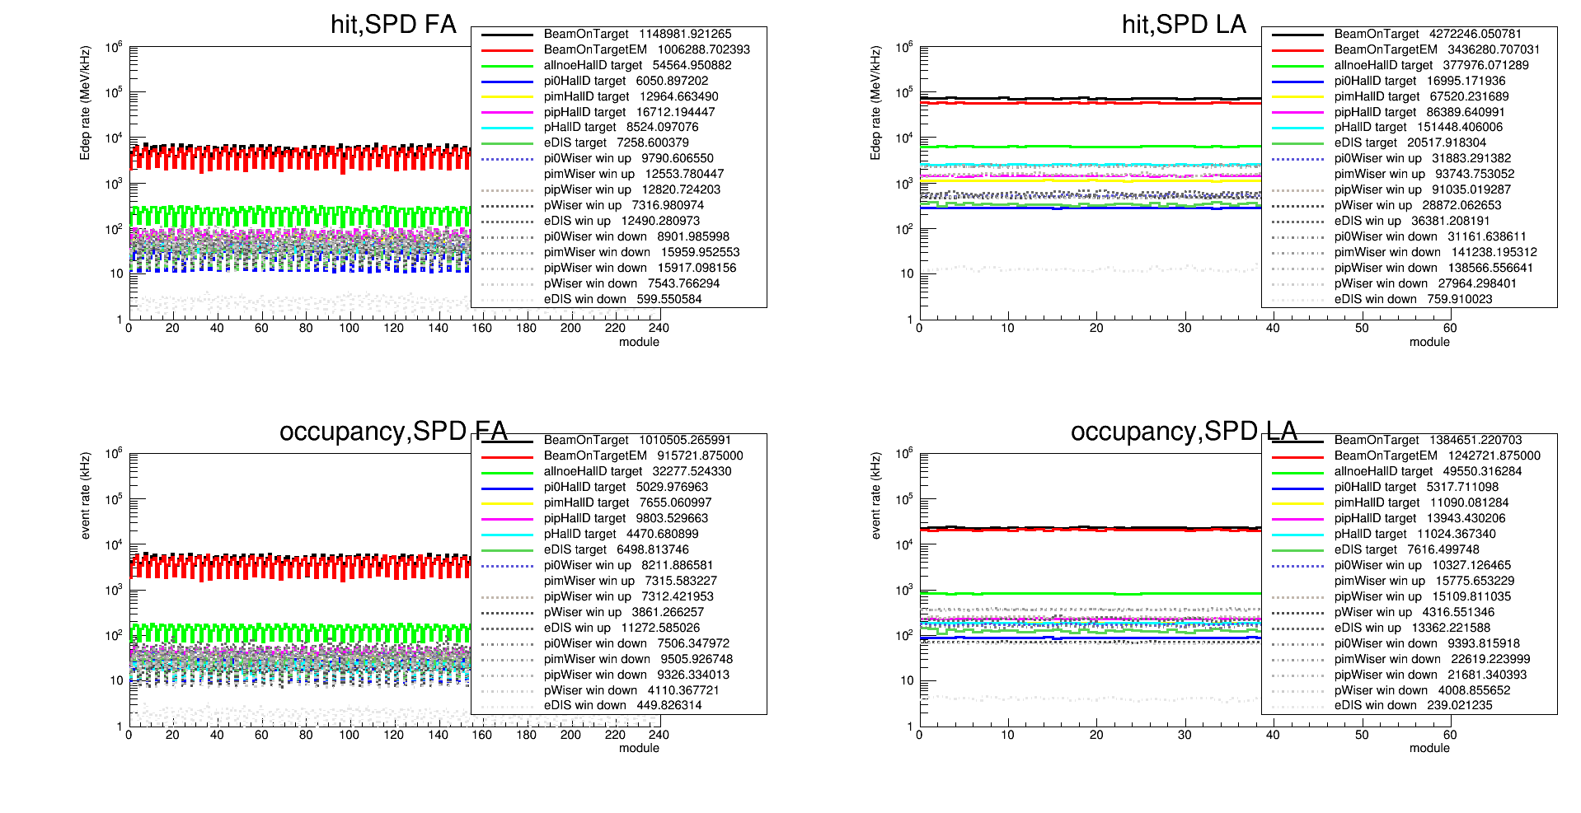
SPD
  Occupancy cut (high), FA > 0.25 MeV, LA > 0.75 MeV

Slide 15
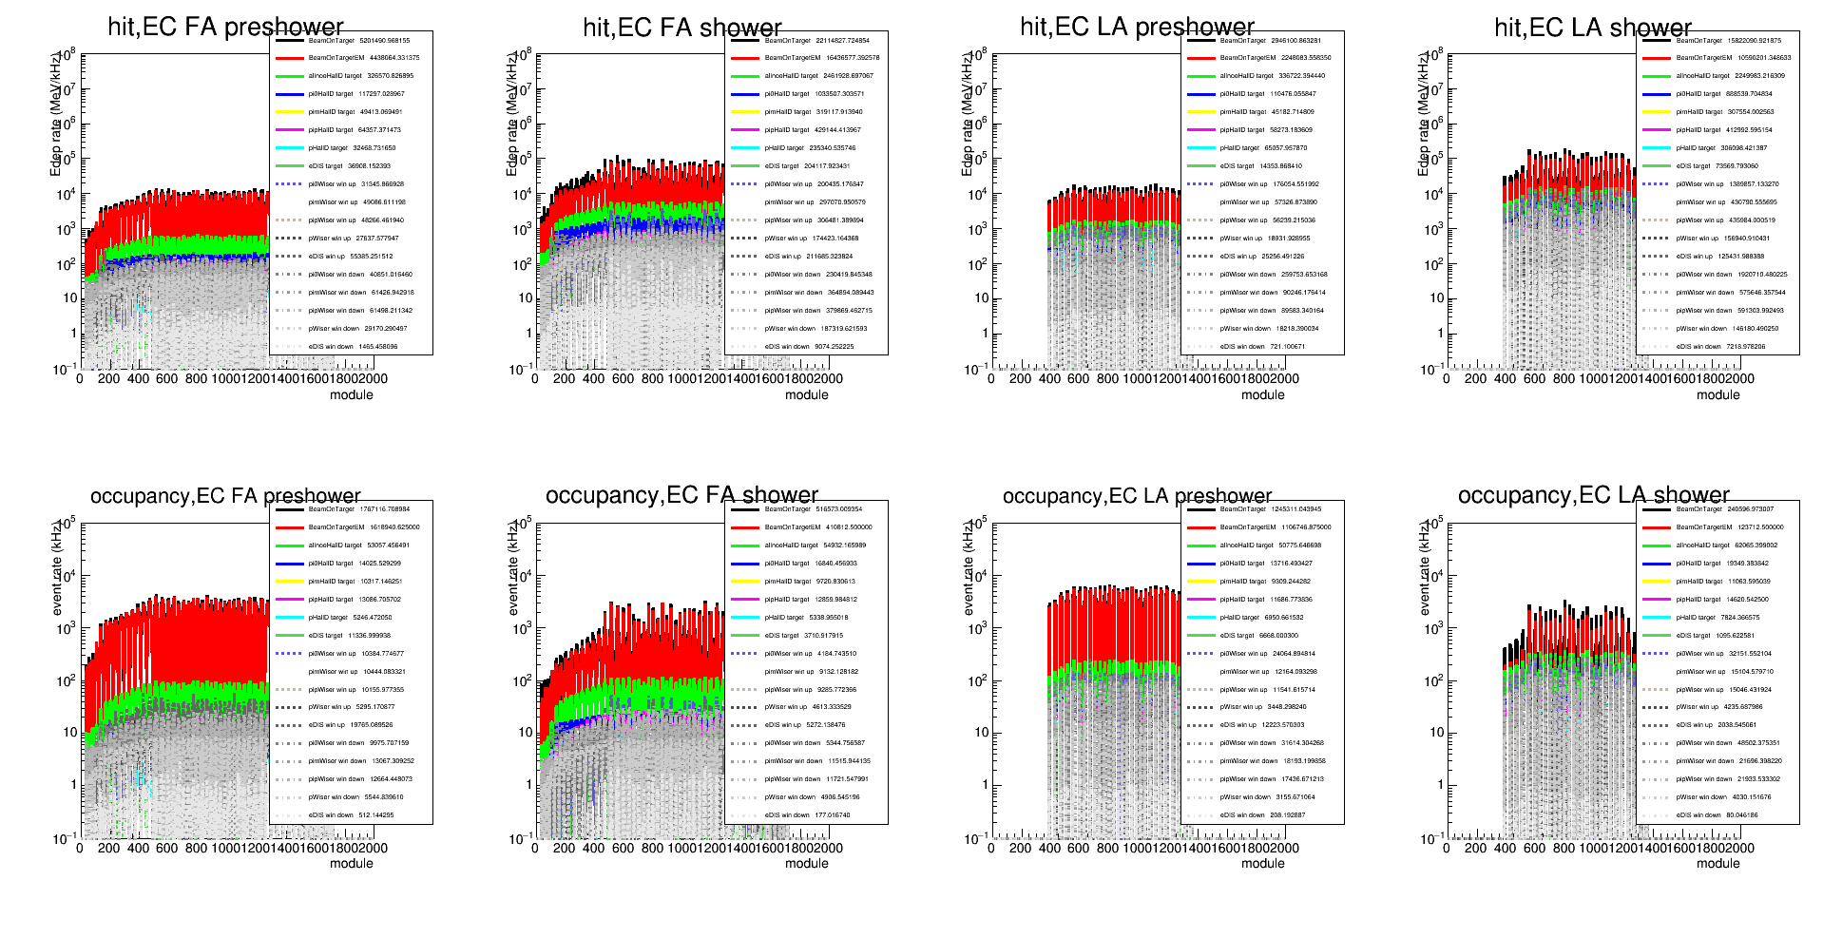
EC
  Occupancy cut (low), preshower > 0.4 MeV, shower > 6 MeV

Slide 16
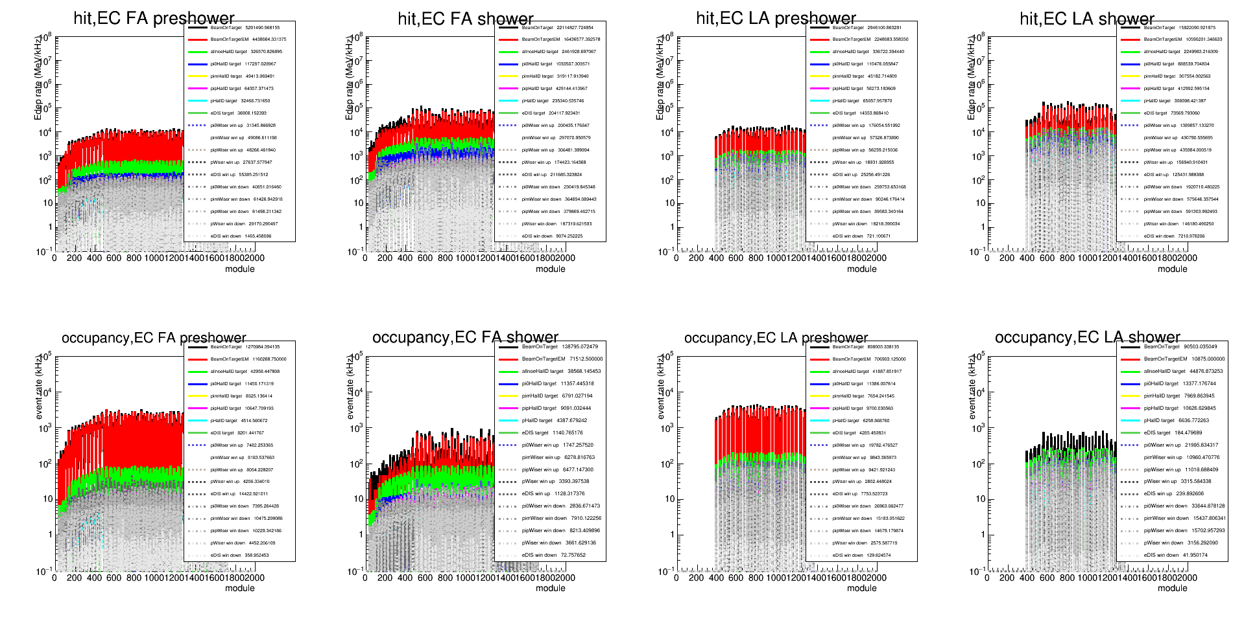
EC
  Occupancy cut (high), preshower > 0.8 MeV, shower > 12 MeV

Slide 17
Occupancy Result: LGC and HGC
  The table shows
    For LGC: sum of 9 channels
    For HGC: sum of 16 channels
Occ(kHz) | BeamOnTarget | BeamOnTargetEM | Pi0 Halld gas | Pi0 Wiser win up | Pi0 Wiser win down | eDIS Halld gas | eDIS Wiser win up | eDIS Wiser win down
LGC (>0) | 2370 | 1332 | 293 | 281 | 560 | 30 | 19 | 3
LGC (>1) | 1064 | 464 | 143 | 117 | 240 | 20 | 7 | 2
HGC (>0) | 1510 | 1460 | 18 | 26 | 30 | 15 | 17 | 1
HGC (>1) | 1010 | 943 | 14 | 19 | 23 | 10 | 12 | 1
  For LGC, EM and hadron contribute half and half
  For HGC, EM is dominating

Slide 18
Occupancy Result: SPD
  The table shows
    For SPD_FA: sum of 240 channels
    For SPD_LA: sum of 60 channels
Occ(kHz) | BeamOnTarget | BeamOnTargetEM
SPD_FA (>0.1) | 1.35e6 | 1.23e6
SPD_FA (>0.25) | 1.01e6 | 0.92e6
SPD_LA (>0.3) | 2.67e6 | 2.43e6
SPD_LA (>0.75) | 1.38e6 | 1.24e6
  For SPD, EM is dominating

Slide 19
Occupancy Result: EC
  The table shows
    For EC_FA: sum of ~1300 channels
    For EC_LA: sum of ~500 channels
Occ(kHz) | BeamOnTarget | BeamOnTargetEM
EC_preshower_FA (>0.4) | 1.79e6 | 1.62e6
EC_preshower_FA (>0.8) | 1.27e6 | 1.16e6
EC_shower_FA (>6) | 5.16e5 | 4.11e5
EC_shower_FA (>12) | 1.39e5 | 0.72e5
EC_preshower_LA (>0.4) | 1.25e6 | 1.11e6
EC_preshower_LA (>0.8) | 0.81e6 | 0.71e6
EC_shower_LA (>6) | 2.41e5 | 1.24e5
EC_shower_LA (>12) | 0.91e5 | 0.11e5
  For shower, EM and hadron contribute half and half
  For preshower, EM is dominating

Slide 20
Result Summary A
  All values from “BeamOnTarget”
 | Max Occ(kHz/channel) low cut | Max Occ(kHz/channel) high cut | Average Occ(kHz/channel) low cut | Average Occ(kHz/channel) high cut | Number of channel | Total Occ(kHz) low cut | Total Occ(kHz) high cut
LGC | 411 | 190 | 263 | 118 | 270 | 71e3 | 32e3
HGC | 120 | 83 | 94 | 63 | 480 | 45e3 | 30e3
SPD_FA | 8.6e3 | 6.3e3 | 5.6e3 | 4.2e3 | 240 | 1.35e6 | 1.01e6
SPD_LA | 45.6e3 | 23e3 | 44.5e3 | 23e3 | 60 | 2.67e6 | 1.38e6
EC_preshower_FA | 4373 | 3312 | 1380 | 980 | ~1300 | 1.79e6 | 1.27e6
EC_shower_FA | 3153 | 920 | 400 | 110 | ~1300 | 5.16e5 | 1.39e5
EC_preshower_LA | 6644 | 4533 | 2500 | 1620 | ~500 | 1.25e6 | 0.81e6
EC_shower_LA | 3415 | 825 | 482 | 182 | ~500 | 2.41e5 | 0.91e5
Total |  |  |  |  | 4650 | 7.9e6 | 4.6e6

Slide 21
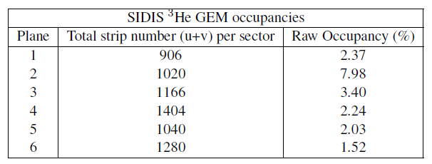
Result Summary B
  All values from “BeamOnTarget”
 | Max Occ(kHz/channel) | Average Occ(kHz/channel) low cut | Number of channel | Total Occ(kHz)
GEM 1 |  |  | 906*30
GEM 2 |  |  | 1020*30
GEM 3 |  |  | 1166*30
GEM 4 |  |  | 1404*30
GEM 5 |  |  | 1040*30
GEM 6 |  |  | 1280*30
MRPC |  | 893 | 33*50*2 | 2.95e6
Total |  |  | 207780

Slide 22
Other thoughts
So far all hit rates and particles rate are based on detector response from individual particles.
Some detector like SPD and EC have high rate. There are many particles entering them within their integration time windows. If we consider this, the hit rate, occupancy cut value, occupancy rate could be different

