Slide 1
MEIC Detector
Zhiwen Zhao
2014/07/22

Slide 2
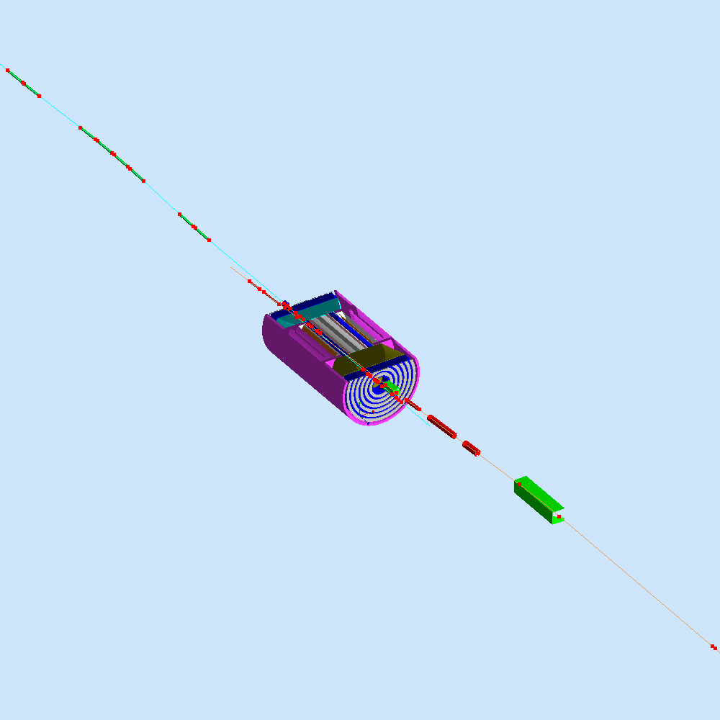
MEIC Interaction Region

Slide 3
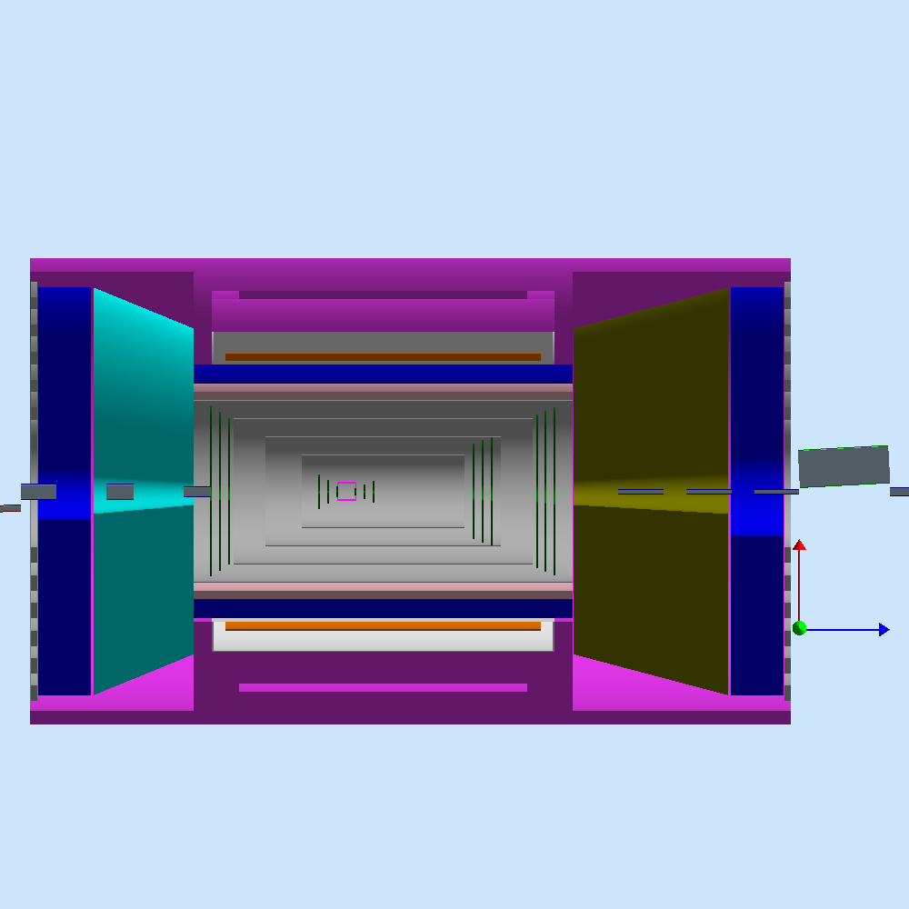
MEIC Central Detector
CLEO II Magnet
CLEO II Solenoid
4 m coil
Coil wall
RICH
+
TORCH?
e/π threshold
Cherenkov
EM calorimeter
EM calorimeter
barrel DIRC + TOF
3 m
forward tracker
forward tracker
Si-pixel vertex + disks
1 m deep
central tracker
2 m deep
EM calorimeter
(top view)
3 m
5 m

Slide 4
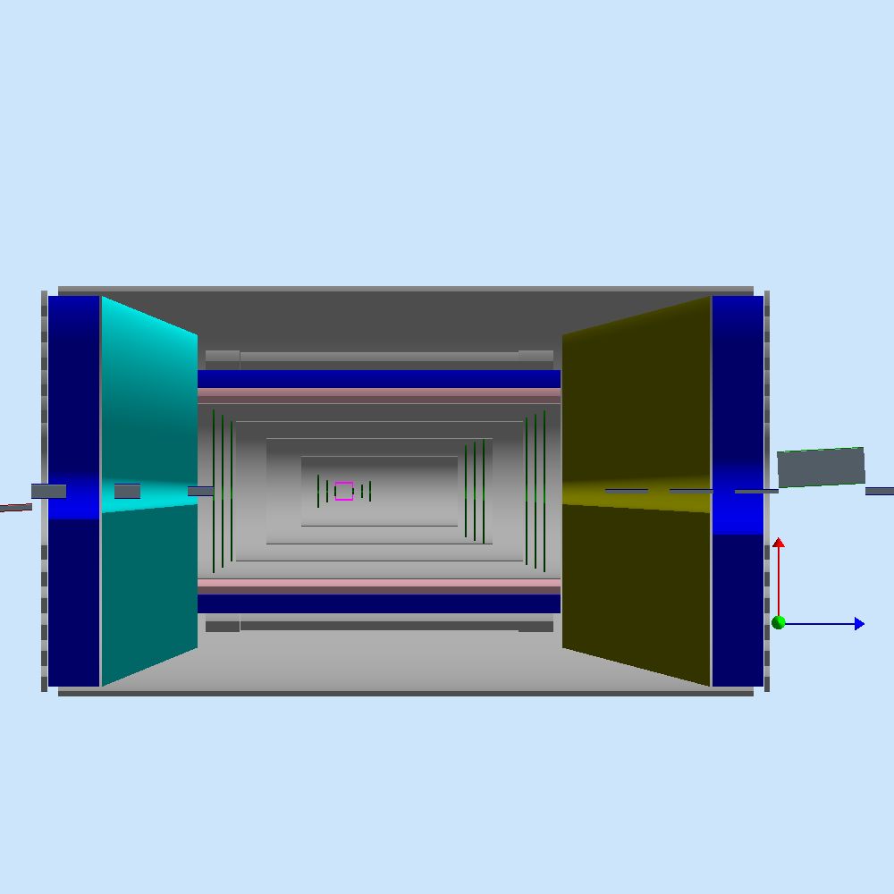
MEIC Central Detector
Dual Coil Magnet
Dual Solenoid in common cryostat
4 m coil
Coil wall
RICH
+
TORCH?
e/π threshold
Cherenkov
EM calorimeter
EM calorimeter
barrel DIRC + TOF
3 m
forward tracker
forward tracker
Si-pixel vertex + disks
1 m deep
central tracker
2 m deep
EM calorimeter
(top view)
3 m
5 m

