Slide 1
SoLID SIDIS He3 target collimator optimization
Zhiwen Zhao and Tianbo Liu
2016/12/12

Slide 2
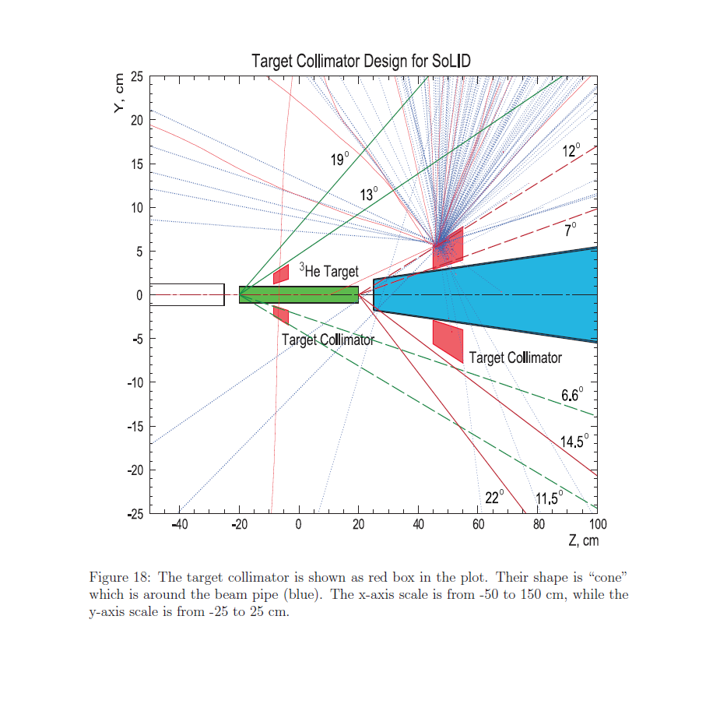
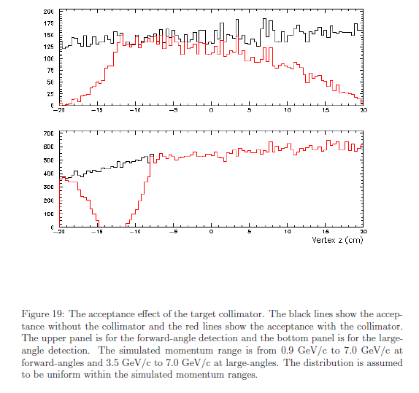
Design
PAC35(2010) design

Slide 3
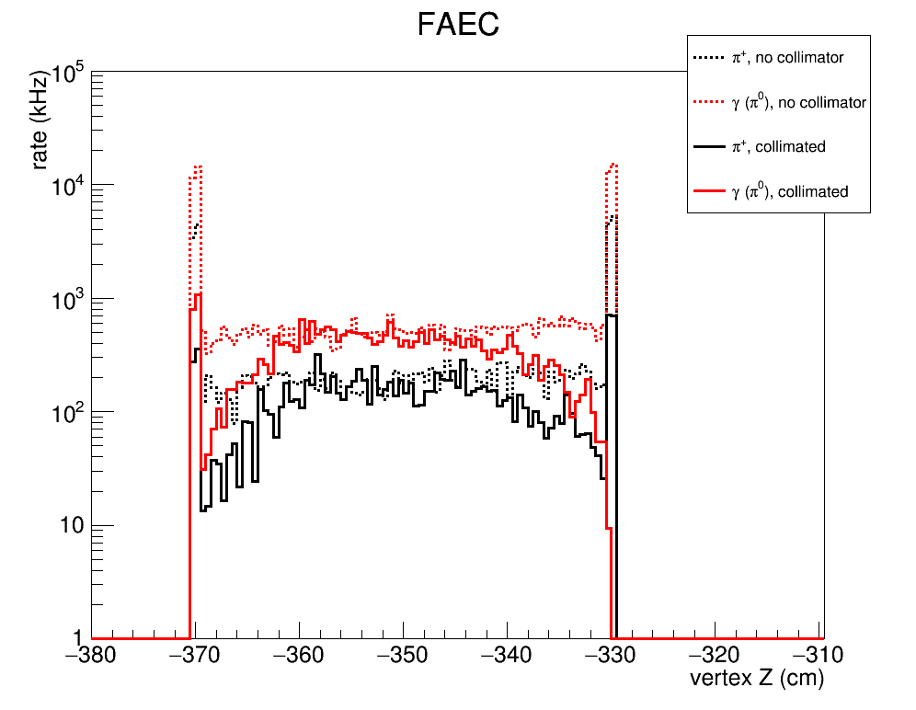
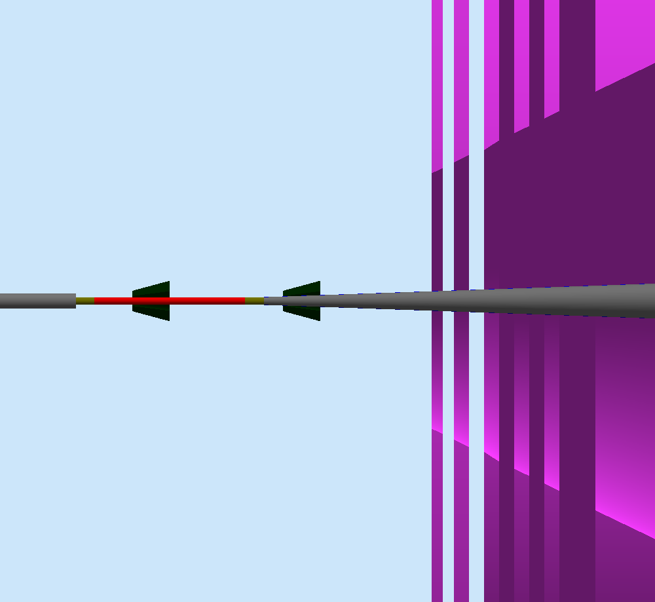
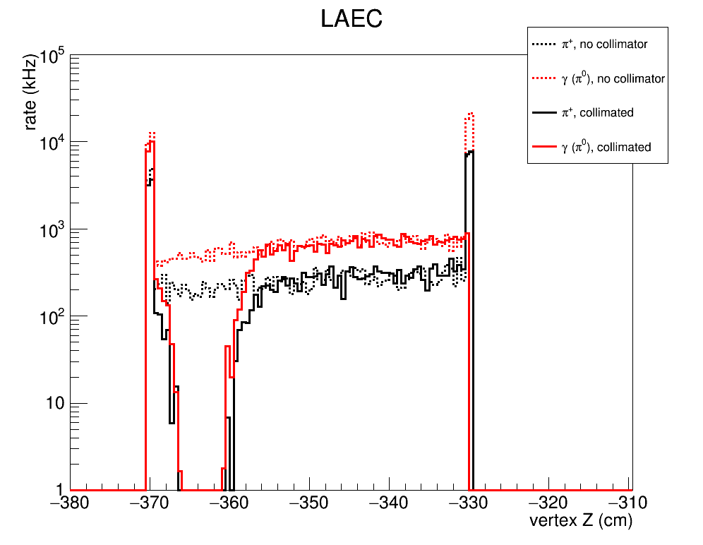
Current Design (Both block 7.5 – 15deg, 15cm away,10cm thick tungsten powder)
Plots shows pure tungsten blocking effect
the smaller, the less blocking of gas,
so closer to windows
Need small beam pipe downstream
After 2015 director review, material change from pure tungsten to tungsten powder by reducing density by from 19.3 to 11.3
The hadron trigger rate from both windows increase by about 30%
collimators
target

Slide 4
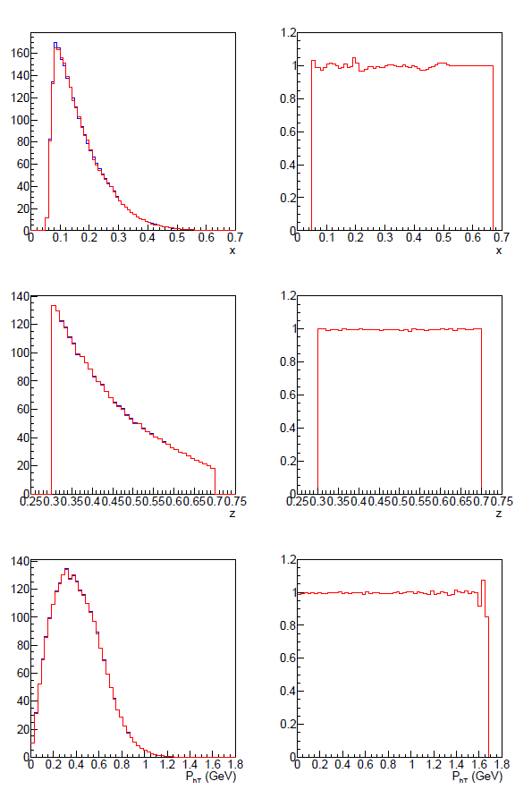
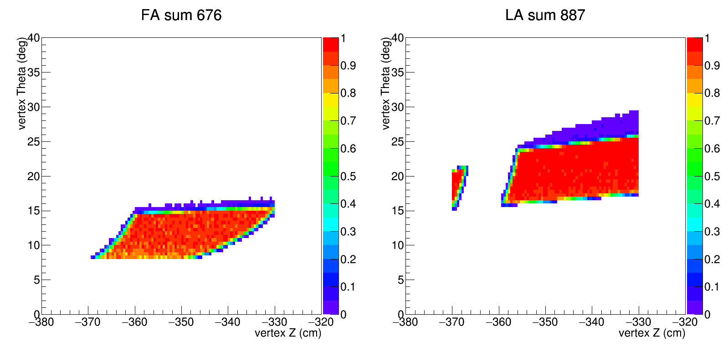
Current Collimator (Both block 7.5 – 15deg, 15cm away,10cm thick kryptonite)

Slide 5
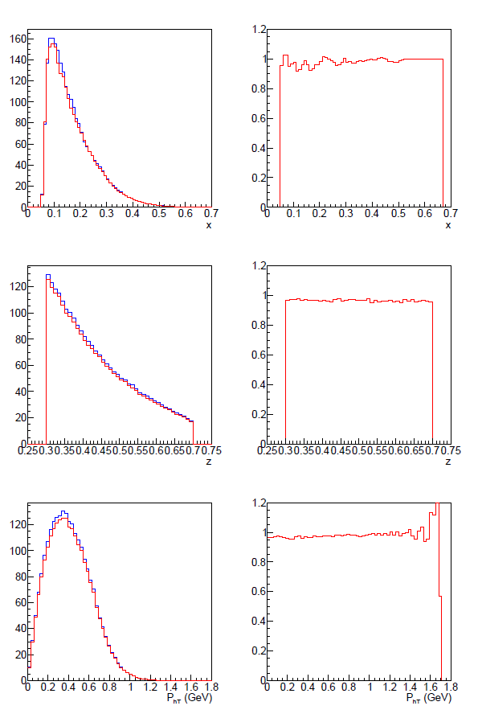
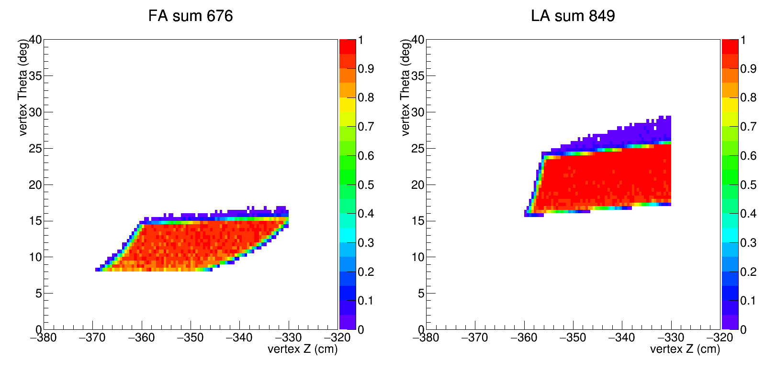
New Collimator 1 (Upstream block 7.5 – 24deg, downstream block 7.5 – 15deg , 15cm away,10cm thick kryptonite)

Slide 6
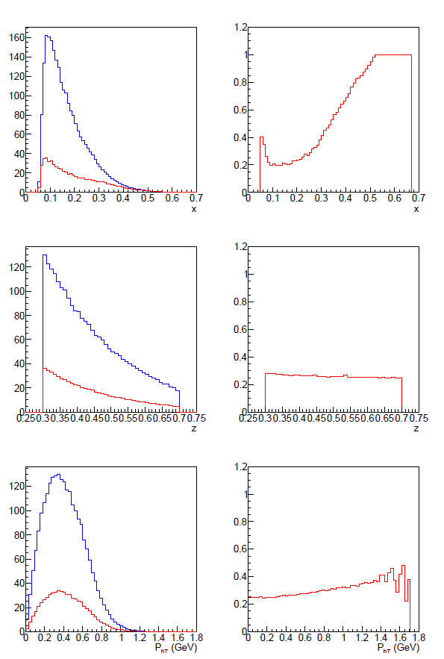
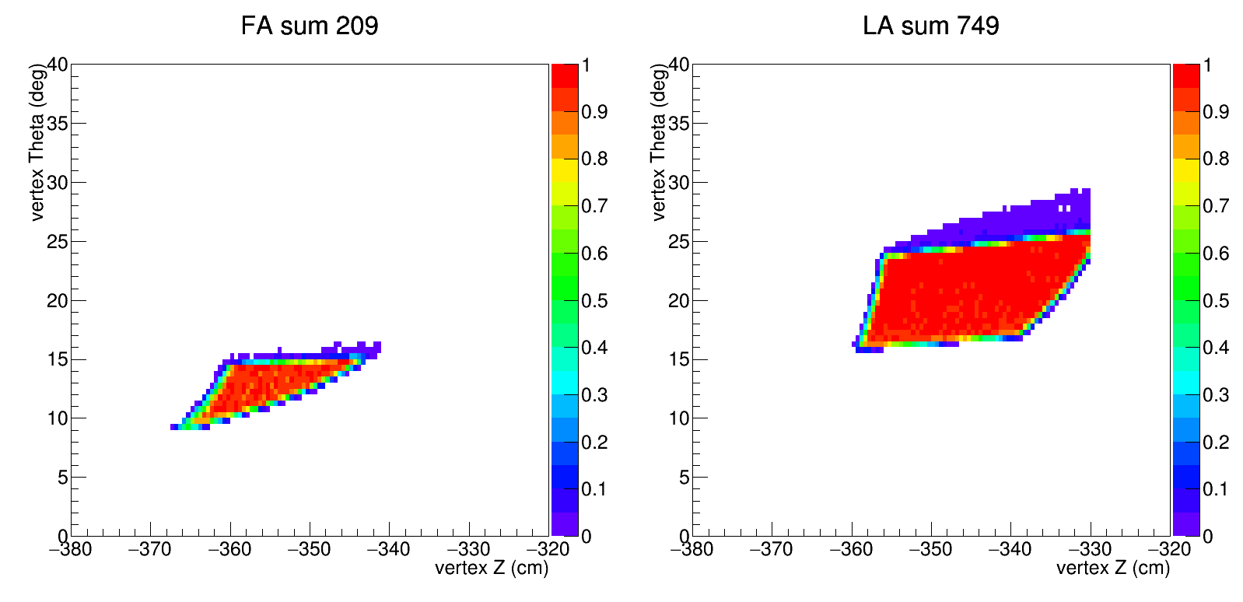
New Collimator 2 (both block 7.5 – 24deg, 15cm away,10cm thick kryptonite)

Slide 7
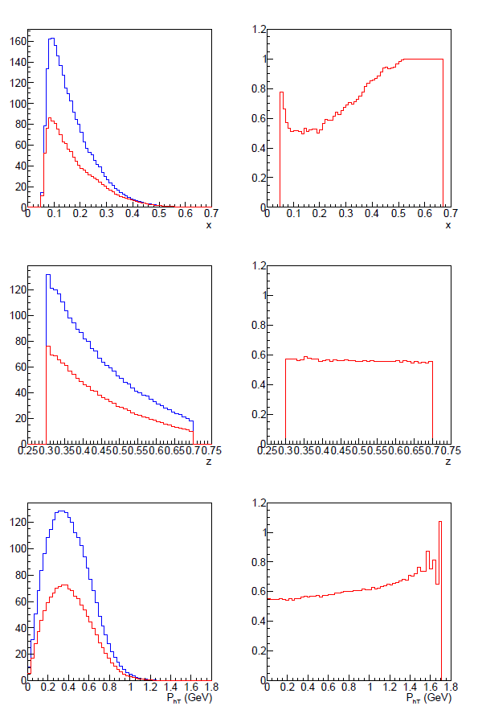
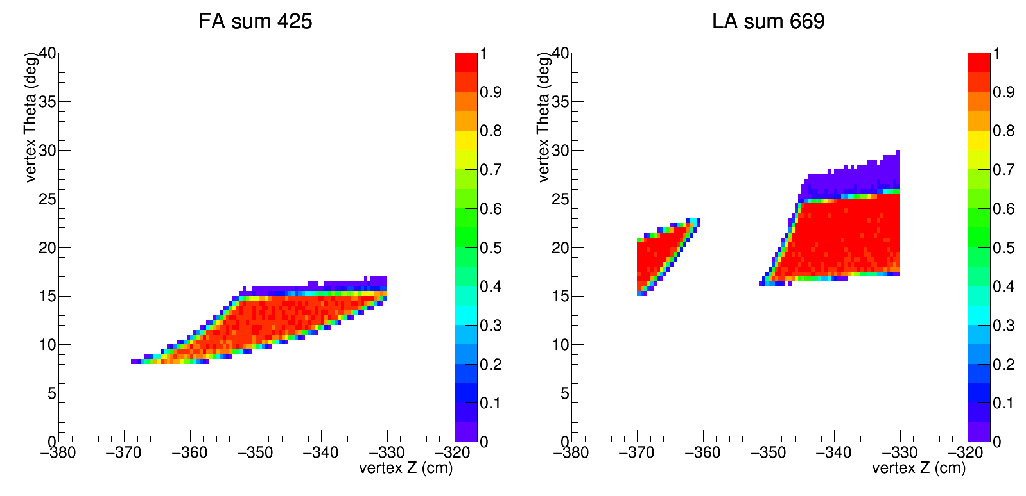
New Collimator 3 (both block 7.5 – 15deg, 30cm away,10cm thick kryptonite)

Slide 8
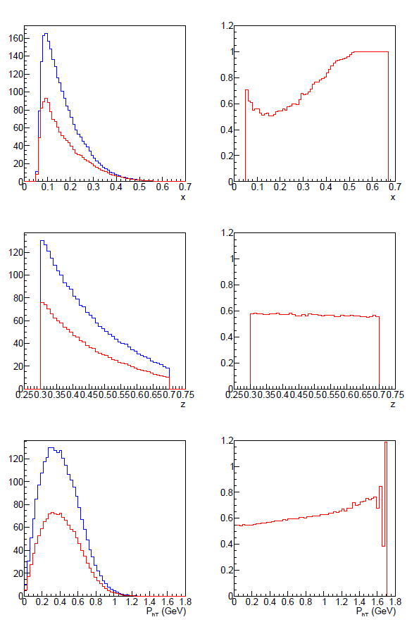
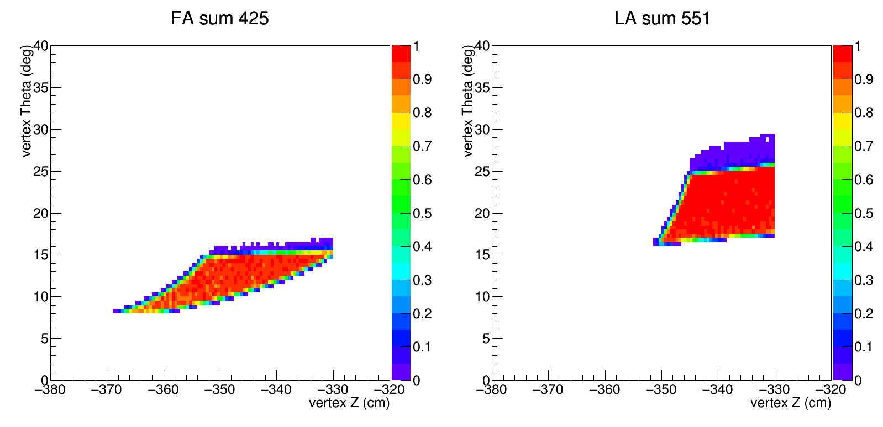
New Collimator 4 (Upstream block 7.5 – 24deg, downstream block 7.5 – 15deg, 30cm away,10cm thick kryptonite)

Slide 9
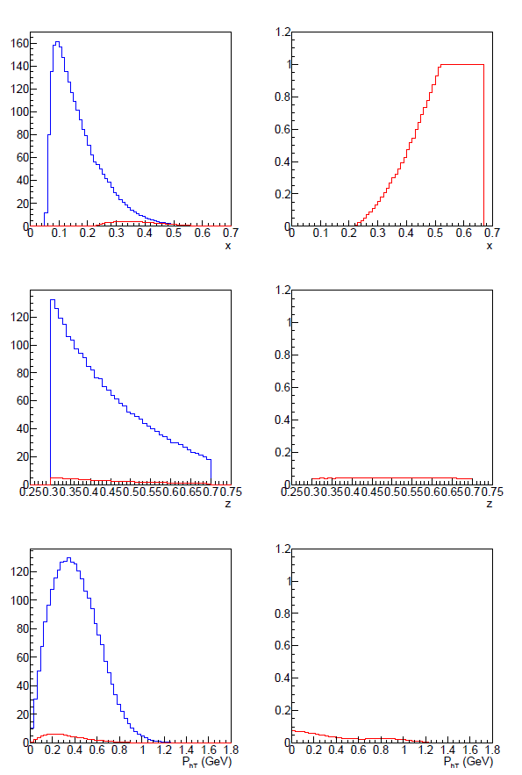
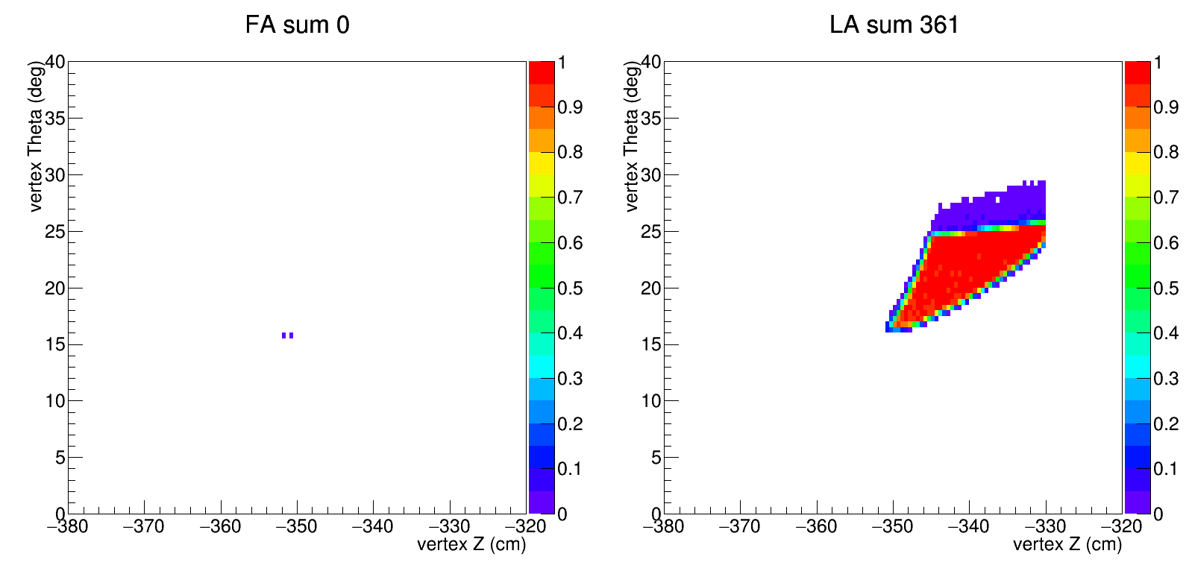
New Collimator 5 (both block 7.5 – 24deg, 30cm away,10cm thick kryptonite)

