Slide 1
SoLID simulation with GEMC update
Zhiwen Zhao
2015/12/03

Slide 2
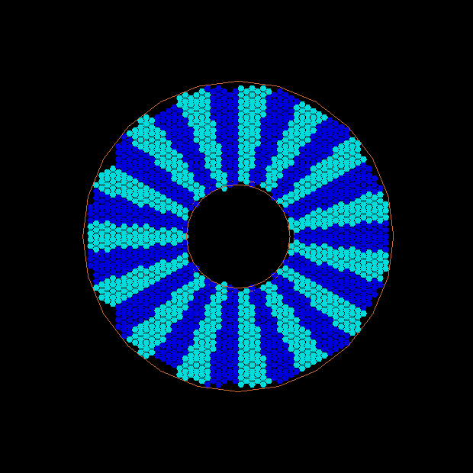
FAEC in simulation with layout from ANL

Slide 3
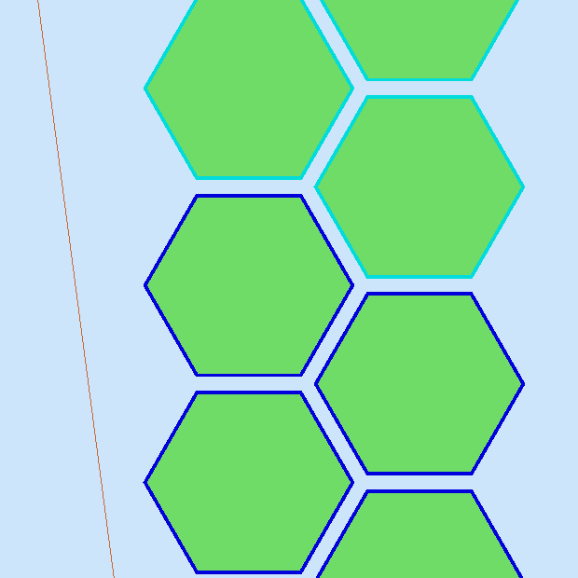
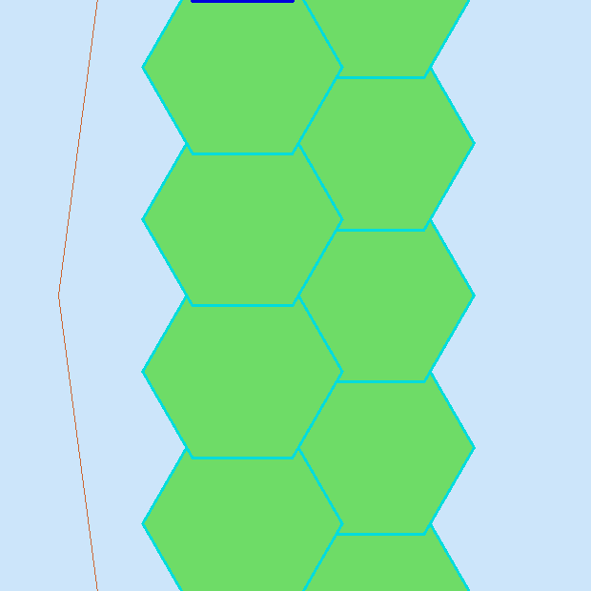
EC module size and layout
Use ANL layout, 5cm edge modules look ok, but 6.25cm edge modules have overlap
Our default module design is 6.25cm
FAEC layout needs to change, LAEC layout is still missing
6.25cm
5cm

Slide 4
SIDIS hadron trigger
To record all hadron (mainly pion)
Dominate by charge pions and gamma from pi0
Previous trigger rate estimation 14MHz for SIDIS He3
Trigger is made of
EC cut below MIP to reserve hadron and suppress low energy background
SPD and MRPC anti-cut below MIP to reject gamma
A simple test with full SoLID simulation under conditions:
Incoming particles evenly distributed within 1-11GeV
No background yet

Slide 5
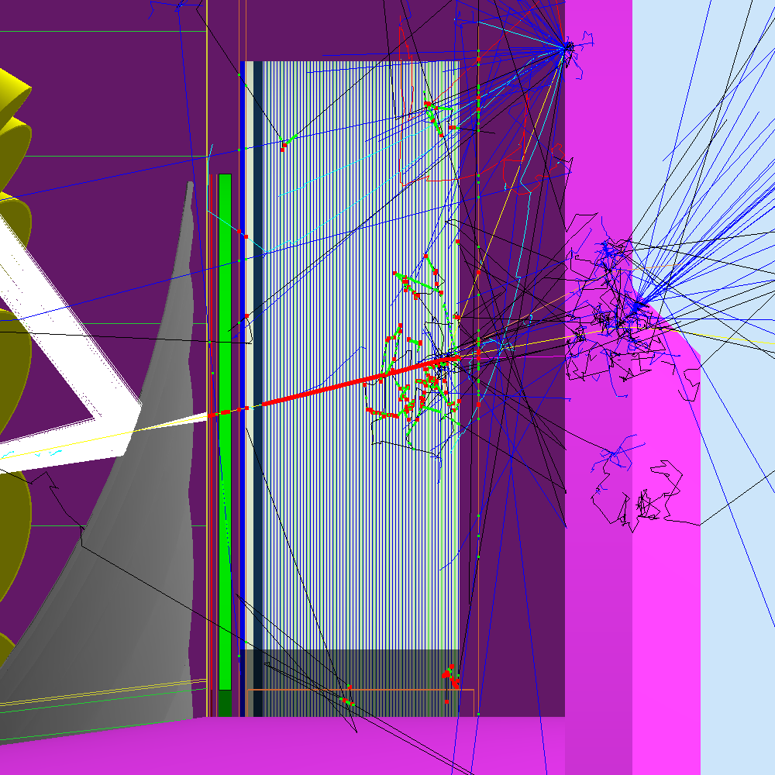
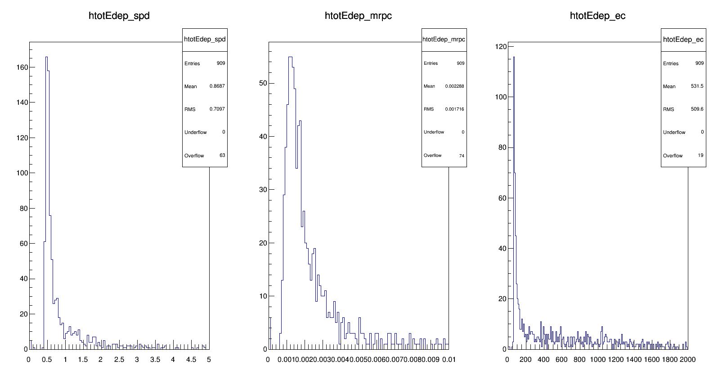
pi- energy deposition
MIP in all three detectors
Counts
MeV

Slide 6
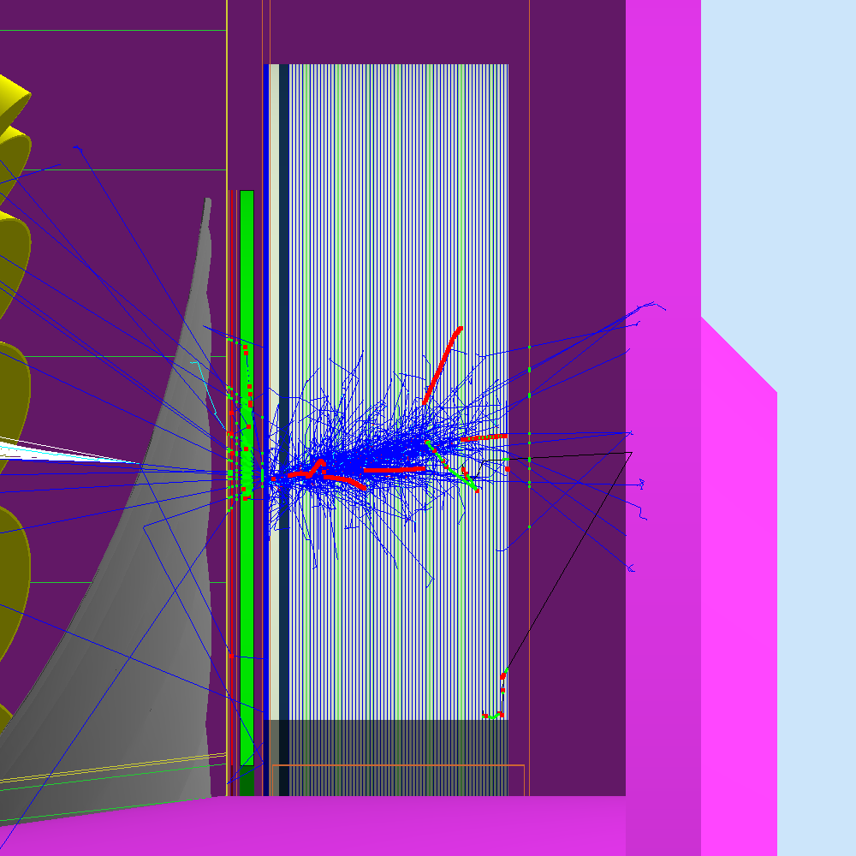
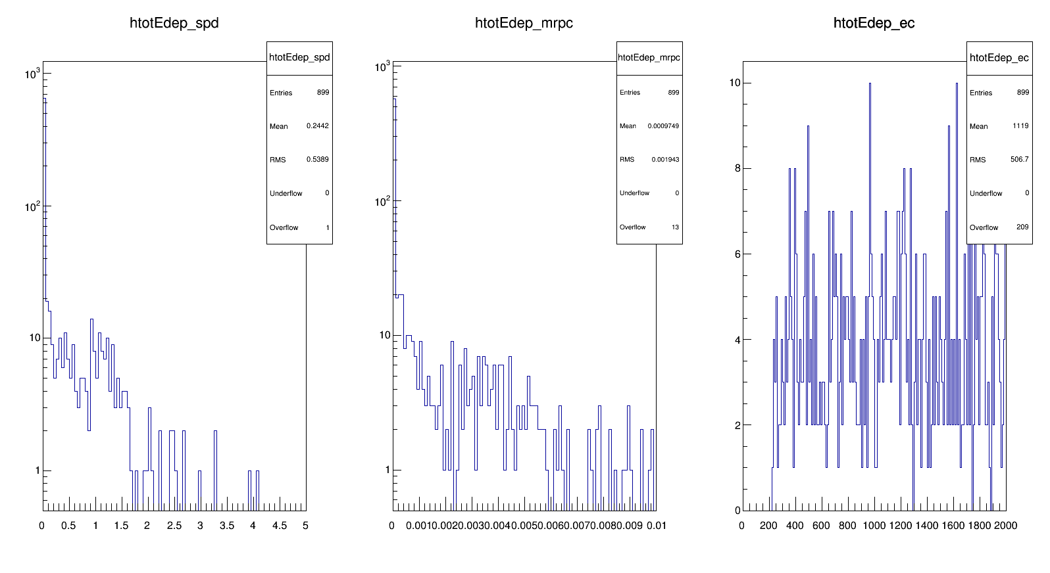
gamma energy deposition
Full energy deposition in EC
Mostly no energy in SPD and MRPC
Counts
MeV

Slide 7
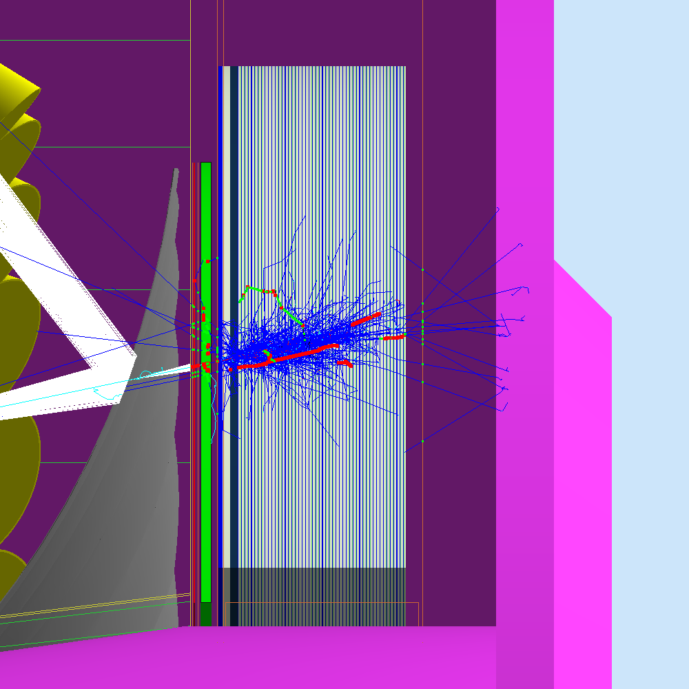
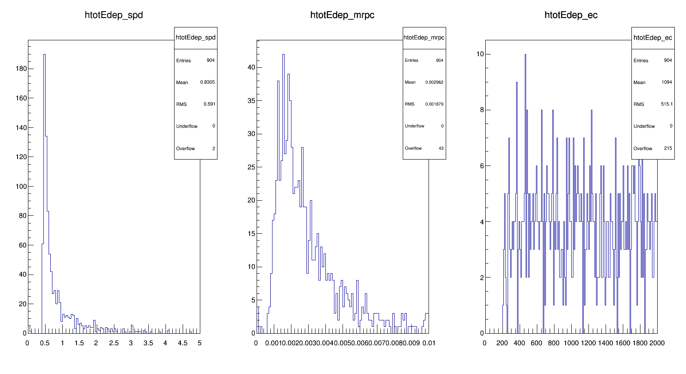
e- energy deposition
Full energy deposition in EC
MIP in SPD and MRPC
Counts
MeV

Slide 8
Trigger estimation (just an exercise)
unit in percent
Logic for gamma
incoming | EC yes && SPD no | EC yes && MRPC no | SPD no && MRPC no | EC yes && (SPD no || MRPC no)
pi- | 0.44 | 0.44 | 0.66 | 0.44
gamma | 79 | 71 | 65 | 85
e- | 0.67 | 0.55 | 0.55 | 0.67
Logic for hadron
incoming | EC yes && SPD yes | EC yes && MRPC yes | SPD yes && MRPC yes | EC yes && (SPD yes && MRPC yes)
pi- | 99.6 | 99.6 | 99.6 | 99.6
gamma | 21 | 29 | 15 | 15
e- | 99.3 | 99.3 | 99.3 | 99.3
pi- detection ~100%
gamma rejection factor 6.6, No electron rejection

