Slide 1
SIDIS He3 trigger update EC cut test
Zhiwen Zhao
2016/12/6

Slide 2
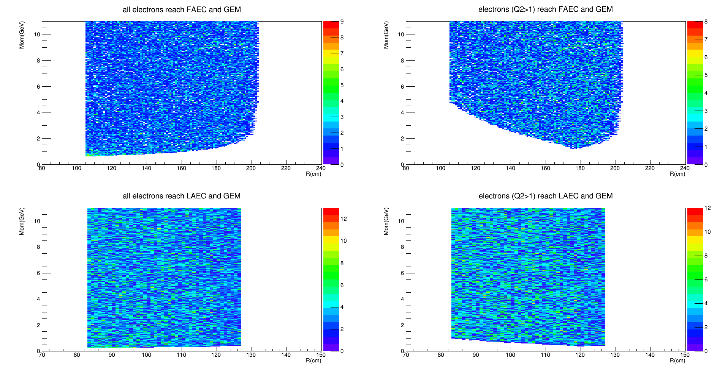
Cut Q2>1
Electron (Q2>1) reach FAEC and GEM

Slide 3
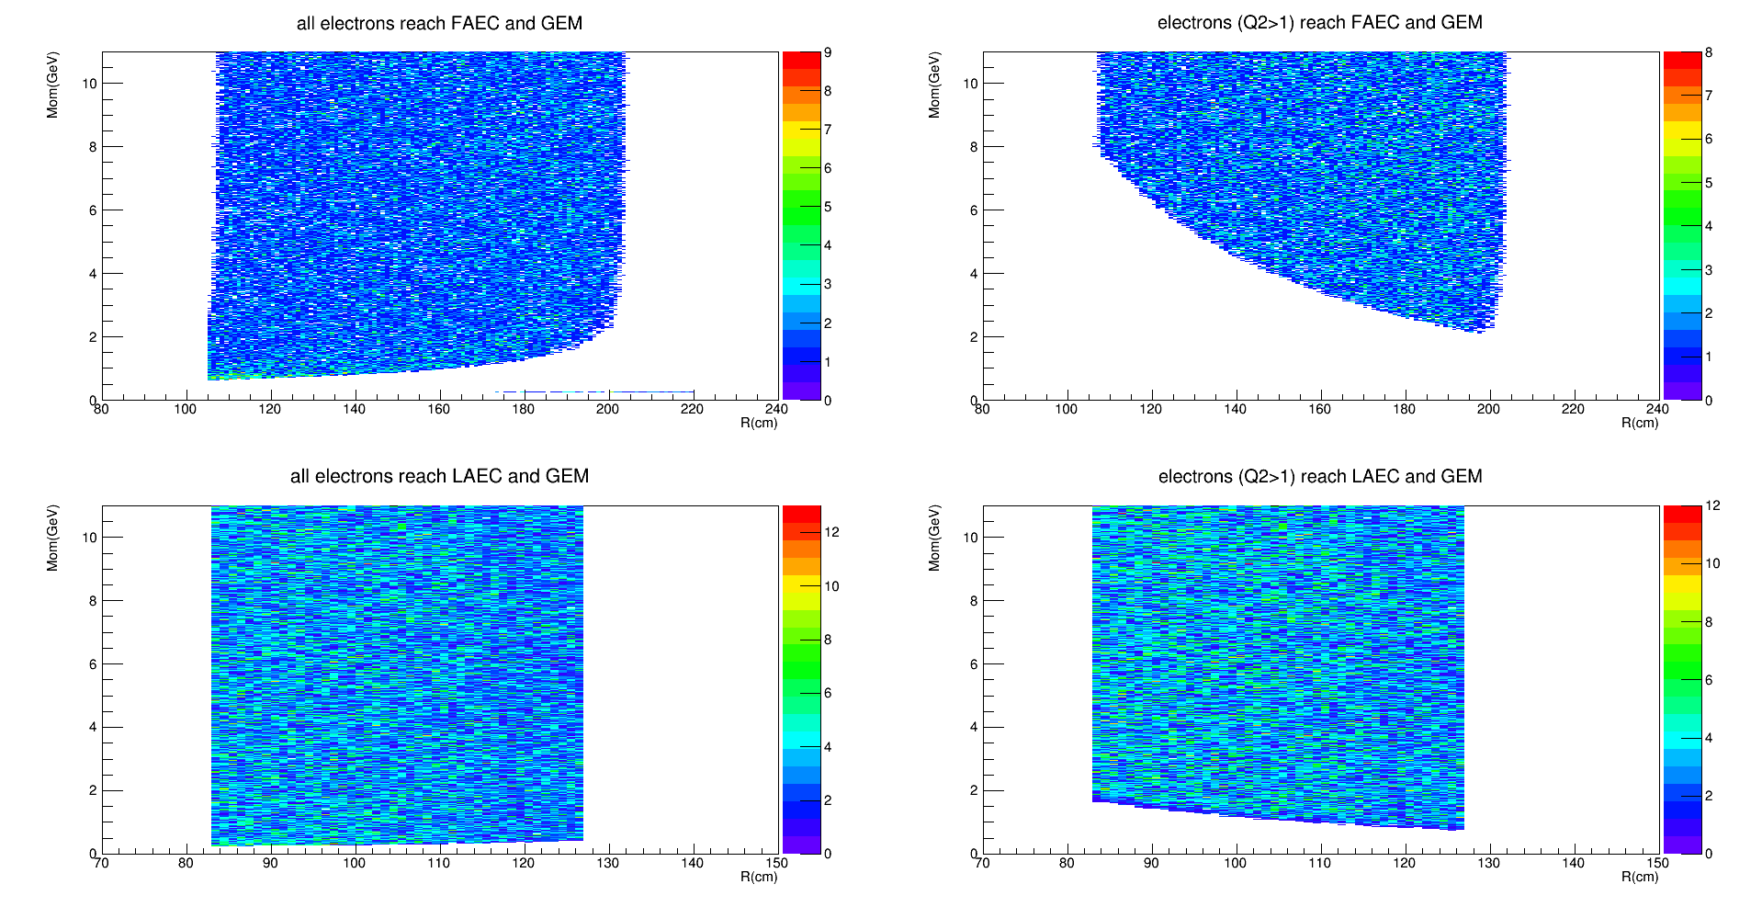
cut “P>5GeV when theta<10deg, Q2>1.7GeV when theta>10deg”
Electron (Q2>1.7) reach FAEC and GEM

Slide 4
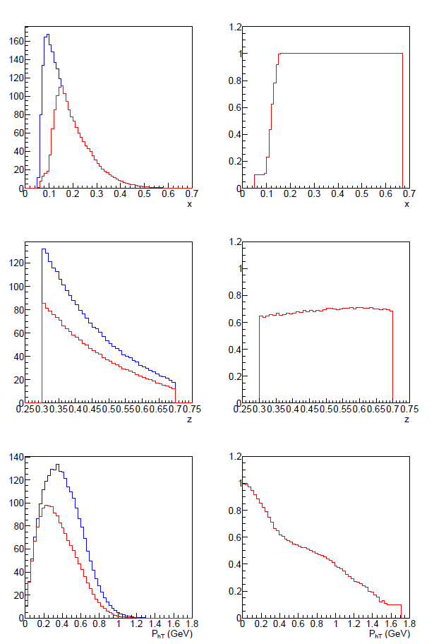
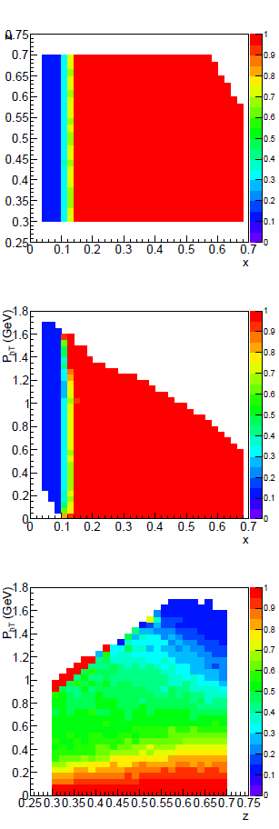
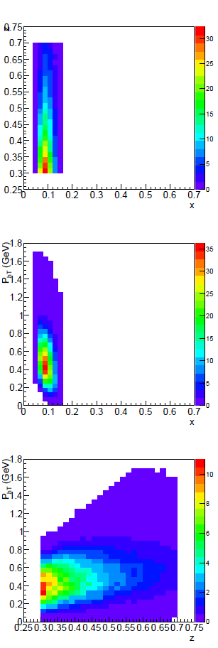
SIDIS single electron trigger rate change between cut “Q2>1” and cut “P>5GeV when theta<10deg, Q2>1.7GeV when theta>10deg”
electron trigger rate (kHz): source e- 58 -> 35, source hadron 47->6

Slide 5
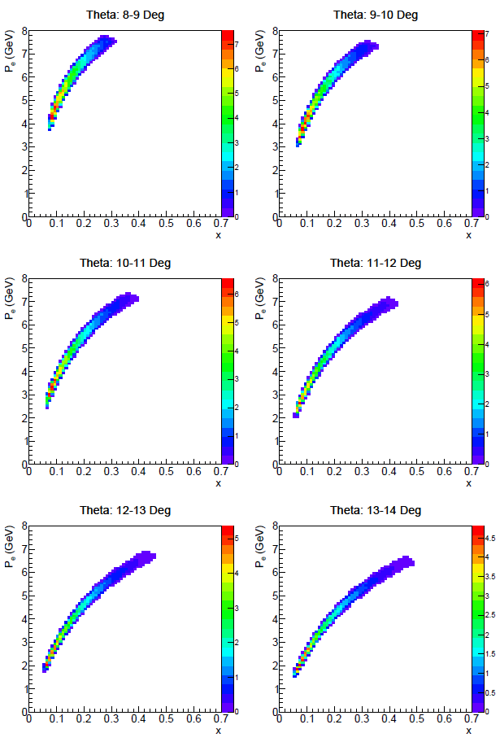
SIDIS e- distribution
How the plots is drawn
Both SIDIS e- and pion accepted,
Q2 > 1.0
W > 2.3
W' > 1.6
0.3 < z < 0.7
Possible EC trigger
cut “5-4-3-3-1.5-1.5-1”:
P>5, at theta 8-9 deg, R_FAEC 105-120 cm
P>4, at theta 9-10 deg, R_FAEC 120-135 cm
P>4, at theta 10-11 deg, R_FAEC 135-149 cm
P>4, at theta 11-12 deg, R_FAEC 149-163 cm
P>4, at theta 12-13 deg, R_FAEC 163-177 cm
P>4, at theta 13-14 deg, R_FAEC 177-191 cm
P>4, at theta 14-15 deg, R_FAEC 191-235 cm

Slide 6
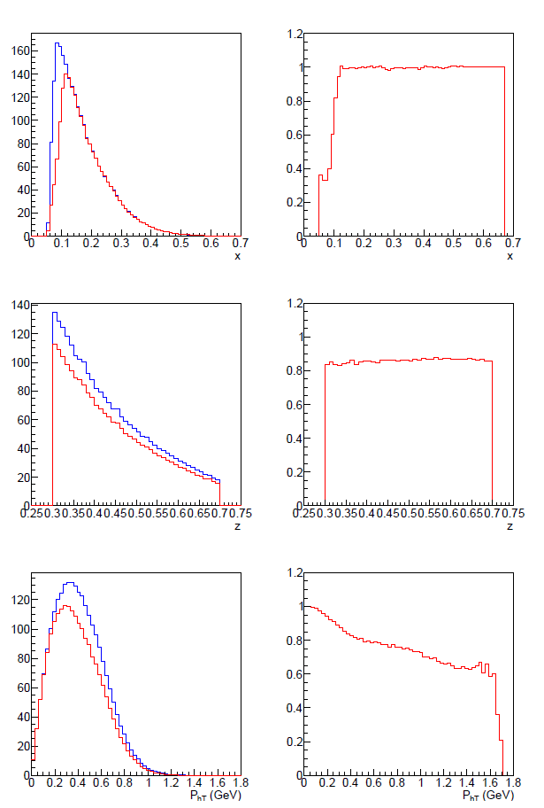
SIDIS single electron trigger rate change between cut “Q2>1” and cut “5-4-3-3-1.5-1.5-1”
FA electron trigger rate (kHz): source e- 58 -> 41, source hadron 47->16

Slide 7
backup

Slide 8
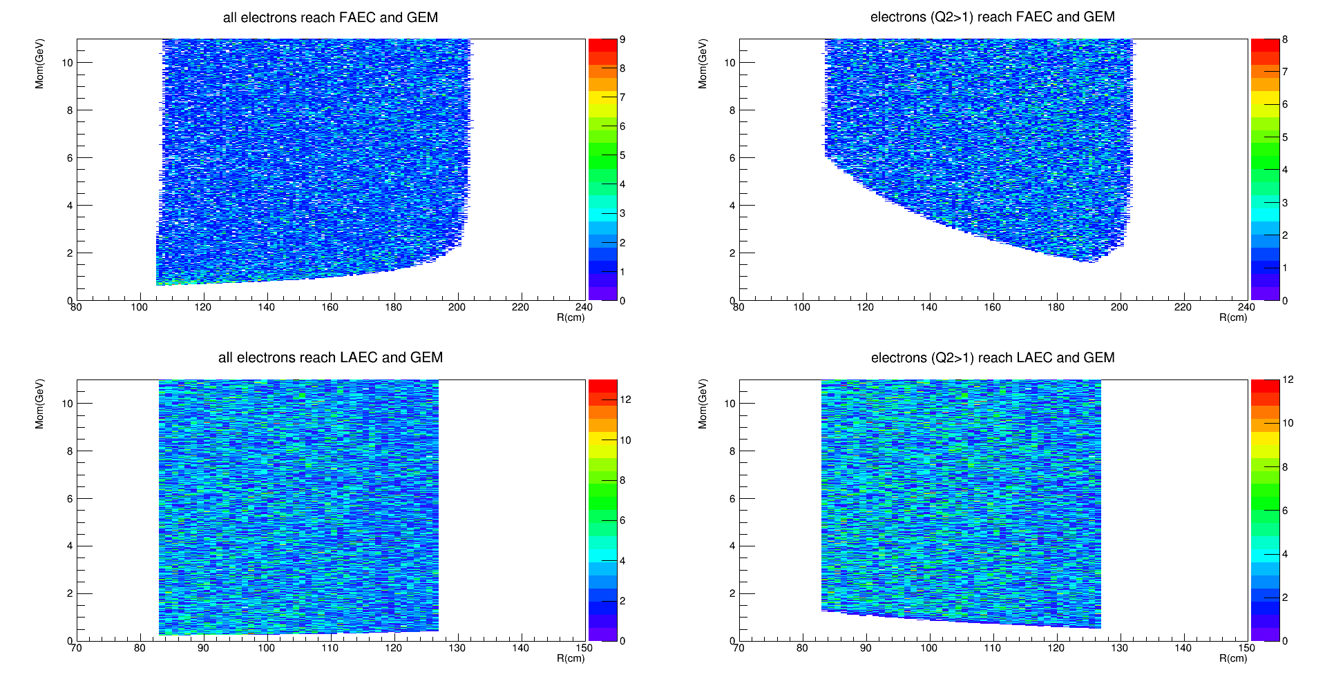
Cut Q2>1.3

Slide 9
