Slide 1
SoLID simulation with GEMC
Zhiwen Zhao
2015/03/26

Slide 2
Outline
GEMC Update
SoLID simulation with GEMC 2.x
“solid_gemc” in general
EC simulation as an example
Summary

Slide 3
GEMC Update: Outline
GEMC 1.x to 2.x, a major code rewrite
use factory method as much as possible, easy to add plug-in and expand functionality
Field map
Field info embedded in field map file, no separated definition needed
Map Reading 3-4x faster Swimming 30% faster
Modular physics list (hadron+EM+optical)
Updated GUI
geometry and parameters, material, optical properties, hit process and output are all external
Built-in hit type “flux” and step-by-step hit info
New features like customized event generator input, voltage signal and FADC support
Took a lot suggestion from SoLID and MEIC simulation and we contribute to its code and structure also

Slide 4
GEMC Update: installation
software installation streamlined by a set of scripts
part of the general jlab software framework (including jana, ccdb and more)
Everything in release package, no SVN or github download
a single version control by env “Jlab_version”
Just an “App” to download on Mac, no install needed
Jlab_version | 1.0 | 1.1 | 1.2 | devel
GEMC | 1.8 | 2.1 | 2.2 | 2.3?
geant4 | 9.5 | 9.5/9.6 | 10.0 | 10.1?

Slide 5
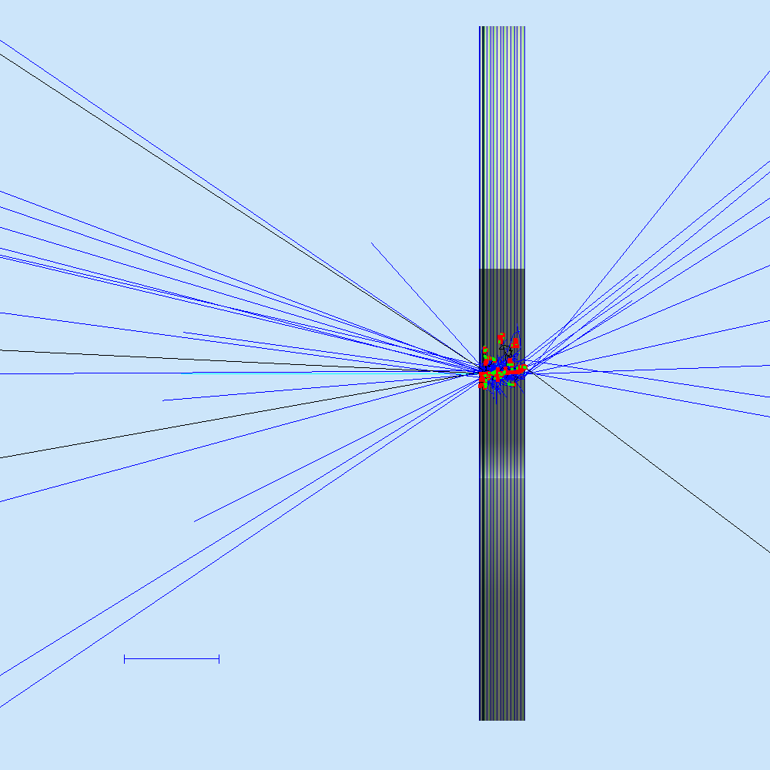
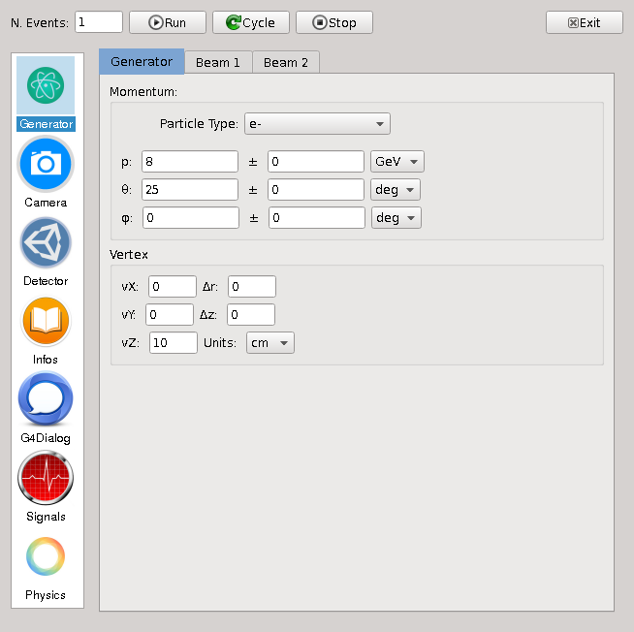
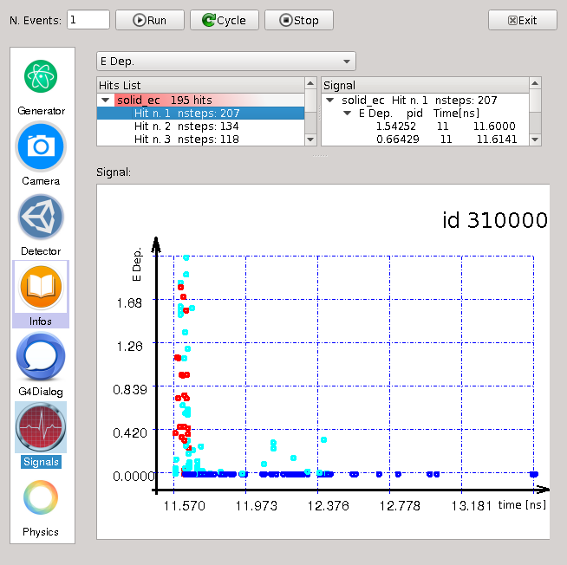
GEMC update: GUI
qt5 and openGL

Slide 6
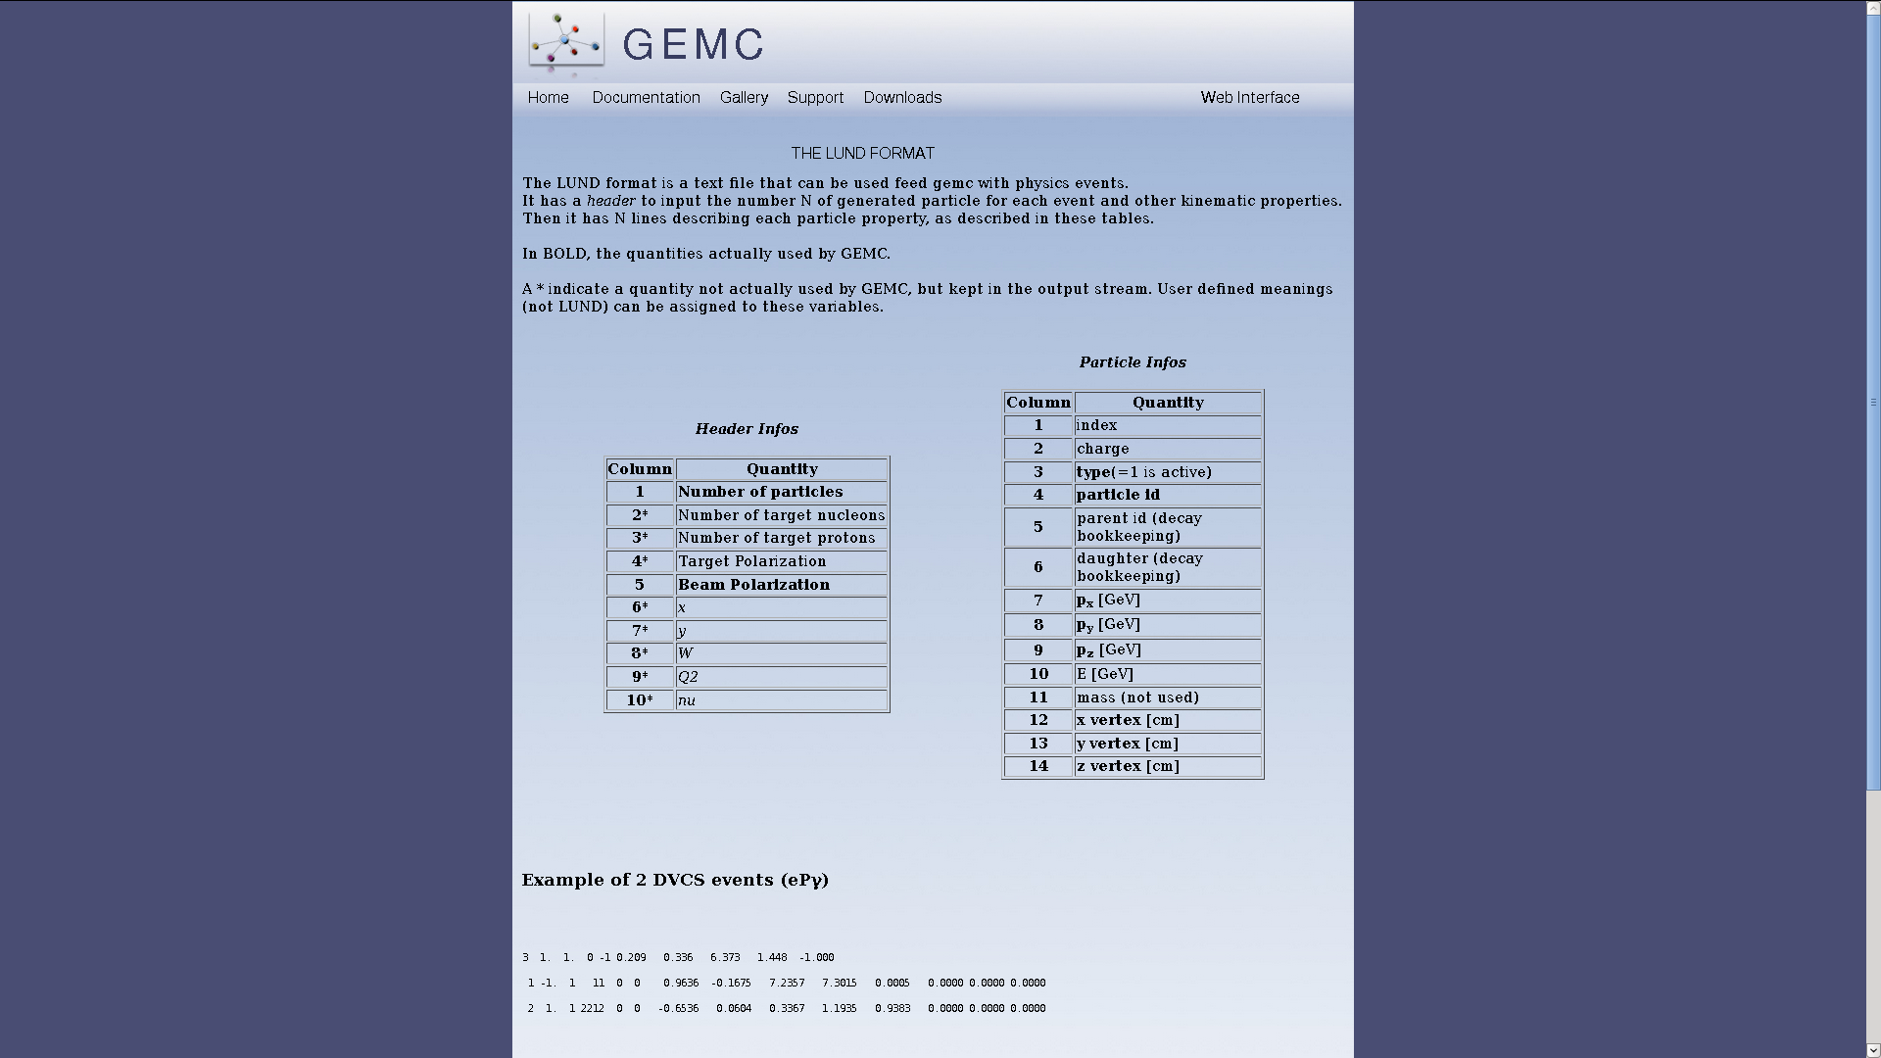
GEMC update: Input
All generators are still fully independent, interface by txt file in customized LUND format
Fully pass customized header info into output

Slide 7
GEMC Update: Optical
All properties defined external in “table” format similar to geometry

Slide 8
GEMC Update: Voltage Signal

Slide 9
GEMC Update: Outlook
FADC banks will emulate FADC output, including translation tables
Hit process routines will be a plugin - completely independent from GEMC, to be loaded at run time. The routines can be stored together with the geometry / materials scripts.
multithreading, following G4
C++ 11

Slide 10
SoLID simulation with GEMC 2.x solid_gemc
GEMC compiled as a lib during installation by default
Then add customized hit process routing and other things and link to libgemc.so to keep all GEMC features, similar idea to “solgemc”
This becomes “solid_gemc” with matching version of GEMC
Solid_gemc2/source
2.1
2.2
Solid_gemc.cc
Hitprocess
Solid_hitprocess.h
Solid_ec_hitprocess.cc
Solid_ec_hitprocess.h
……

Slide 11
EC simulation with solid_gemc
solid - Revision 746: /subsystem/ec/ec_solid_gemc
..
config_solid_PVDIS_ec_forwardangle.dat configuration file for generating
readme
solid_PVDIS_ec_forwardangle.gcard input file to run simulation
solid_PVDIS_ec_forwardangle.pl file to generate geomtry,bank,hit
solid_PVDIS_ec_forwardangle__bank.txt generated bank
solid_PVDIS_ec_forwardangle__geometry_Original.txt generated geometry
solid_PVDIS_ec_forwardangle__hit_Original.txt generated hit
solid_PVDIS_ec_forwardangle__materials_Original.txt generated material
solid_PVDIS_ec_forwardangle__parameters_Original.txt parameters defines geometry
solid_PVDIS_ec_forwardangle_real.pl file to generate geometry
solid_ec_bank.pl file to generate bank
solid_ec_hit.pl file to generate hit
solid_ec_materials.pl file to generate material
solid_slice.vis
Purple and orange files needed to generate files for simulation
Red files needed to run simulation
Red and orange files are in “table” format, they can be in
txt file
Database (mysql now, CCDB soon)
expanded to more sources
An example line of a txt file
solid_PVDIS_ec_forwardangle_real_shower | root |solid_PVDIS_ec_forwardangle_real_shower | 0*cm 0*cm 350*cm | 0*deg 0*deg 0*deg | ff0000 | Tube | 110*cm 365*cm 21.728*cm 0*deg 360*deg | G4_AIR | no | 1 | 1 | 1 | 1 | 1 | no | no | no

Slide 12
Customized hit process routine “solid_ec”
insert_bank_variable(\%configuration, $bankname, "bankid", $bankId, "Di", "$bankname bank ID");
insert_bank_variable(\%configuration, $bankname, "pid", 1, "Di", "ID of the first particle entering the sensitive volume");
insert_bank_variable(\%configuration, $bankname, "mpid", 2, "Di", "ID of the mother of the first particle entering the sensitive volume");
insert_bank_variable(\%configuration, $bankname, "tid", 3, "Di", "Track ID of the first particle entering the sensitive volume");
…………………
insert_bank_variable(\%configuration, $bankname, "id", 24, "Di", "id number");
insert_bank_variable(\%configuration, $bankname, "hitn", 99, "Di", "Hit Number");
solid_ec_bank.pl
dgtz["pid"] = (double) aHit->GetPID();
dgtz["mpid"] = (double) aHit->GetmPID();
dgtz["tid"] = (double) aHit->GetTId();
………….........
dgtz["id"] = id;
dgtz["hitn"] = hitn;
solid_ec_hitprocess.cc
Totally flexible to any raw and digitized hit processing and output, fit any level of simulation and digitization need
As far as the two match each other to give consistent result, “solid_gemc” need recompile if any change

Slide 13
Hit process control
solid_ec_hit.pl
$hit{"name"} = "solid_ec";
$hit{"description"} = "solid ec hit definition";
$hit{"identifiers"} = "id";
$hit{"signalThreshold"} = "0*MeV";
$hit{"timeWindow"} = "400*ns";
$hit{"prodThreshold"} = "1*mm";
$hit{"maxStep"} = "1*cm";
$hit{"delay"} = "10*ns";
$hit{"riseTime"} = "1*ns";
$hit{"fallTime"} = "1*ns";
$hit{"mvToMeV"} = 100;
$hit{"pedestal"} = -20;
Fine tuning hit processing without source code change
No need to recompile solid_gemc

Slide 14
External parameters
solid_PVDIS_ec_forwardangle__parameters_Original.txt
Nlayer | 194 | | Nlayer | - | - | - | - | - | -
Thickness_lead | 0.05 | cm | Thickness_lead | - | - | - | - | - | -
Thickness_scint | 0.15 | cm | Thickness_scint | - | - | - | - | - | -
Thickness_gap | 0.024 | cm | Thickness_gap | - | - | - | - | - | -
Thickness_shield | 1.0274 | cm | Thickness_shield | - | - | - | - | - | -
Thickness_prescint | 2 | cm | Thickness_prescint | - | - | - | - | - | -
Thickness_support | 2 | cm | Thickness_support | - | - | - | - | - | -
z_shower | 350 | cm | z_shower | - | - | - | - | - | -
Rmin | 110 | cm | Rmin | - | - | - | - | - | -
Rmax | 365 | cm | Rmax | - | - | - | - | - | -
Sphi | 0 | deg | Sphi | - | - | - | - | - | -
Dphi | 360 | deg | Dphi | - | - | - | - | - | -
It can take source from survey data
And can be part of calibration database

Slide 15
solid_gemc summary
status
EC, GEM, MRPC, SPD have initial implementation at various stages
Cherenkov implementation is under work
advantage
fast MC and full MC within one framework
The exact same files for standalone simulation and combined simulation

Slide 16
Other things
Record simulation condition
GEMC record all input options into EVIO file
We can think of ways to record detector related input (as SVN or github version or database entry with index like run number? It will depends on where we store them)
Output file format
“evio2root”, convert evio to root tree, included with framework
“clas-root”, read evio like a root tree, will include
https://userweb.jlab.org/~gavalian/clas12docs/sphinx/html/rootio/introduction.html
Documentation
Nice GEMC tutorials available
Doxygen for source code
Wiki https://hallaweb.jlab.org/wiki/index.php/Solid_Software

